Slide 1
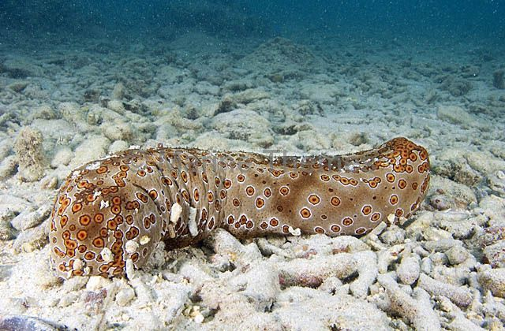
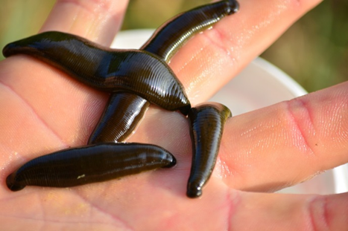
MEDICAL Invertebrates
Prof. Dr. Ola A. Abu Samak
Prof. of Parasitology
Zoology Department

Slide 2
COURSE SPECIFICATION
1ـ بيانات المقرر | أحد المقررات الاختيارية للحصول على درجة البكالوريوس تخصص الحيوان والكيمياء
الرمز الكودى : 218ح | اسم المقرر : لافقاريات طبية Medical Invertebrates | الفرقة: الثانية /علم الحيوان والكيمياء
التخصص: الحيوان والكيمياء | عدد الساعات: محاضرة:1 تمرين: 0 عملى: 2 (ساعة/الأسبوع) عدد الساعات المعتمدة: 2
2ـ هدف المقرر: | By the end of this course the student must be able to: Use pertinent biological information as well as state of science information pertaining in the field of invertebrate animal medicine to develop the familiarity with importance of invertebrates in biomedical research and ecosystems.
3-المخرجات التعليمية المستهدفة من المقرر:
أ ـ المعلومات والمفاهيم: | By the end of this course the student must be able to: a1. Identify the general concepts of natural history and taxonomy of certain invertebrates. a2. Identify the general information about anatomy and physiology of certain invertebrate groups. a3. Recognize the benefits as well as the environmental disorders and infectious diseases of certain invertebrate animals. a4. List the medically importance of certain invertebrates
ب ـ المهارات الذهنية | By the end of this course the student must be able to: b1. Report symptoms of infectious diseases to increase the familiarity with invertebrate importance. b2. Review the benefits as well as the environmental disorders to develop the familiarity with importance of invertebrates in ecosystems.
جـ ـ المهارات المهنية الخاصة بالمقرر : | By the end of this course the student must be able to: c1. Use the light microscope to identify the infectious diseases of certain invertebrate animals. c2. Examine various disorders in the selected examples of invertebrate animals to increase the information in the field of invertebrate animal medicine.
د ـ المهارات العامة: | By the end of this course the student must be able to: d1. Acquire self- and long life-learning during the study of the invertebrate medicine. d2. Apply scientific models, and tools effectively to understand the different symptoms of invertebrate diseases.

Slide 3
Content
W. | Topic | Lect | Pract | Tutor.
1 | Introduction | 1 | 2 | 0
2 | Porifera (Sponges) | 1 | 2 | 0
3 | Coelenterates | 1 | 2 | 0
4 | Turbellarians | 1 | 2 | 0
5 | Annelids | 1 | 2 | 0
6 | Custaceans | 1 | 2 | 0
7 | Midterm exam | 1 | - | 0
8 | Insects | 1 | 2 | 0
9 | Horseshoe Crabs | 1 | 2 | 0
10 | Spiders | 1 | 2 | 0
11 | Gastropods | 1 | 2 | 0
12 | Cephalopods | 1 | 2 | 0
13 | Bivalves | 1 | 2 | 0
14 | Echinodermats | 1 | 2 | 0
15 | Practical exam. | 0 | 2 | 0
16&17 | Writing and oral exam. | 1 | - | 0

Slide 4
Turbellarians
Quick Facts
True bilateral symmetry.
Dorso-ventral flattening of the body.
Unsegmented.
Ciliated epidermis.
System of sheathed nerve fibers.
Parenchyma between the epidermis and the gastrodermis.
Some cephalization.
Blind ending gut.
Flame cells for excretion.

Slide 5
Turbellarians
Quick Facts
Turbellarians are mainly free-living and aquatic, but some are terrestial and live in moist, humid environments.
They range in size from a few millimeters to a half meter long. Small turbellarians use cilia for their propulsive force, and some very small forms swim through fluid.
A lot of energy is used for the production of mucus to lubricate and protect the surface of the body and to help capture prey.
Most are hermaphroditic and reproduce sexually, but asexual reproduction by fission is also possible.
If a flatworm is starved it is capable of shrinking to hatching size and when fed it has the ability to grow back to original size.

Slide 6
Turbellarians
Quick Facts
Turbellarians sense their environment with statocysts, chemoreceptors, and photoreceptors.
They do not have image-forming eyes, but many species have pigment cells and photoreceptors concentrated into eyespots.
The complexity of the turbellarian peripheral nervous system varies from a simple nerve net based on pairs of longitudinal nerve cords to an interlacing web of nerves capable of fine muscular control.
Regeneration of somatic parts is well.
Some of the colorful marine polycladids are in demand in the aquarium trade, and Dugesia is a common laboratory animal, but the vast majority of turbellarians are of little economic importance to humans.
Humans can threaten turbellarian populations through pollution of aquatic habitats.

Slide 7
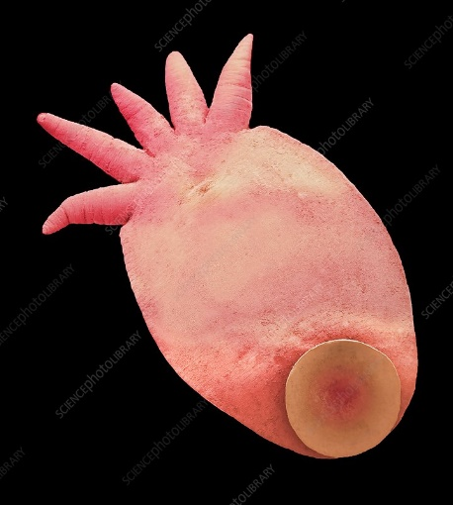
Turbellarians
Temnocephalidae are ectoparasites on the body surfaces of some crustaceans. They have an adhesive disc and tentacles, but lack cilia.

Slide 8
Turbellarians
The economic importance of Turbellaria
HUMAN CONNECTIONS
Since they breathe through their skin, terbellarians are sensitive to water quality and serve as indicators of reduced oxygen and other changes in their habitat.
ECOSYSTEM CONNECTIONS
Ecosystems are based on the tiny plants and animals that form the base of food chains. Turbellarians are an important link between the tiny, sometimes microscopic animals they eat and their own, larger predators, such as small fish, crayfish, and aquatic insect.

Slide 9
Turbellarians
Humans can threaten turbellarian populations through pollution of aquatic habitats.
Most species of freshwater turbellarian are at least moderately tolerant of polluted conditions.
Tolerant species tend to live in areas where decaying organic matter causes the water to contain only a small amount of dissolved oxygen, which they absorb along the entire surface area of their bodies.
In healthy ecosystems, turbellarians usually exist in low to moderate numbers. (bioindicator for water)

Slide 10
Turbellarians
The economic importance of Planaria
Planarians could revolutionize modern medicine. They can resist bacteria that are highly pathogenic in humans.
They are also unique among invertebrates in that they display addiction-like behaviors to many drugs that are abused by humans. The planarian is often used as an animal model in neurological research.
Specifically (because of their regenerative properties), researchers believe that studying them could lead to significant advancements in treatment for individuals with brain damage or other neurological diseases.

Slide 11
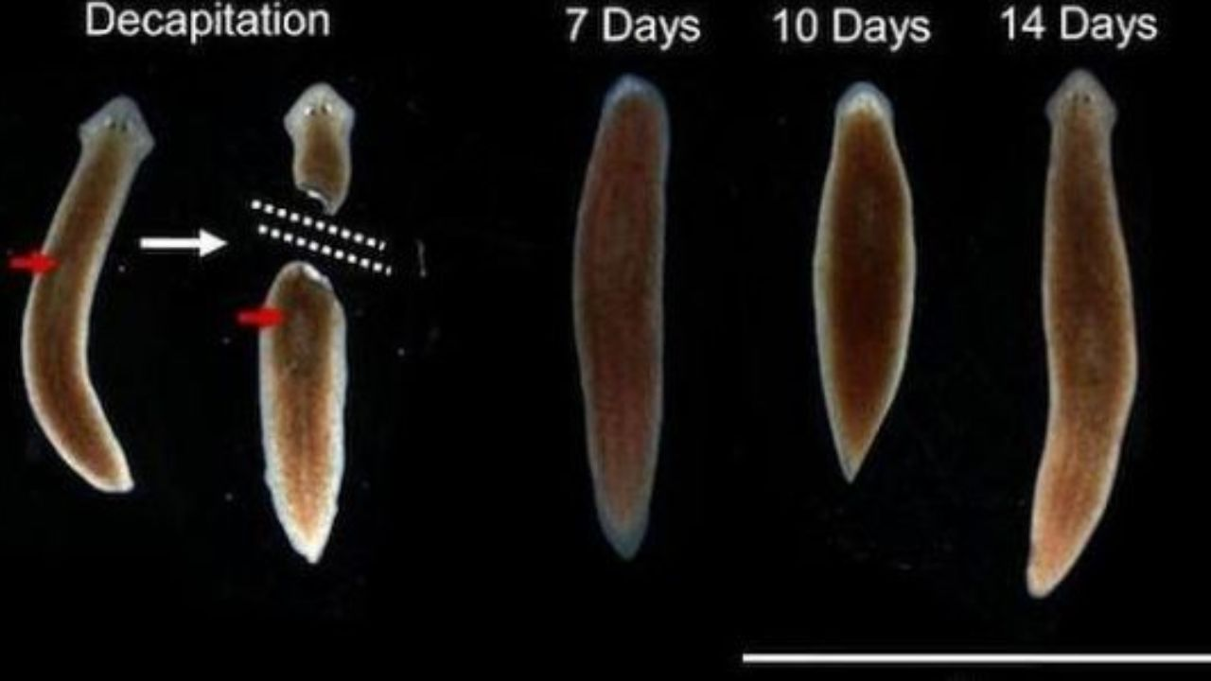
Turbellarians
Planarians use as animal models in pharmacology.

Slide 12
See you in the next lecture

