Slide 1
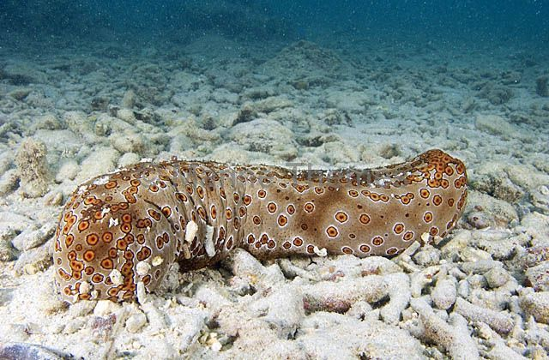
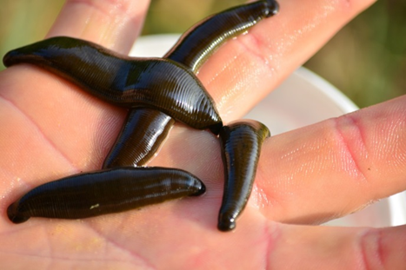
MEDICAL Invertebrates
Prof. Dr. Ola A. Abu Samak
Prof. of Parasitology
Zoology Department

Slide 2
COURSE SPECIFICATION
1ـ بيانات المقرر | أحد المقررات الاختيارية للحصول على درجة البكالوريوس تخصص الحيوان والكيمياء
الرمز الكودى : 218ح | اسم المقرر : لافقاريات طبية Medical Invertebrates | الفرقة: الثانية /علم الحيوان والكيمياء
التخصص: الحيوان والكيمياء | عدد الساعات: محاضرة:1 تمرين: 0 عملى: 2 (ساعة/الأسبوع) عدد الساعات المعتمدة: 2
2ـ هدف المقرر: | By the end of this course the student must be able to: Use pertinent biological information as well as state of science information pertaining in the field of invertebrate animal medicine to develop the familiarity with importance of invertebrates in biomedical research and ecosystems.
3-المخرجات التعليمية المستهدفة من المقرر:
أ ـ المعلومات والمفاهيم: | By the end of this course the student must be able to: a1. Identify the general concepts of natural history and taxonomy of certain invertebrates. a2. Identify the general information about anatomy and physiology of certain invertebrate groups. a3. Recognize the benefits as well as the environmental disorders and infectious diseases of certain invertebrate animals. a4. List the medically importance of certain invertebrates
ب ـ المهارات الذهنية | By the end of this course the student must be able to: b1. Report symptoms of infectious diseases to increase the familiarity with invertebrate importance. b2. Review the benefits as well as the environmental disorders to develop the familiarity with importance of invertebrates in ecosystems.
جـ ـ المهارات المهنية الخاصة بالمقرر : | By the end of this course the student must be able to: c1. Use the light microscope to identify the infectious diseases of certain invertebrate animals. c2. Examine various disorders in the selected examples of invertebrate animals to increase the information in the field of invertebrate animal medicine.
د ـ المهارات العامة: | By the end of this course the student must be able to: d1. Acquire self- and long life-learning during the study of the invertebrate medicine. d2. Apply scientific models, and tools effectively to understand the different symptoms of invertebrate diseases.

Slide 3
Content
W. | Topic | Lect | Pract | Tutor.
1 | Introduction | 1 | 2 | 0
2 | Porifera (Sponges) | 1 | 2 | 0
3 | Coelenterates | 1 | 2 | 0
4 | Turbellarians | 1 | 2 | 0
5 | Annelids | 1 | 2 | 0
6 | Custaceans | 1 | 2 | 0
7 | Midterm exam | 1 | - | 0
8 | Insects | 1 | 2 | 0
9 | Horseshoe Crabs | 1 | 2 | 0
10 | Spiders | 1 | 2 | 0
11 | Gastropods | 1 | 2 | 0
12 | Cephalopods | 1 | 2 | 0
13 | Bivalves | 1 | 2 | 0
14 | Echinodermats | 1 | 2 | 0
15 | Practical exam. | 0 | 2 | 0
16&17 | Writing and oral exam. | 1 | - | 0

Slide 4
Cnidaria (Coelentrates)
Quick Facts
The coelenterates are simplest metazoans and have tissue grade of body organization.
All of them possess a single large internal cavity known as gastro-vascular cavity or coelenteron, which performs the function of intestine that is related with digestion and circulation of digestion.
They are commonly called stinging animals.

Slide 5
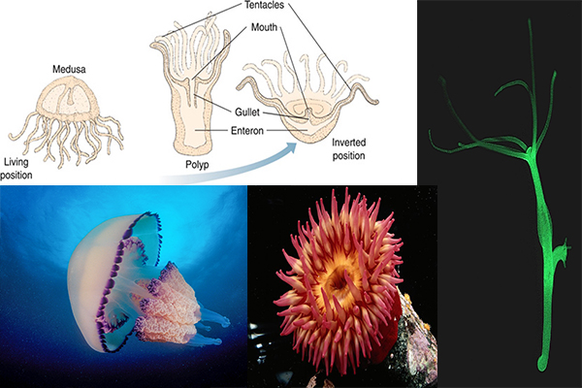
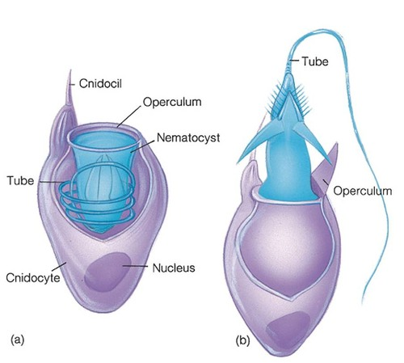
Cnidaria (Coelentrates)
Quick Facts

Slide 6
Cnidaria (Coelentrates)
Quick Facts
Nematocysts (present inside cnidoblast cells) are activated by touch with foreign body.
Sensory and nerve cells appeared first time in this phylum.
Tentacles are soft present around mouth
Mode of digestion is first extracellular and then intracellular. Pathway of intracellular digestion is first acidic and then alkaline.
Cnidoblasts are most abundant on tentacles and absent on pedal disc.
Epidermis contains 7 types of cells namely: Epitheliomuscle cells, Glandulo-muscle cells, interstitial cells, Cnidoblast or nematocysts, Germ cells, Sensory and Nerve cells.
Gastroderm contains 5 types of cells: Epithelio-muscle cells (or nutritive cells), Endothelio-gland cells, Interstitial cells, Sensory cell and nerve cell.
Body consists of swelling knob like structure called cnidoblast cells which secrete hypnotoxin chemical that help in offence, defence and paralyzing the prey.
Deposition of calcium carbonate by coelenterates is called corals.

Slide 7
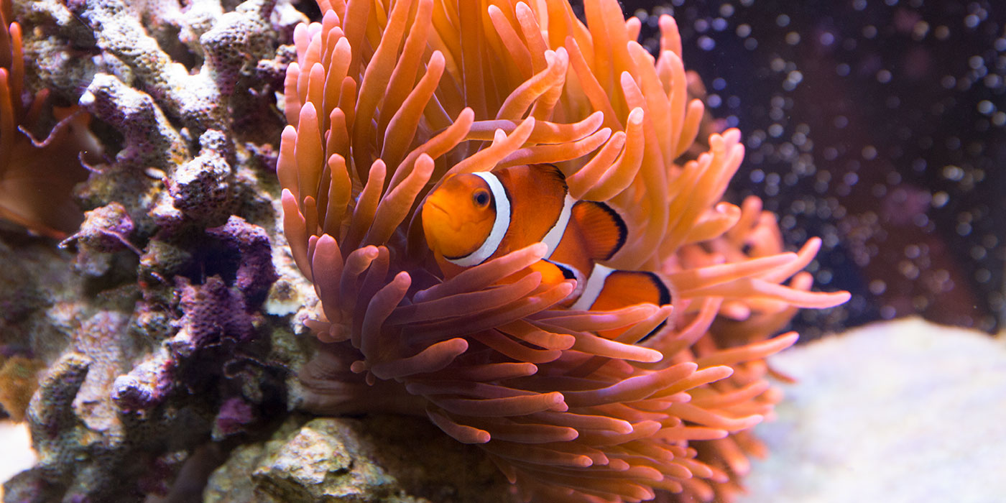
Cnidaria (Coelentrates)
The economic importance of Cnidaria
Many animals belonging to the phylum Cnidaria actually have a quite significant economic importance for humans, especially those belonging to the Anthozoa class. For instance, scientists have discovered many chemical compounds in Cnidarians that can be used to treat cancer and other illnesses.

Slide 8
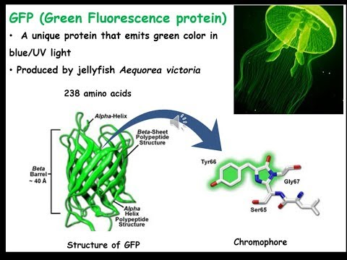
Cnidaria (Coelentrates)
The economic importance of Cnidaria
Another jellyfish-derived product takes advantage of the jellies' fluorescent protein, and could be used to power medical devices in the future.

Slide 9
Cnidaria (Coelentrates)
Coral ecosystems are a source of food for millions; protect coastlines from storms and erosion; provide habitat, spawning and nursery grounds for economically important fish species; provide jobs and income to local economies from fishing, recreation, and tourism; are a source of new medicines, and are hotspots of marine biodiversity.

Slide 10
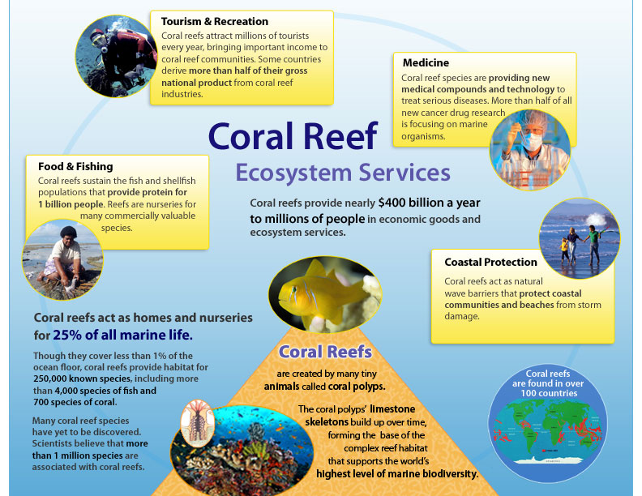
Cnidaria (Coelentrates)

Slide 11
Cnidaria (Coelentrates)
Many species found in coral ecosystems produce chemical compounds for defense or attack, particularly the slow-moving or stationary species like nudibranchs and sponges. Searching for potential new pharmaceuticals, termed bioprospecting, has been common in terrestrial environments for decades. However, bioprospecting is relatively new in the marine environment and is nowhere close to realizing its full potential. Creatures found in coral ecosystems are important sources of new medicines being developed to induce and ease labor; treat cancer, arthritis, asthma, ulcers, human bacterial infections, heart disease, viruses, and other diseases; as well as sources of nutritional supplements, enzymes, and cosmetics. Natural medicine in the United States has only been used for a little more than 50 years, but other regions of the world with ancient civilizations, such as India, have been using it way before that.

Slide 12
Cnidaria (Coelentrates)

Slide 13
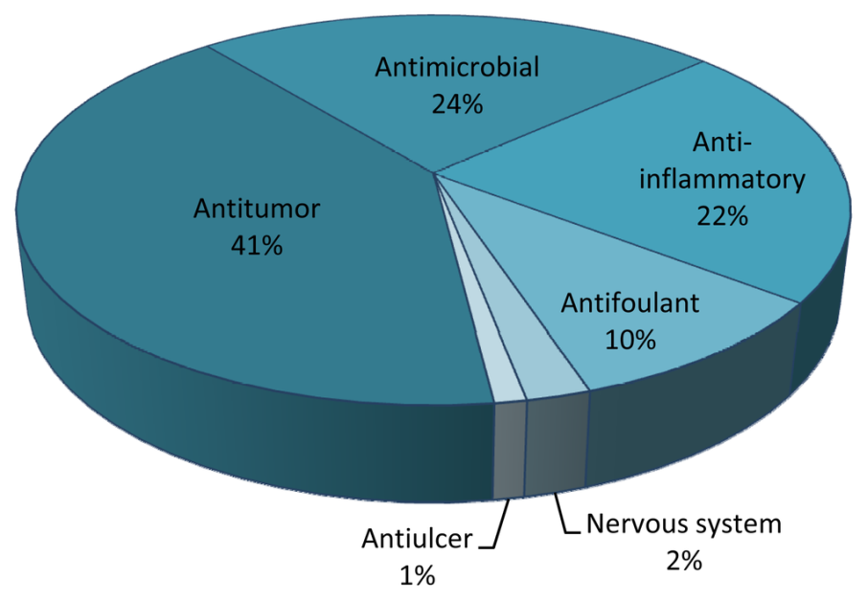
Cnidaria (Coelentrates)
Antitumor drugs are the main area of interest in the screening of MNPs from cnidarians. This is not surprising, as the major financial effort for the screening of new marine compounds is made in cancer research

Slide 14
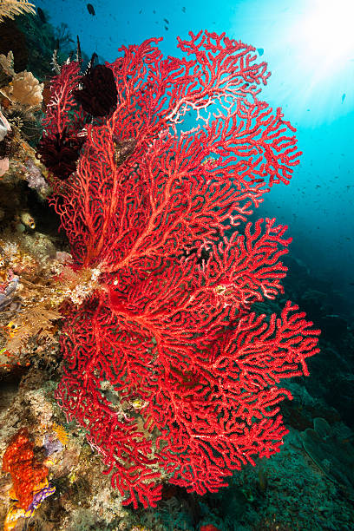
Cnidaria (Coelentrates)
The red coral and organ pipe coral are used in some indigenous medicine systems in south India. Coral reef organisms are already being used in treatments for diseases like cancer and HIV.

Slide 15
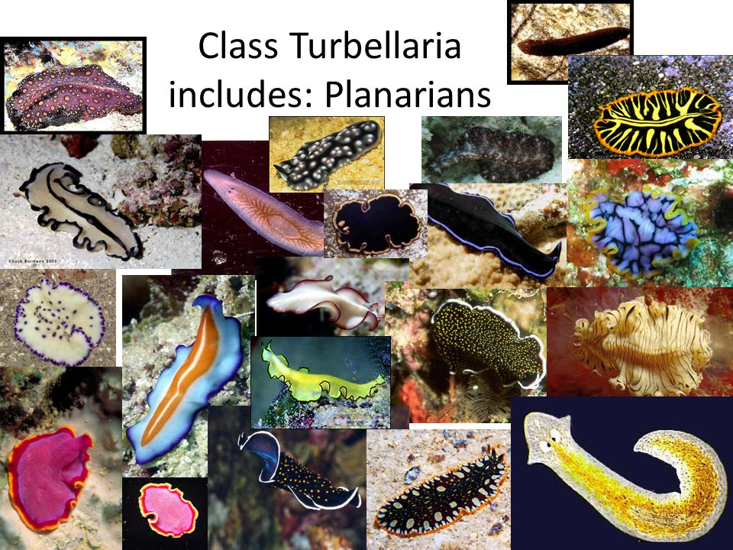
See you in the next lecture

