Slide 1
Advanced invertebrates
by
Dr/ Ola Abu Samak

Slide 2
Syllabus
Filter Feeding
In Polychetes
In Molluscs
In Deuterosmia
In Crustaceans
Respiration
Physical factors
Pigments
Gills and Lophophores in Polychetes
Gills and Lungs in Molluscs
Gills and Trachea in Arthropods

Slide 3
Filter feeding

Slide 4
Filter Feeding
Remember
This type is found only in aquatic animals
It is disappeared from the terrestrial animals due to the lower density of air
It is occurred in small aquatic animals
It takes place through special organs

Slide 5
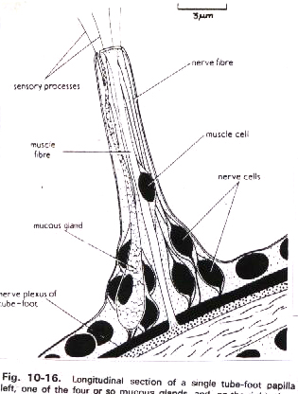
Filter feeding in Deuterosmia
The other ciliary feeding occurs in Echinodermates and primitive chordates
In ecinodermates (the crinoids are all ciliary feeders)
They are sessile animals As in Antedon
During feeding
This animal attaches to the substratum by its cirri
Then, its tube feet secrete a mucus net for trapping of plankton
The mucus is largely derived from papillae on the tube feet
Each papilla bears a group of four to six sensory processes, a single muscle fiber and several mucus and nerve cells
The secretion is shot out by the contraction of the muscle fiber

Slide 6
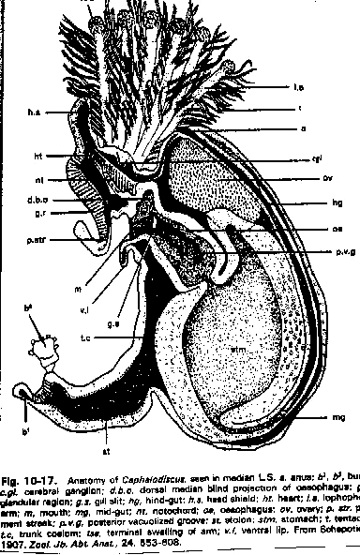
Filter feeding in Deuterosmia
In Primitive chordates (they are all ciliary feeders)
Hemichordata (Cephalodiscus)
It uses ciliated tentacles as a feeding organ
It is associated with the pharyngotremy
This organ draws a stream of water into the mouth via a pair of gill slits in the wall of the pharynx
The ciliated proboscis can trap food particles in mucus and pass them towards the mouth

Slide 7
Filter feeding in Deuterosmia
Protochordates( Urochordate and Cephalochordate)
The pharyngotremy has the basis of a new type for ciliary feeding mechanism
Pharynx is used for feeding and respiration
There is no any ciliated tentacles
The ciliary mechanisms of the pharynx prove similar to those of the branchial crown of the polychaetes and the gills of lamellibranchs.

Slide 8
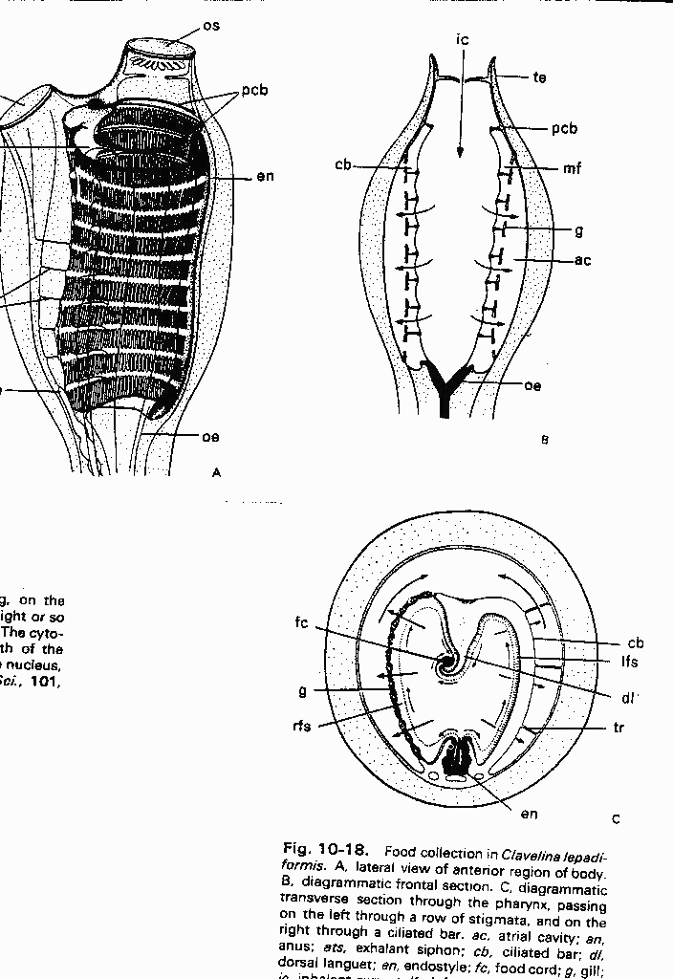
Filter feeding in Deuterosmia
The feeding in Amphioxus and Ascidians
It depends upon groups of cilia beating at right angles to each other
Lateral cilia of the pharynx draw water through the pharyngeal wall into an atrial cavity
The filtering of this water depends upon the presence of the endostyle (longitudinal groove in the floor of the pharynx).
This organ moves up the secretion to the pharyngeal wall by frontal cilia thus the food particles are caught up and pass backwards as a food cord which is digested.

Slide 9
Filter Feeding in Molluscs
Filter feeding in Deuterosmia
This feeding mechanism is well suited for sessile and bottom dwelling animals
It is modified in the pelagic urochordates
The flow of water is maintained by pulsations of the body wall and the food is trapped by strands of mucus in the lumen of the pharynx

Slide 10
Digestion in Deuterosmia
In Amphioxus the intracellular digestion is associated with ciliary filter feeding
The food cord formed in the pharynx is passed back by ciliary action into the mid-gut
At the hind of this part , the food passage is arrested in the region called ilio-colon ring
Cilia in this region set it into rotation around its longitudinal axis
This rotation delays the backward movement of the food cord
At the same time the food cord is mixed with the digestive enzymes that are passed into the ilio-colon ring from the mid-gut caecum
The rotation also breaks up the mass of food and secretion into fragments
The smallest of the food are swept forwards by ciliary currents into the caecum where they are rest on the epithelial surface and are ingested by the cells

Slide 11
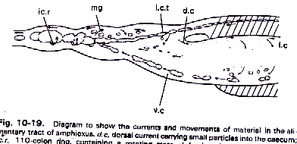
Digestion in Deuterosmia
So that while the initial stages of digestion are extracellular the process is finally intracellular
The larger particles drop back into the mid-gut and are returned to the rotating mass.

Slide 12
Filter feeding in Deuterosmia
The rotary action of the ilio-colon ring resembles that of the style mechanism of molluscs
The digestive gland of bivalves also resembles in principle the mid-gut caecum of Amphioxus.

