Slide 1
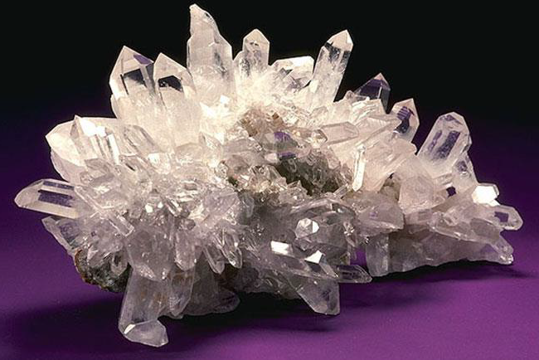
Common Rock-forming Minerals
Quartz
• Quartz , which is usually called
silica, is one of the most common minerals in
the Earth's crust.
• Quartz is made up of silicon dioxide (SiO2)
• Quartz crystals are usually hexagonal and
prismatic in shape.
• Pure quartz is colourless, although the
presence of impurities may give a range of
colours, such as violet, pink and orange.
• Quartz is the raw material for making glass

Slide 2
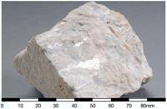
Plagioclase Feldspar
• Plagioclase feldspar is sodium- or calcium-rich
feldspar. The chemical composition ranges from sodium
aluminium silicate, NaAlSi3O8to calcium aluminium silicate,
CaAl2Si2O8.
• Plagioclase feldspar crystals usually occur as stubby prisms.
• Plagioclase feldspar is generally white to grey and has
vitreous lustre.
• Plagioclase feldspar is an important industrial mineral used
in ceramics

Slide 3
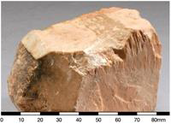
Alkali Feldspar
• Alkali feldspar is another member of the
family of feldspar minerals.
• Alkali feldspar (Potassium aluminium silicate
(K,Na)AlSi3O8) are rich in alkali metal ions.
• Alkali feldspar crystals usually occur as stubby prisms.
• Alkali feldspar is commonly pink to white.
• Alkali feldspar is used as raw material to make porcelain.

Slide 4
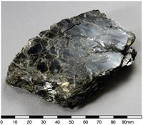
Micas
• Micas are a family of silicate minerals.
• Micas are made up of varying amounts of potassium,
magnesium, iron, as well as aluminium, silicon and
water.
• Micas form flat, book-like crystals that split into
individual sheets, separating into smooth flakes along
the cleavage planes.
• They are common minerals in intrusive igneous
rocks, and can also be found in sedimentary and
metamorphic rocks.
• Biotite (Figure 4) is dark, black or brown mica;

Slide 5
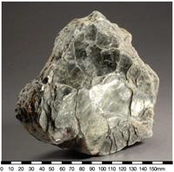
Muscovite is light-coloured or clear mica

Slide 6
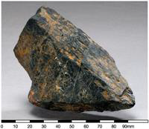
Amphiboles
• Amphiboles are a family of silicate minerals.
• Amphibole minerals generally contain iron,
magnesium, calcium and aluminium as well as silicon,
oxygen, and water.
• Amphiboles form prismatic or needle-like crystals.
• Amphibole is a component of many igneous and
metamorphic rocks.
• Hornblende is a common member of the
amphibole group of rock-forming minerals.

Slide 7
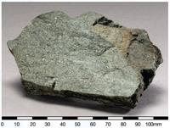
Pyroxene
• Pyroxenes are a family of silicate minerals.
• Pyroxene minerals generally contain magnesium,
iron, calcium and aluminium as well as silicon and
oxygen.
• Pyroxenes form short or columnar prismatic crystals.
• Pyroxene is a component in many igneous and
metamorphic rocks.
• Pyroxene crystals are commonly faceted as
gemstones. For instance, precious jade (jadeite) is a
pyroxene.

Slide 8
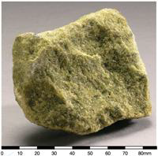
Olivine
• Olivine is a silicate mineral.
• Olivine ((Mg,Fe)2SiO4) contains iron and
magnesium.
• Olivine is a green, glassy mineral.
• Olivine is common in mafic and ultramafic rocks.
• Clear and transparent olivine crystals are
commonly faceted as gemstones

Slide 9
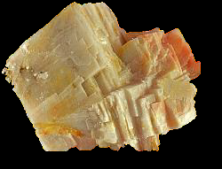
Calcite
• Calcite (Figure 9) is a carbonate mineral.
• Calcite is made up of calcium carbonate (CaCO3).
• Calcite is generally white to clear, and is easily
scratched with knife.
• Calcite is a common sedimentary mineral that is
the major component of calcareous sedimentary
rocks such as limestone. Metamorphism of
limestone produces marble.

Slide 10
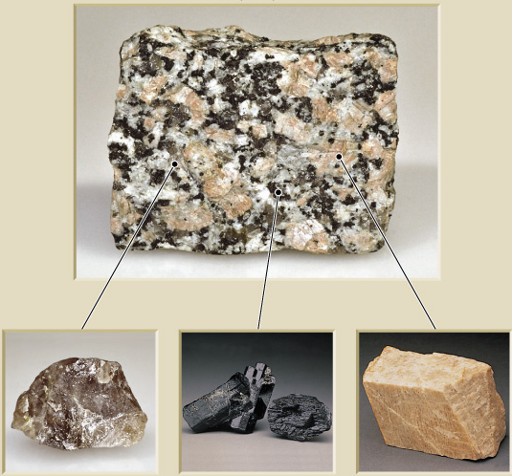

Rock-forming Minerals
Rocks are aggregates of minerals. Many are silicate minerals.
This granite, an igneous rock, has Quartz, an amphibole
called Hornblende, a pink potassium feldspar,
and a white Plagioclase feldspar

Slide 11
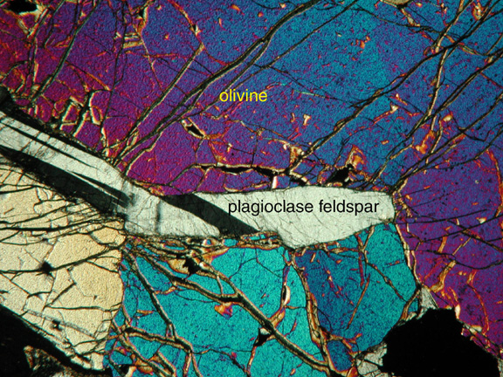
http://www.science.smith.edu/departments/Geology/Petrology/Petrography/
Rock-forming minerals
    Common minerals that make up most of the rocks of Earth’s crust
    Only a few dozen members
    Composed mainly of the 8 elements that make up 98% of the continental crust

Slide 12
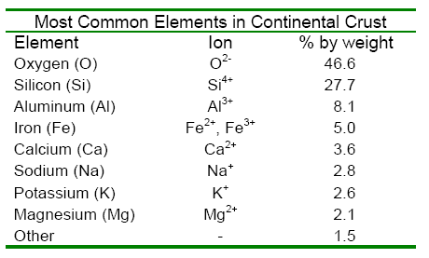
Commonly formed Ion charges often called “oxidation state”
Metals can form more than one Ion. Fe⁺² is name Ferrous, Fe⁺³ is named Ferric

Slide 13
Classification of Minerals
Silicates
    Most important mineral group
      Comprise most of the rock-forming minerals
      Very abundant due to large amounts of silicon and oxygen in Earth’s crust
    Basic building block is the silicon-oxygen tetrahedron molecule
      Four oxygen ions surrounding a much smaller silicon ion

Slide 14
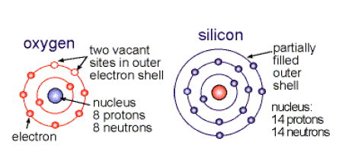
The Component Atoms
Silicon has 4 electrons in
Its outer shell
Oxygen has
6 electrons in its
valence shell

Slide 15
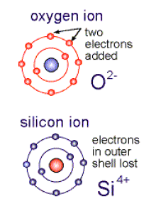
Remember: atoms can gain or lose electrons
They then combine with oppositely charged ions to form neutral molecules
Ions
Anion (negative)
Cation (positive)

Slide 16
Silicate Molecule
2_25
The Silicon-Oxygen
Tetrahedron
O² ⁻
Si⁴⁺
O² ⁻
O² ⁻
The basis of most rock-forming minerals, charge - 4
O² ⁻

Slide 17
Silicate Bonding I
Oxygen O atoms may obtain electrons from Si atoms, producing the SiO₄ ⁻⁴ Ion.
The negative charge is balanced by positive metal ions.
This occurs in Olivine, (Fe,Mg)₂SiO₄, a high temperature Fe-Mg silicate. Forms of this mineral are stable 100’s of kilometers below Earth’s surface.
A type of Ionic Bond

Slide 18
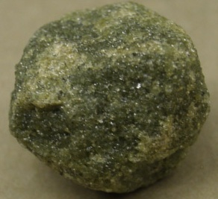
Example OLIVINE
Positive ion
Fe and Mg
SiO₄ ⁻⁴ Ion
Tetrahedron
facing down
Tetrahedron
facing up
Independent tetrahedra

Slide 19
Silicate Bonding II
Alternately, the oxygen atoms may complete their outer electron shells by sharing electrons with two Silicon atoms
in nearby silicon tetrahedra.
Mainly a covalent bond

Slide 20
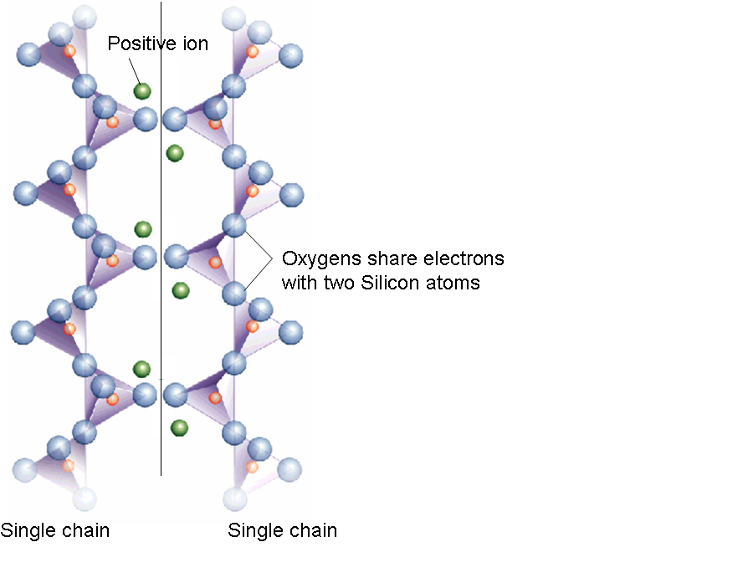
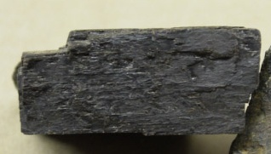
A Pyroxene
Single chains weakly paired

Slide 21
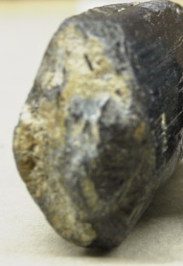
2_26c
An Amphibole
Positive
ion
Cleavages 56 and 124 deg
Double chains
(c)

Slide 22
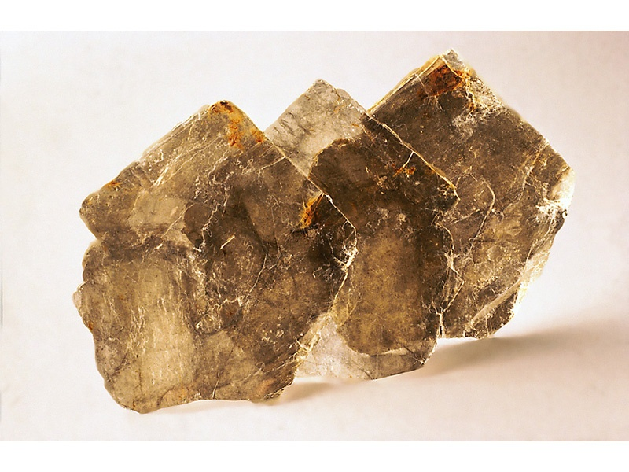
Example: Mica
Sheet silicates
(d)

Slide 23
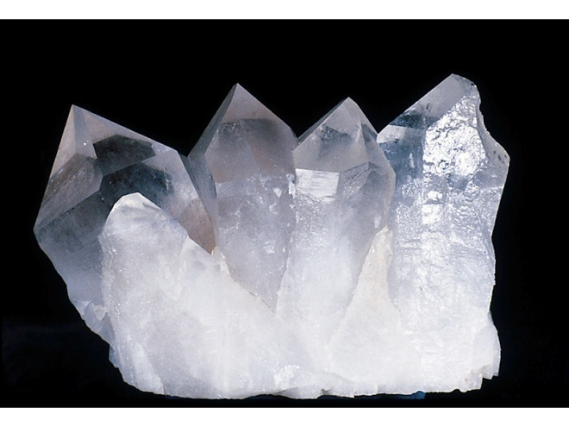
2_26e
Example: Quartz
SiO₂
Framework silicates
(e)
(3-D, also the Feldspars)

Slide 24
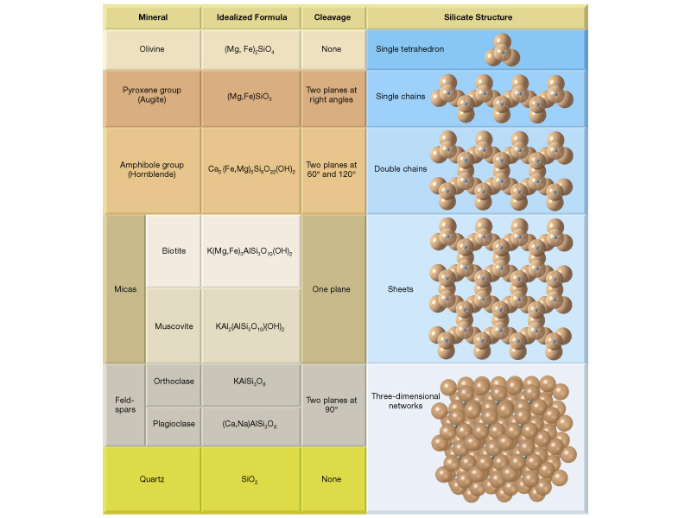
Summary

Slide 25
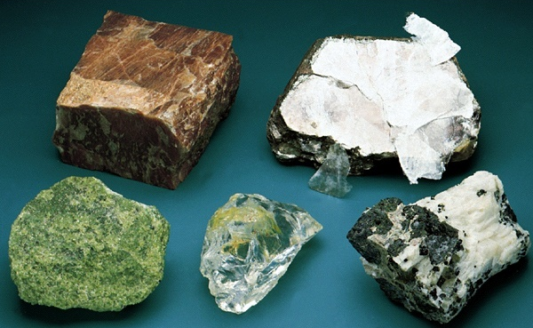
Silicate Mineral Appearance
Mica
Feldspar
Olivine
Quartz
Pyroxene

Slide 26
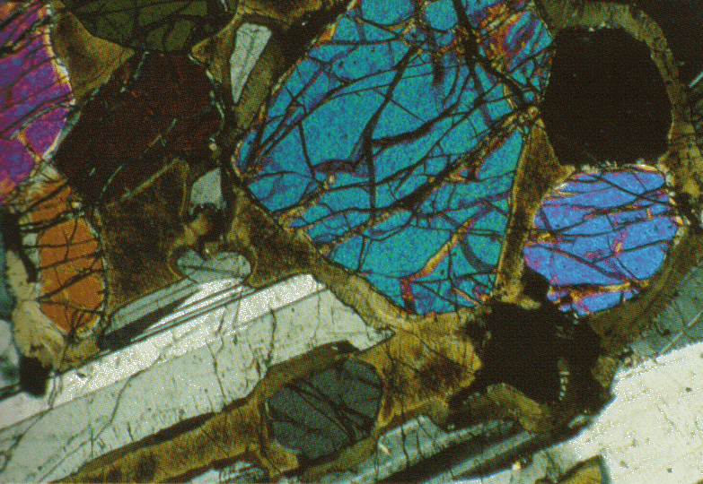
Classification of Minerals
Common Silicate minerals
    Nesosilicates – Independent Tetrahedra
    Olivine
      High temperature Fe-Mg silicate (typical mantle mineral - formed 100’s km in Earth
      Individual tetrahedra linked together by iron and magnesium ions
      Forms small, rounded crystals with no cleavage
(Mg,Fe)₂SiO₄
High interference colors
No consistent cleavages

Slide 27
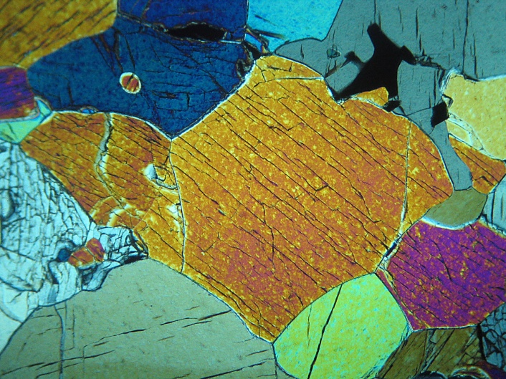
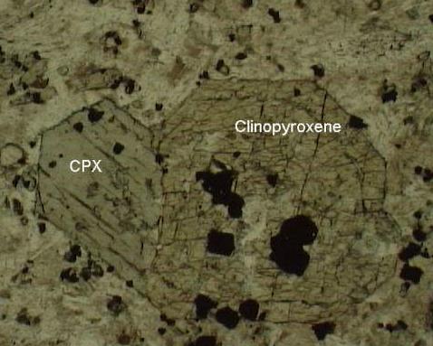
Classification of Minerals
Common Silicate minerals
    Pyroxene Group Single Chain Inosilicates
    for example (Mg,Fe)SiO₃
      Single chain structures involving iron and magnesium, chains weakly paired
      Two distinctive cleavages at nearly 90 degrees
      Augite is the most common mineral in the pyroxene group

Slide 28
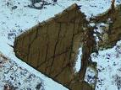
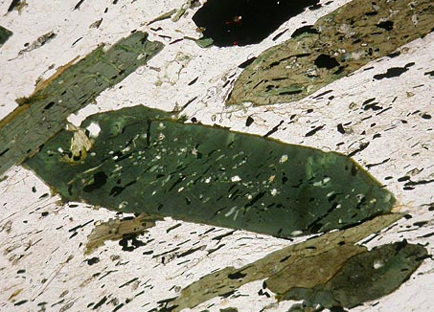
Classification of Minerals
Common Silicate minerals
    Amphibole Group Double Chain Inosilicates
    Ca₂(Fe,Mg)₅Si₈O₂₂(OH)₂
      Double chain structures involving a variety of ions
      Two perfect cleavages exhibiting angles of , e.g. 124 and 56 degrees in Hornblende.
      Hornblende is the most common mineral in the amphibole group
Pleochroic in Plane Polarized Light

Slide 29
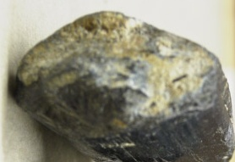
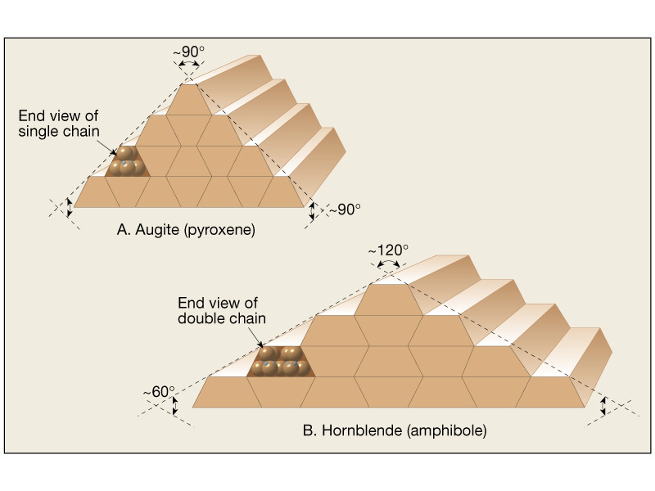
Hornblende Crystal
56 and 124 degree
Cleavages
Distinguish Hornblende from
Pyroxene Group by cleavage
Pyroxene Crystal
Two Cleavage Faces at about 90 degrees

Slide 30
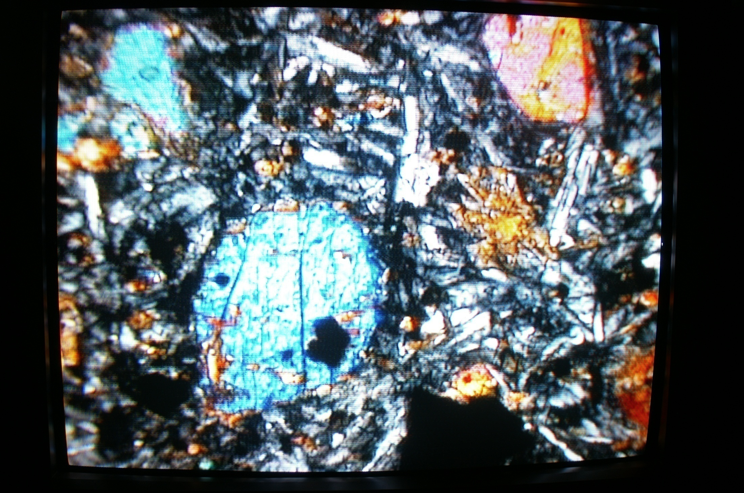
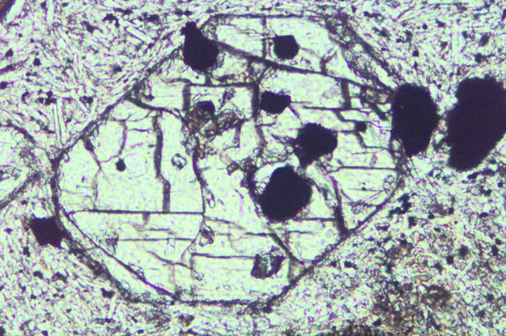
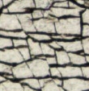
Cleavage in Pyroxenes
It isn’t perfect in all slices

Slide 31
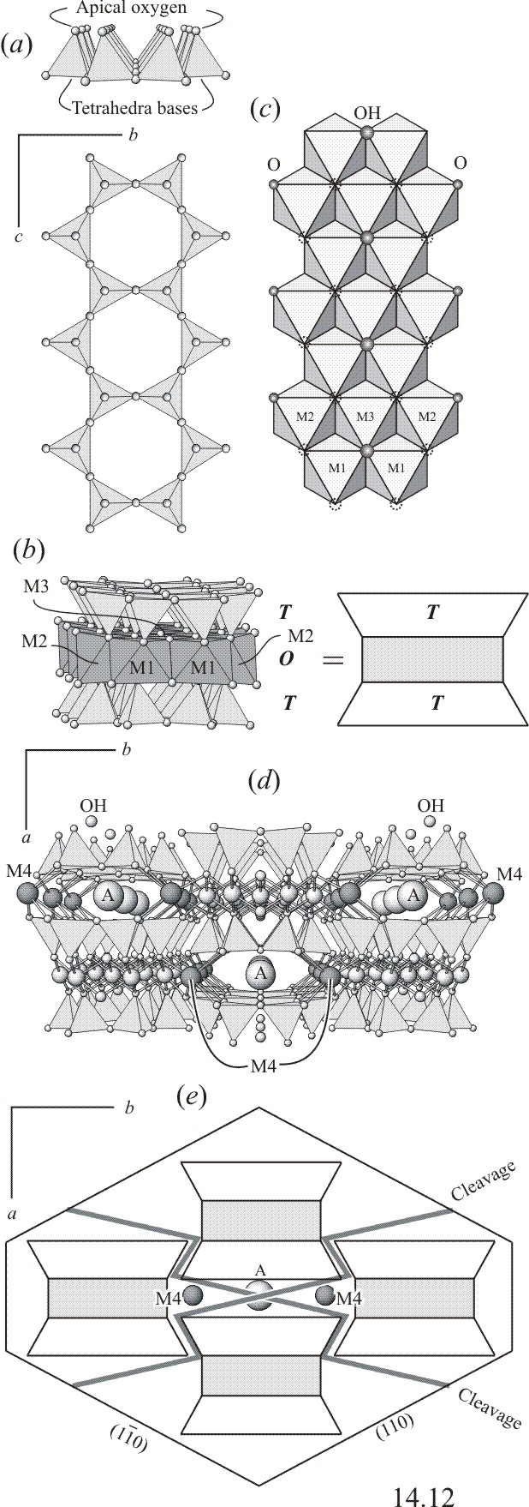
Cleavage in Amphiboles

Slide 32
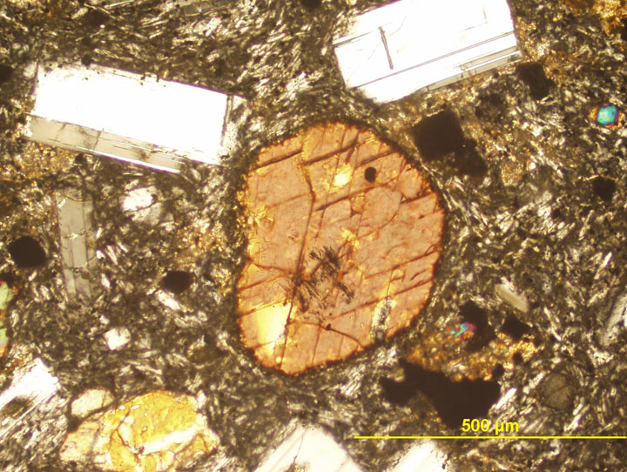

Slide 33
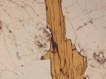
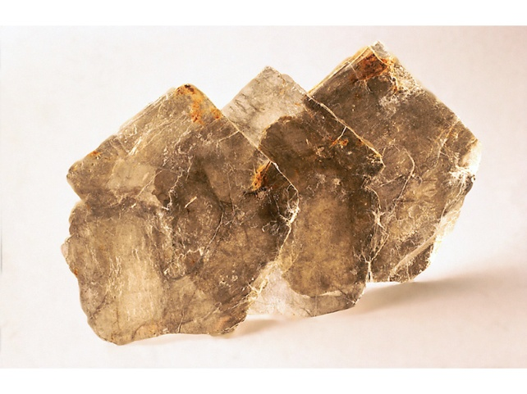
Classification of Minerals
Common Silicate minerals
    Mica Group Phyllosilicates
      Sheet structures that result in one direction of perfect cleavage
      Biotite is the common dark colored mica mineral
      Muscovite is the common light colored mica mineral
KAl₃Si₃O₁₀(OH)₂
Muscovite

Slide 34
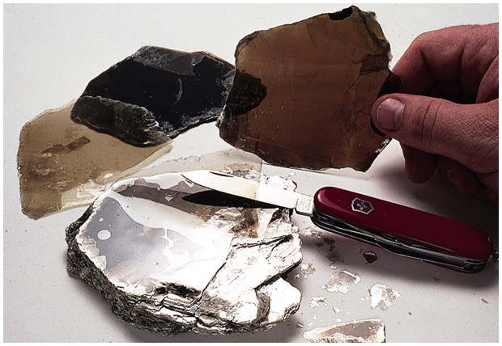
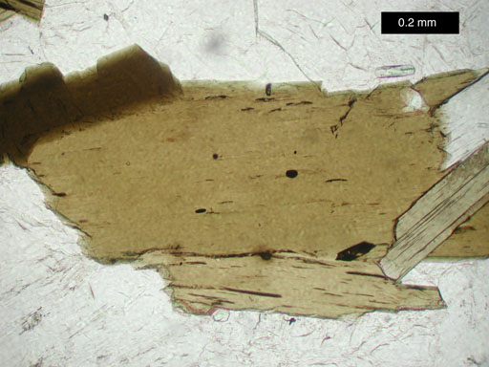
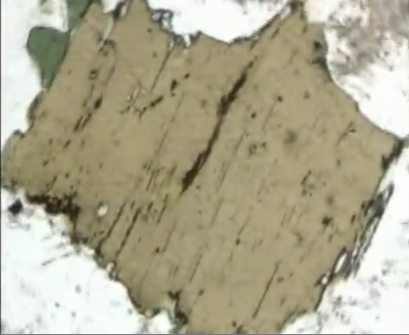
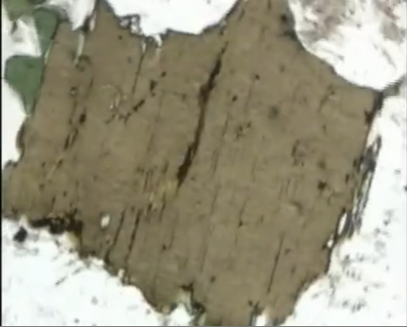
In plane polarized light, Biotite is seen as dark brown to grey against the surrounding mostly colorless minerals. Under crossed polars "bird's eye " = “mottled” = “wavy” extinction can easily be seen when the mineral is nearly extinct. Often, the mineral color masks the interference colors when the mineral is not extinct.
http://www.youtube.com/watch?v=Bv3MVkyyxjk
Pleochroic in PPL http://www.youtube.com/watch?v=-6LEW_H-ccQ

Slide 35
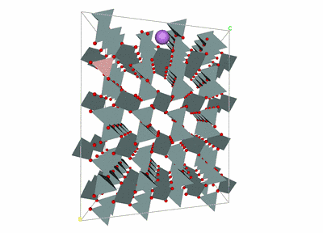
3-D (Framework) Tectosilicates
Quartz SiO2

Slide 36
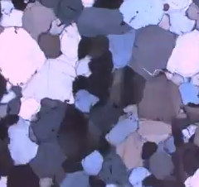
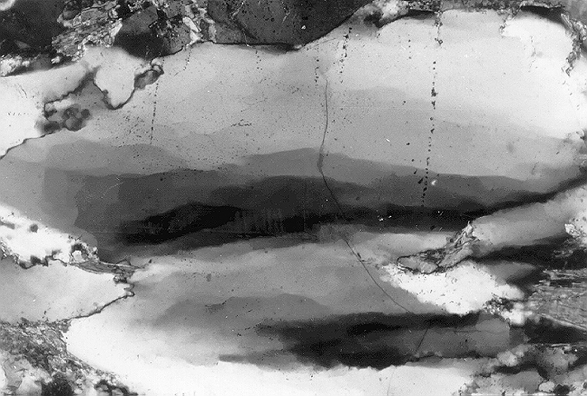
Quartz
Undulose extinction
1º grey for standard thin section thickness
a thin section is 30 microns ( 3 hundredths of a millimeter)
http://www.youtube.com/watch?v=O1I-_YdgaHg

Slide 37
Feldspars
Common Silicate minerals
Tectosilicates
    Feldspar Group
      Most common mineral group
      3-dimensional framework of tetrahedra exhibit two directions of perfect cleavage at 90 degrees
      K-spars (potassium feldspar) and Plagioclases (sodium to calcium feldspar solutions) are the two most common groups
      Pearly to vitreous Luster

Slide 38
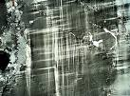
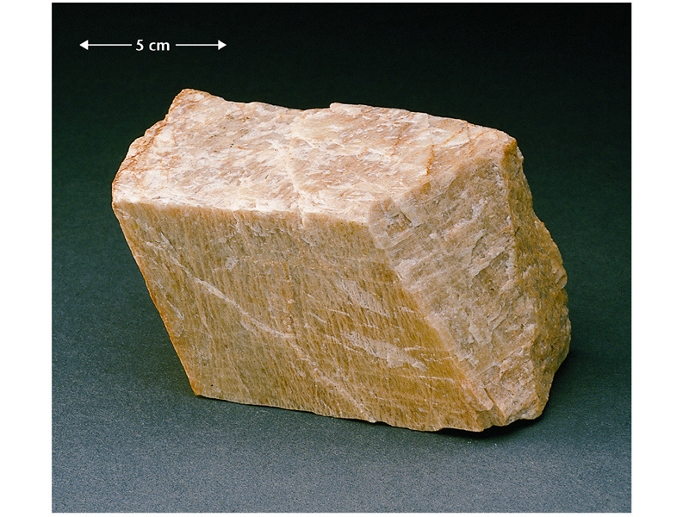
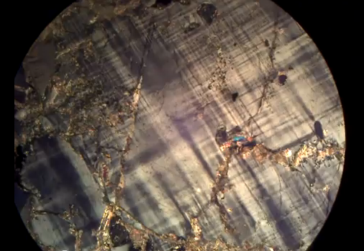
Potassium feldspar
KAlSi₃O₈
Note Pearly Luster
http://www.youtube.com/watch?v=7-KZREqrh44
Tartan twins in Microcline.
Microcline is the low TP version of K-spars KAlSi₃O₈
Microcline is Triclinic, Orthoclase is Monoclinic
Perthitic Texture, Microcline plus exsolved Albite

Slide 39
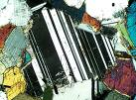
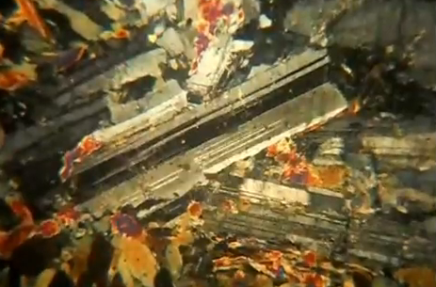
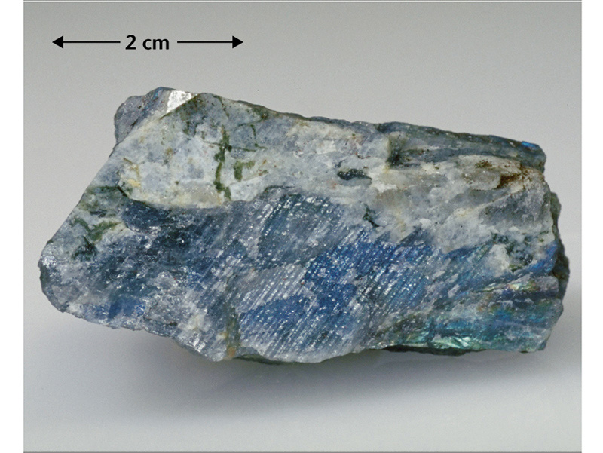
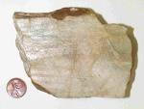
Plagioclase feldspar
(Ca,Na)AlSi₃O₈
Note the Twinning, seems to have ‘stripes’
http://www.youtube.com/watch?v=gLcVT_6y-MA
Labradorite Albite

