Slide 1
Growth Physiology
Second Year
Botany/Chemistry Students
Prof. Dr. Nemat M. Hassan
Lecture
15-3-2020

Slide 2
Respiration during germination
The respiration of dry seeds is so slow as to be near the limit of detection
germinating seeds accompanied by high rates of respiration both in embryonic and storage regions.
Respiratory enzymes are already present in dry seeds and hydration leads to a steep rise in respiration rate.

Slide 3
The respiratory quotient (RQ) of germinating seed is defined as the fraction volume of CO2 evolved/ volume of O2 absorbed.
For the aerobic oxidation of
carbohydrates, the RQ = 1.0;
for lipids, 0.7-0.8;
for proteins, 0.8-1.0.

Slide 4
During anaerobic respiration, CO2 evolution takes place without O2 uptake, giving an RQ of infinity
Mature plant tissues respire aerobically on a carbohydrate substrate and with an RQ of 1.0.

Slide 5
During germination the RQ deviates widely from unity and changes rapidly
In the first hours of imbibition many seeds exhibit RQ values above unity.

Slide 6
Mobilization of food reserves
The first stage in the utilization of the nutrient reserves is hydrolysis
Increases in enzyme activity may come about either by release of an enzyme present in an inactive form or by de novo synthesis.

Slide 7
Hydrolases convert insoluble reserves to soluble drevatives
In cereals, the scutellum acts as an absorbing organ
It absorbs glucose arising from starch breakdown in the endosperm and converts the glucose into sucrose

Slide 8
Utilization of food reserves for seedling growth
The reserve materials provide
(i) building blocks for the development of embryo,
(ii) energy for the biosynthesis and
(iii) nucleic acids for control of protein synthesis and overall embryonic development.

Slide 9
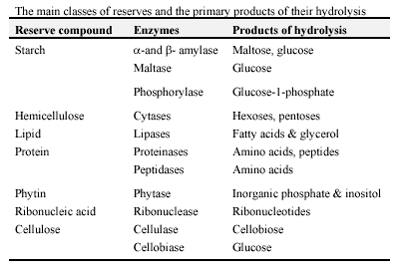

Slide 10
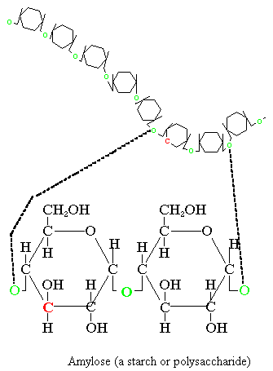

Slide 11
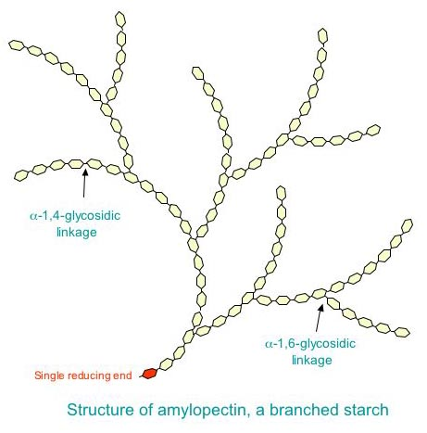

Slide 12
Utilization of Starch during germination
In the cereal endosperm the complete breakdown of starch is accomplished by a mixture of (1,4) -α- glucanases and (1,6)-α-glucanases

Slide 13
Alpha-amylase, an endohydrolase, catalyse the initial steps in polymerization of both the amylose and amylopectin and linear or branched dextrins are the major products of this action.
The embryonic axis secrets gibberellic acid into the aleurone layer which cause de novo synthesis of α-amylase. This enzyme is not found in ungerminated seeds.

Slide 14
Beta-amylase, catalyses the release of maltosyl residues from the non-reducing end of amylose and amylopectin.
There is no evidence for de novo synthesis of Beta -amylase in wheat and barley
they arise from pre-existing forms, already present in the starchy endosperm.

Slide 15
Limit dextrinase is the debranching enzyme involved in starch
This catalyses the hydrolysis of (1,6) -α-glucosidic linkages in branched dextrins and amylopectin.

Slide 16
Glucose is absorbed from the endosperm, converted to sucrose and transported as such to the seedling by scutellum

Slide 17
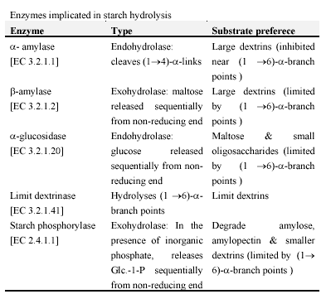

Slide 18
Lipids
Plant species that store lipids in their seeds are more numerous than those that store mainly carbohydrates.

Slide 19
2- Lipids
store in seeds as triacyl glycerol
1 CH2 - O - C – O - R1
2 CH - O - C – O - R2
3 CH2 - O - C – O - R3

Slide 20
Many seeds belong to lipid storing seeds, these are:
soybean (Glycine max),
sunflower (Helianthus annuus),
peanut (Arachis hypogaea),
cotton (Gossypium hirsutum),
rape (Brassica napus),
coconut (Cocos nucifera),
palm (Elaeis guineensis),
linseed (Linum usitatissimum), and
castor bean (Ricinus communis).

Slide 21
Safflower (Carthamus tinctorius),
maize (embryo) (Zea mays),
olive seed (Olea europaea),
sesame (Sesamum indicum) and
tung (Aleurites fordii) also provide useful oils.
cotyledons are the predominant storage organ.

Slide 22
The process of lipid mobilization involves numerous enzymes.
The activities of these enzymes characteristically increase following germination, together with the onset of the linear rate of lipid degradation.

Slide 23
At least four subcellular compartments are involved in lipid mobilization. They are :
(i) storage lipid (oil or wax) bodies
(ii) Glyoxysomes
(iii) mitochondria
(iv) the cytosol.

Slide 24
The conversion of reserve lipid to carbohydrates is calld (gluconeogenesis).
Fatty acids are liberated from triacylglycerols (or wax esters) in the lipid bodies and oxidized to acetyl-CoA through a sequence of β-oxidation enzymes located in glyoxysomes.

Slide 25
The metabolism of acetyl-CoA in the glyoxysomes via the glyoxylate cycle results in a net synthesis of succinate.
Succinate is transported to the mitochondria where it is oxidized to oxaloacetate via three enzymes commonly associated with Krebs cycle metabolism.

Slide 26
In the cytosol, oxaloacetate is decarboxylated to phoshoenolpyruvate (PEP) which is converted to hexose via reversed glycolysis.

Slide 27
Evaluation
Define:
Quiescent seeds
Soaking process depends on seed type. Comment.
Compare between amylose and amylopectin.
Seeds and grains
Endospermic and non-endospermic seed
Hypogeal and epigeal germination.
Follow-up the fate of starch during germination.

