Slide 1
MINERAL CLASSIFICATION
How minerals are grouped

Slide 2
Classification
Minerals are generally grouped or classified based on their chemical composition.
Most common system is the Dana system.
Developed by Professor James Dana of Yale University in 1848.

Slide 3
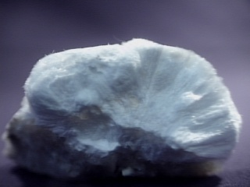
Mineral Composition
Minerals are usually compounds made of the most common elements in the crust

Slide 4
Native Elements
Silicates
Oxides
Halides
Phosphates
Gold: Au
Beryl: Be₃Al₂(Si₆O₁₈)
Chromite: FeCr₂O₄
Cryolite: Na₃AlF₆
Apatite: Ca₅(F,Cl,OH)(PO₄)₃
Silver: Ag
Talc: Mg₃(Si₄O₁₀)(OH)₂
Corundum: Al₂O₃
Halite: NaCl
Turquoise: CuAl₆(PO₄)₄(OH)₈.2H₂O
Copper: Cu
Orthoclase: KAlSi₃O₈
Hematite: Fe₂O₃
Fluorite: CaF₂
Lazulite: MgAl₂(OH)₂(PO₄)₂
Sulfur: S
Muscovite: KAl₂(AlSi₃O₁₀)(OH)₂
Magnetite: Fe₃O₄
Sylvite: KCl
Quartz: SiO₂
Ilmenite: FeTiO₃
Kaolinite: Al₄(Si₄O₁₀)(OH)₈
Rutile: TiO₂
Carbonates
Sulfates
Sulfides
Nitrates
Calcite: CaCO₃
Gypsum: CaSO₄.2H₂O
Galena: PbS
Niter: KNO₃
Dolomite: CaMg(CO₃)₂
Barite: BaSO₄
Sphalerite: ZnS
Siderite: FeCO₃
Anhydrite: CaSO₄
Pyrite: FeS₂
Malachite: Cu₂CO₃(OH)₂
Epsomite: MgSO₄.7H₂O
Bornite: Cu₅FeS₄

Slide 5
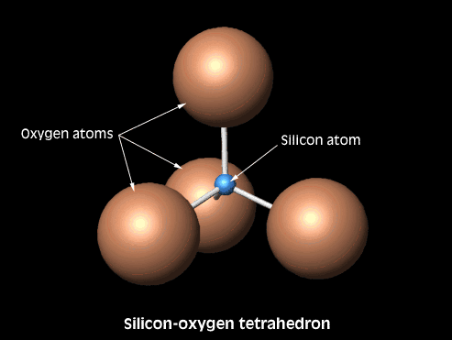

Slide 6
سليكات التتراهيدرا المنفردةnesosilicate
سليكات التتراهيدرا المذدوجة sorosilicate
سليكات التتراهيدرا الحلقية cyclosilicate
سليكات التتراهيدرا المسلسلة inosilicate
سليكات التتراهيدراالصفائحية phyllosilicate
سليكات التتراهيدراالشبكية tectosilicates

Slide 7
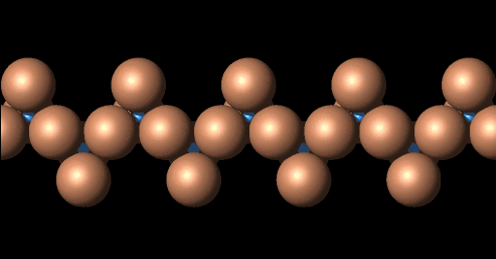
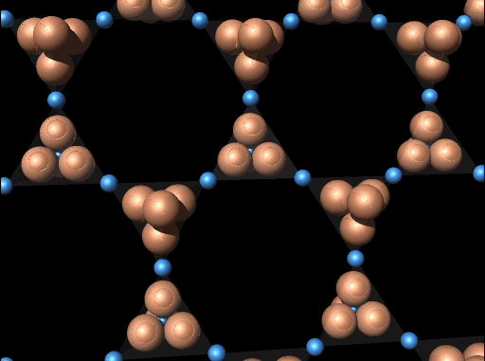
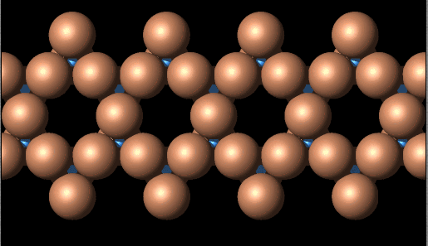
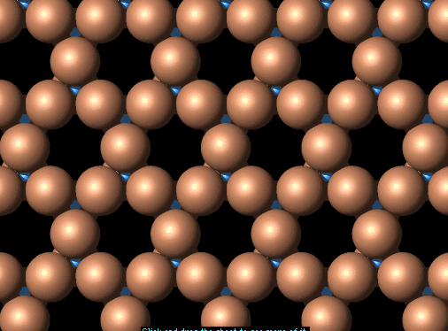
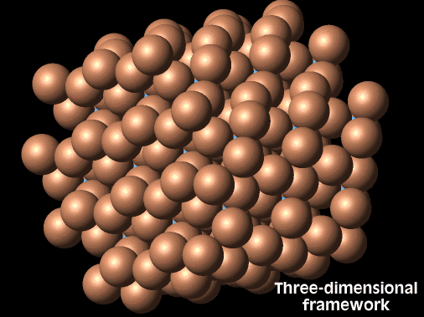

Slide 8
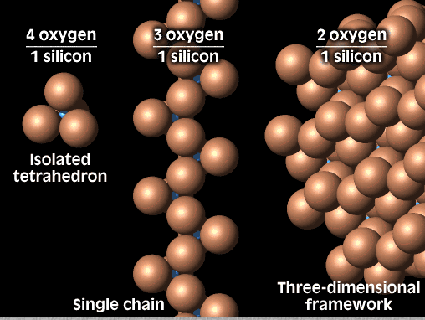

Slide 9
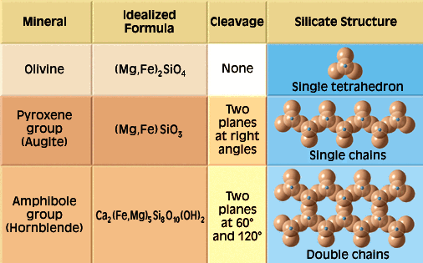
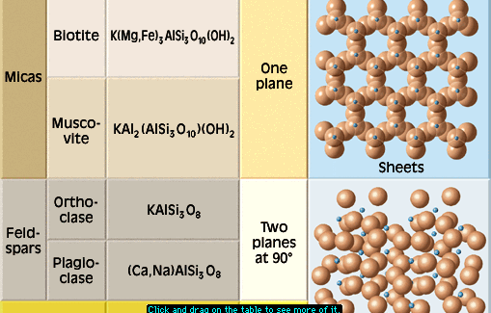

Slide 10
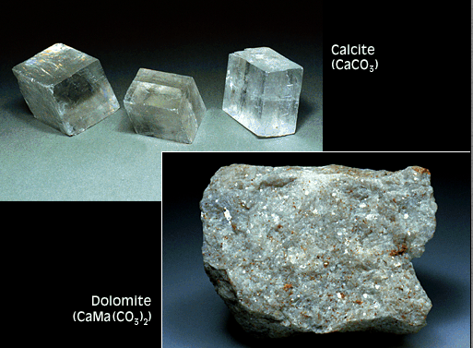

Slide 11
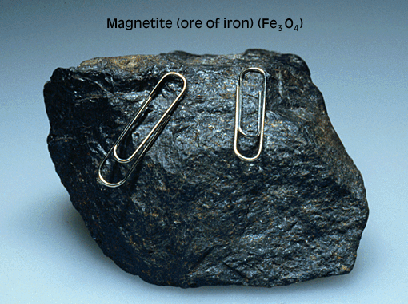

Slide 12
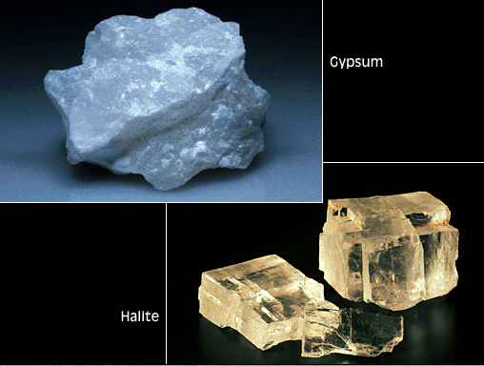
Halides and Sulphides

Slide 13
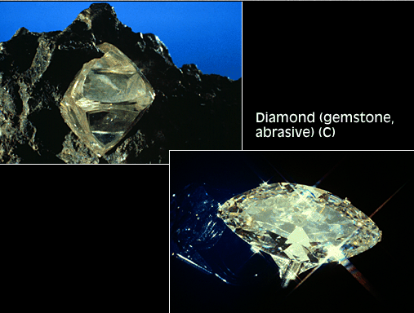
Native Elements

