Slide 1
Course: Plant Physiology
Code: 308 Bot
Students: Third year Botany
Lecture 1 (Plant Mineral Nutrition)
Dr. Taha Mohamed El-Katony

Slide 2
3. Specificity
Roots absorb ions selectively.
That is, different ions are absorbed at different rates and have different levels of accumulation.
This suggests the presence of specific carriers.
This specificity is rather rigid with ions of dissimilar chemical behavior but weak or non-existent with ions of similar behavior.
The monovalent cations K⁺, Cs⁺ and Rb⁺ compete with each other for the same binding site.

Slide 3
The rate of absorption of Rb⁺ can be lowered by the addition of K⁺ or Cs⁺ to the medium.
Increasing the concentration of Rb⁺ can overcome the inhibiting effect of the other two cations.
Selenate (SeO₄²⁻) can inhibit SO₄²⁻ absorption, but not phosphate or nitrate absorption.

Slide 4
This is analogous to the enzyme-substrate specificity.
In enzyme studies competitive inhibition is explained on the basis of mutual attraction of a substrate and an inhibitor for active sites on the enzyme.
The carrier, like the enzyme, may have a binding site that attracts two or more ions, and it may differentiate among ions just as an enzyme will do among different substrates.

Slide 5
Ion pumps
Salt accumulation is dependent on metabolic energy.
The rate of respiration increases when a plant is transferred from water to a salt solution.
The amount of increase over ground respiration is known as salt respiration.
A close relationship exists between anion absorption and anion or salt respiration. This means that only anions are actively absorbed.
The inhibition of salt respiration and of anion absorption by cyanide or CO suggests that transport of anions is mediated by cytochrome oxidase and that cytochromes may be anion carriers.

Slide 6
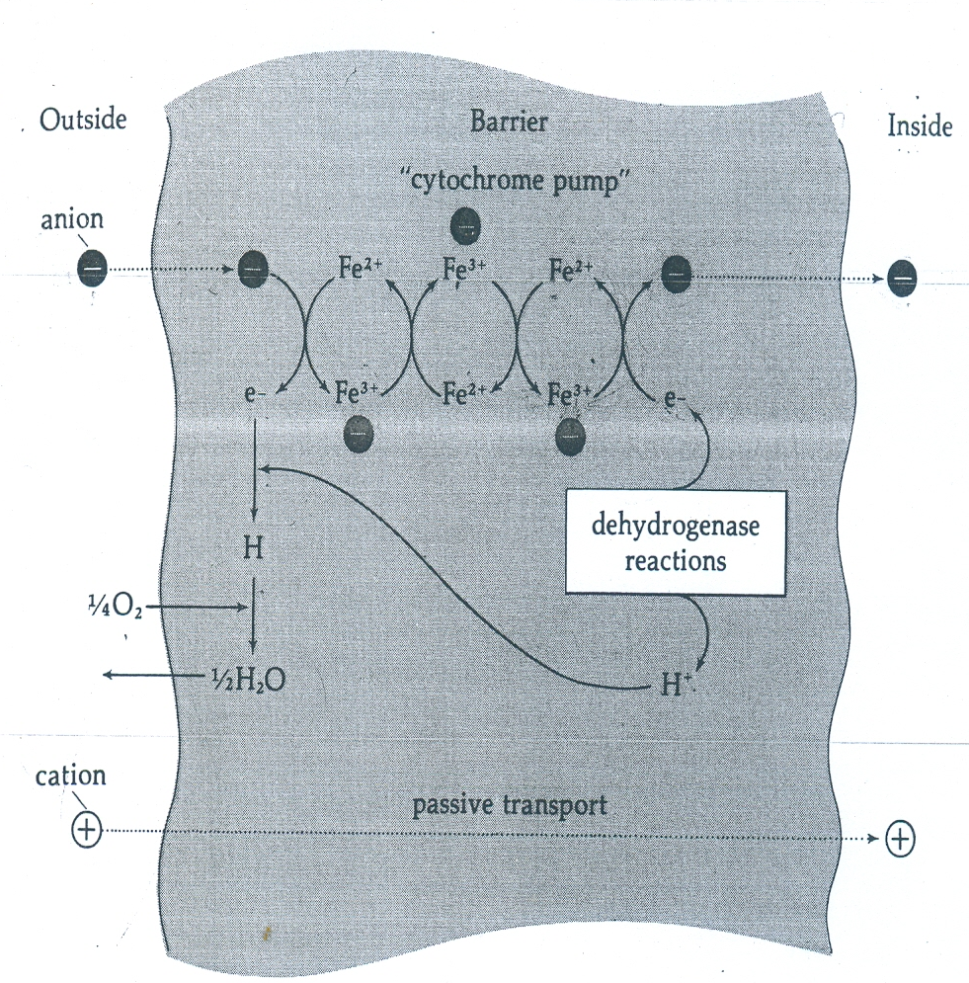
Cytochromes are (e⁻) carriers in respiration. They can be manipulated to transport (e⁻)s outward in exchange of inward transport of anions

Slide 7
Criticism to the cytochrome theory
1. cytochromes are not present in outer membranes; but in the inner membranes of chloroplasts and mitochondria.
2. 2,4-dinitrophenol (DNP), an inhibitor of oxidative phosphorylation, increases respiration (uptake of O₂ and production of CO₂) but decreases salt absorption.
3. not only anions stimulate respiration, but also cations (K⁺ and Na⁺) .
4. if there is only one carrier for all anions, competition among anions should be apparent. The anions sulfate, nitrate and phosphate do not compete with one another.

Slide 8
ATP carrier mechanism
That DNP inhibits active salt absorption suggests the participation of ATP in this process.
Low concentrations of DNP will completely retard ATP formation without affecting respiration.
Thus ATP may be essential for ion pumps.
It has been proposed that phospholipids are important for transport of ions across the impermeable membrane.
Lecithin is synthesized and hydrolyzed in a cyclic manner, picking up ions on the outer surface and releasing them on hydrolysis into inner space.
The synthesis of one of the components of this phosphatide cycle requires ATP.

Slide 9
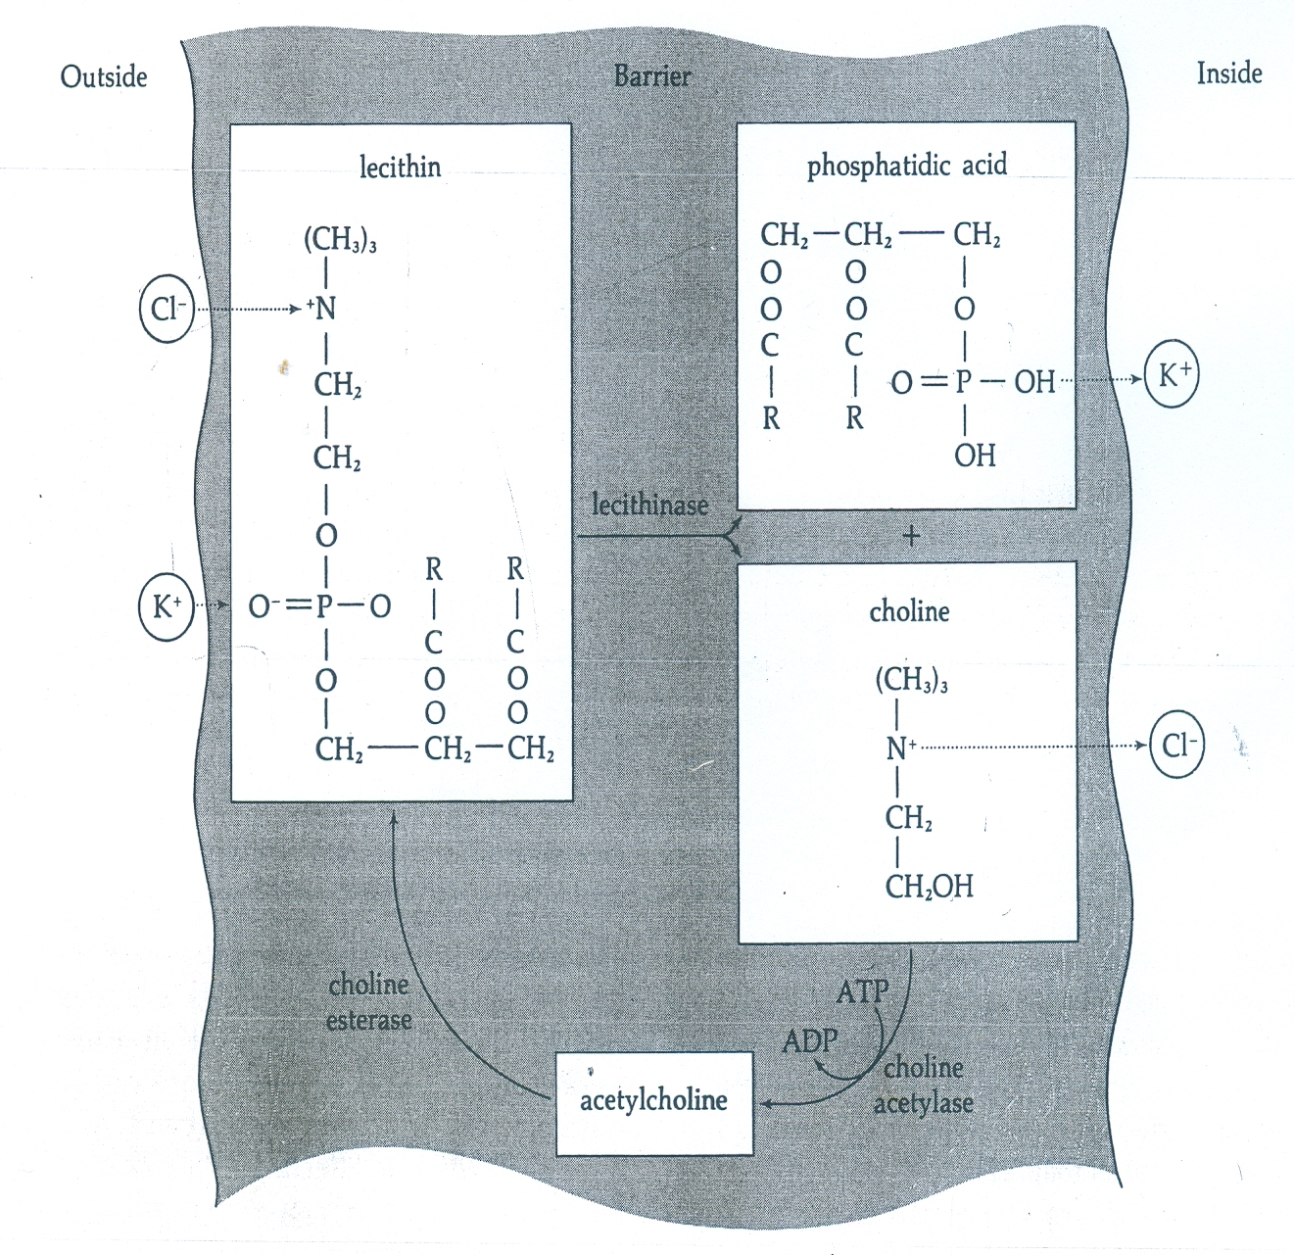

Slide 10
The proton pump
Hodges (1973) showed that ATP degradation is important in the transport of H⁺ across membranes.
The enzyme ATPase catalyzes the breakdown of ATP into a phosphoryl cation [O=P(OH)₂]⁺ and the ADP⁻ anion.
The phosphoryl cation reacts with water, generating H⁺.
The H⁺ ions are extruded outside the cell generating:
(a) a pH gradient, and
(b) an electrical potential gradient across the membrane (transmembrane potential).

Slide 11
Consequently, the cytoplasm is generally with high pH and is negatively charged compared with the medium.
The negatively charged cytoplasm attracts cations that diffuse through pores (channels) in the membrane in exchange for H⁺.
This process is termed electroosmosis.
The specificity of ion uptake resides in the nature of the groups lining these channels.

Slide 12
Factors affecting salt absorption
Temperature
Increase in temperature -within a range- accelerates salt absorption.
Further increase in temperature past a maximum point will inhibit the process.
Temperature affects both passive and active absorption.
Passive absorption:
The rate of free diffusion depends on the kinetic energy of molecules or ions, which in turn depends on temperature.
Therefore, lowering of temperature will slow down free diffusion.

Slide 13
In addition the cytoplasm and membranes are more viscous at low temperature, which increases resistance to movement of solutes.
Active absorption:
Low temperature will also slow down the biochemical reactions involved in active transport.
The inhibitory effects of high temperatures can be due to: denaturation of enzymes involved either directly in salt absorption or in the synthesis of components of salt absorption.

Slide 14
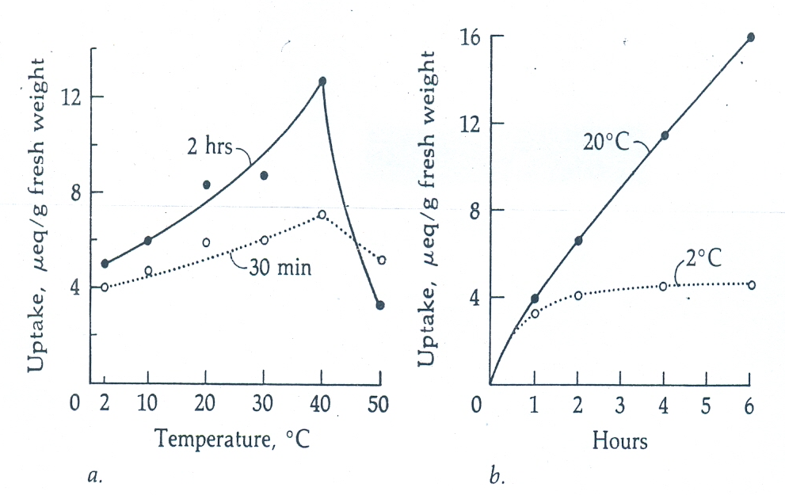

Slide 15
2- Hydrogen ion concentration
I. Moderate pH change (within the physioloogical range)
The effect of pH is mainly through affecting ionization and valence number of electrolytes in the apoplast without affecting cell viability.
A - The rate of uptake of B and P decreases with the increase in external pH.
This is related to the decrease in the boric acid/ borate anion ratio and the H₂PO₄⁻/HPO₄²⁻ ratio.

Slide 16
B - At high pH, ammonium uptake increases sharply, due to an increase in the proportion of the uncharged species NH₃ and NH₄OH.
C - In alkaline soils, the availability of Fe and Mn, is very low, whereas that of Mo increases due to changes in the oxidation state of ions.
At high pH Fe³⁺, Mn⁴⁺ and Mo⁶⁺ are prevalent but in acid soils the Fe²⁺, Mn²⁺ and Mo⁴⁺ dominate.

Slide 17
II. Extreme pH values (outside the physiological range)
In addition to the above-mentioned effects:
damage to plant tissues and carriers (denaturation of proteins) will inhibit salt absorption.
Solution pH affects protonation/deprotonation of amino acid residues of transport proteins.

Slide 18
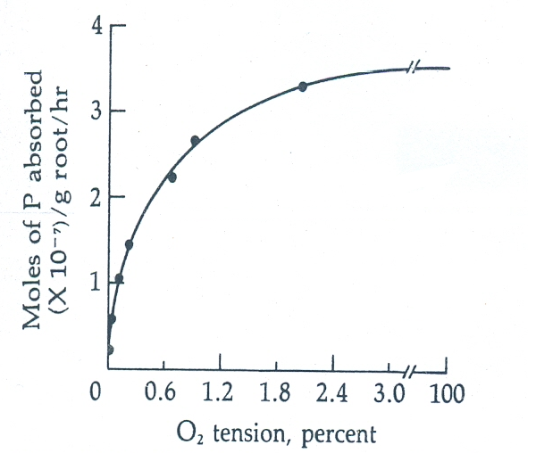
3. Oxygen tension
Active salt absorption is inhibited by the absence of oxygen. This supports theories of active transport.
Effect of O₂ on uptake of P by barley roots from a solution of 0.1 mM H₂PO₄⁻ (pH 4).

Slide 19
4. Interaction
Absorption of one ion is influenced by the other ions.
The interaction between ions includes:
regulation,
competition and
the counter ion effect.
A. The regulatory effect
The regulatory effect is exemplified by the role of Ca in the uptake of other ions.
Ca, and to a lesser extent Mg maintain membrane integrity and selective permeability.

Slide 20
Effect of Ca on K/Na selectivity of roots of maize and sugar beet.

Slide 21
B. Competition
Ions with similar physicochemical properties compete with one another for the uptake sites on the membrane.
Cation competition
Rb⁺ and Cs⁺ compete with K⁺ at binding site.
Li⁺ and Na⁺ do not compete with K⁺ since they have different binding sites.
Ba²⁺, Ca²⁺ and Sr²⁺ compete with one another for a mutual binding site, which is not involved in the uptake of Mg²⁺.
Mn²⁺ inhibits Mg²⁺ uptake but not K⁺ uptake by roots.

Slide 22
Anion competition
Competition occurs between sulphate and molybdate, sulphate and selenate, and phosphate and arsenate.
Interaction among ions depends on the availability and specificity of binding sites:
1- With enough binding sites, interaction will not be apparent, and ions with mutual binding sites will be taken up with maximum efficiency.
2- With highly specific binding sites ion absorption is not affected by the presence of other ions.

Slide 23
C. Counter ion effect
A cation might affect the uptake of an anion and vice versa.
Uptake of K⁺ increases when supplied as KNO₃ rather than as K₂SO₄.
Uptake of nitrate was faster if the accompanying ion was K⁺ not Na⁺ or Ca²⁺.
Increasing NH₄⁺ availability suppresses NO₃⁻ uptake, but increasing NO₃⁻ supply has little effect on NH₄⁺ uptake.

Slide 24
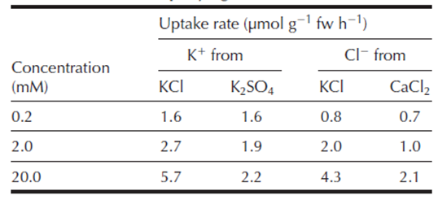
Effect of counter ion on uptake of K⁺ and Cl⁻ by maize roots

Slide 25
5. Growth
In case of a tissue:
For a short period of time, absorption of salt is not affected by growth.
But over prolonged time salt absorption is influenced by growth, because growth of a tissue increases:
1- surface area.
2- number of cells.
3- synthesis of new binding sites or carriers,
4- volume of water taken up which dilutes salt concentration.
factors that stimulate salt absorption.

Slide 26
In case of whole plant:
Different phases of development affect salt absorption.
As a root ages much of the surface area formerly involved in salt absorption becomes heavily suberized and unable to take up salt.
Vegetative growth makes heavy demands on many elements (N in particular),
Flowering makes heavy demand for P
Fruiting necessitates K.
Vegetative growth is accompanied by increased water movement, which affects passive absorption and translocation of salts (mass flow).

