Slide 1
Course: Plant Physiology
Code: 308 Bot
Students: Third year Botany
Lecture 4 (Water relationships)
Dr. Taha Mohamed El-Katony

Slide 2
Chapter III. Water loss:
Transpiration and Guttation
Water is the major constituent of plant body, yet only a small portion of the absorbed water is retained for metabolic processes.
Most of the absorbed water is translocated to the leaves and lost to the atmosphere due to the anatomical features of the leaves.
Aside from the role of water in maintenance of turgidity and in translocation of dissolved minerals, water use in plants is inefficient.

Slide 3
Water loss from plants occurs primarily through transpiration, in addition to minor contribution from guttation, secretion and bleeding.
Secretion is the loss of liquid water in the form solution from glands and nectaries. Water is actively secreted from water glands; that is, the cells surrounding the pore actively participate in pushing water through the pore.
Bleeding is loss of liquid water from wounds.
Guttation is loss of liquid water, from leaf tips or margins through specialized structures called hydathodes, from plants growing in a moist, warm soil in humid conditions.

Slide 4
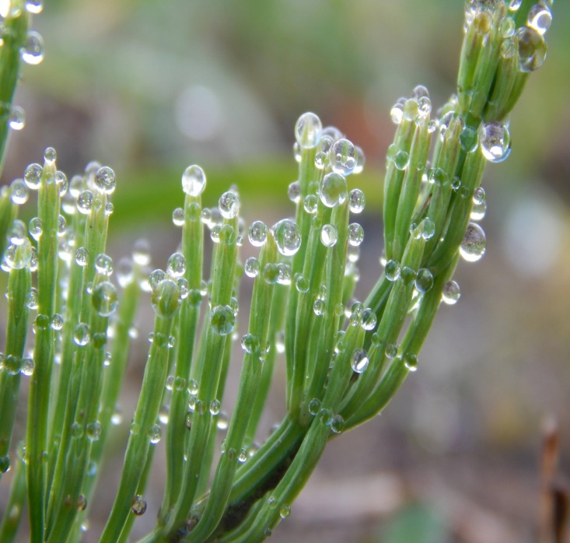
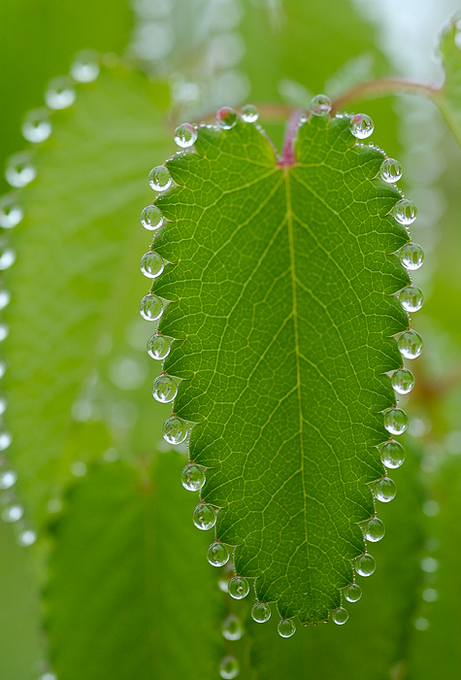
The factors that favor guttation are high water absorption, high root pressure and reduced or no transpiration.
Water exudes from a hydathode as a result of the hydrostatic pressure of xylem sap and not as a result of any local activity in the hydathode or surrounding tissues.

Slide 5
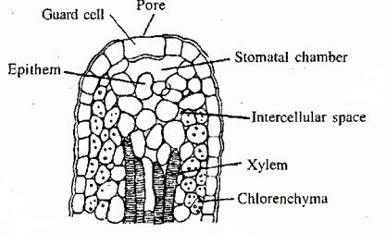
The guttation liquid is not pure water, but a solution containing a great variety of dissolved substances including phytohormones such as cytokinins.
When guttation water evaporates, the dissolved materials appear as precipitates on the leaf surface and can be redissolved and taken by the leaf again. The salt concentration is very high and may injure the leaf.

Slide 6
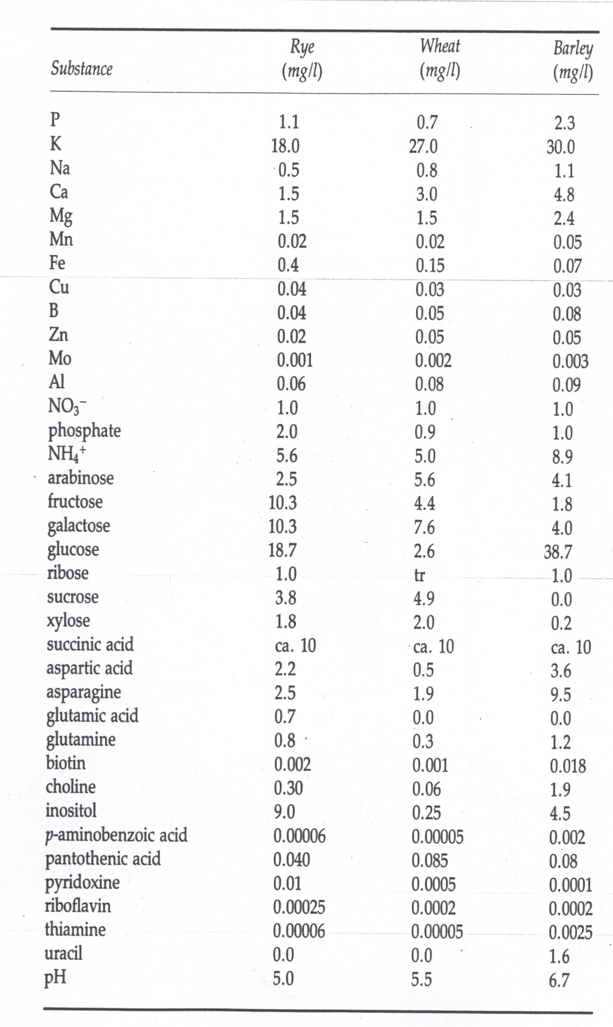

Slide 7
Transpiration
Water is lost from the plant primarily in the form of vapor, by transpiration.
Features of the leaf facilitating transpiration:
1- The loose arrangement of the mesophyll cells, means abundance of intercellular spaces and ideal conditions for evaporation of water from internal leaf surfaces (the surface phenomenon). Is transpiration a passive process?
2- The leaf epidermis is occupied by a large number of minute pores; the stomata.
The stomatal pores provide a path from the interior of the leaf to the environment.

Slide 8
The transpiration stream can be viewed as an unbroken column of water, pulled from the soil through the roots, up the xylem ducts, out of the mesophyll cells to their surface, into the intercellular spaces as vapor, and through the stomatal pores into the atmosphere.
3- The morphology and position of the leaf.
The leaf is flattened which means large surface area. The surface phenomenon again; compare the surface/volume ratio of a sphere (storage organ or fruit), cylinder (the stem) and a flattened cuboid (the leaf).
In addition the leaf projects from the stem in different directions which maximizes exposure to the atmosphere.

Slide 9
Three types of transpiration: one major (stomatal) and two minor (cuticular and lenticular)
Cuticular transpiration is direct water vapor loss from the surfaces of leaves and herbaceous stems through the cuticle.
Cuticle is the cutin layer covering the surface of leaves to retard water loss. Nevertheless, the cuticle can permit water vapor loss.
The extent of cuticular transpiration varies greatly among species.
In sun leaves and xerophytes the cuticle is thick and cuticular transpiration is insignificant.
In shade leaves, mesophytes and particularly hydrophytes the cuticle is thin and the plant may suffer from wilting under high transpiration.

Slide 10
Lenticular transpiration is water vapor loss through lenticels, which are small openings in the corky tissue covering stems and twigs.
Stomatal transpiration is the major type.
But under very dry conditions, stomata are closed, cuticular and lenticular transpiration are significant.
lenticular transpiration may cause desiccation in trees that shed their leaves at the onset of winter.
During a cold winter, water absorption by roots is low and the importance of lenticular transpiration is increased.

Slide 11
Magnitude of transpiration
Most of the absorbed water is transpired.
In herbaceous plants, the entire plant water may be replaced in the course of a single day. The amount of water lost varies according to species.
Examples:
1- Herbs: during one season a corn plant transpires up to 54 gallons (205 l) of water and an acre (4047 m²) transpires 15 inches (37.5 cm) of water.
2- Trees: an average forest may lose up to 8000 gallons (30.4 m³) of water/acre/day. A silver maple tree transpires as much as 58 gallons per hour.

Slide 12
Magnitude of transpiration per plant during
growing season for five plant species.
Plant species | Transpiration (gal/plant/season)
Cowpea | 13
Irish potato | 25
Winter wheat | 25
Tomato | 34
Corn | 54

Slide 13
Measurement of transpiration Transpiration can be estimated by measuring either the water absorbed or the water vapor transpired by a plant. The first approach takes advantage of the accordance between absorption and transpiration. However, there are exceptions to this rule.

Slide 14
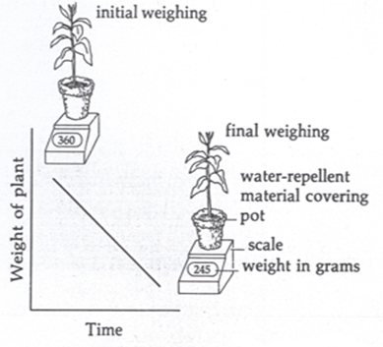
1. Weighing method.
It is the simplest way.
Accomplished by weighing a potted plant at time intervals.
The soil surface and the pot should be covered with a water repellent material to retard
evaporation from surfaces other
than the plant.
The loss of weight over a short
time will be due to transpiration.
Gain or loss of weight due to
photosynthesis or respiration is
insignificant.

Slide 15
This method is restricted to small plants .
For big plants, a very large balance (lysimeter) is used.
Plants, in a large container, are placed in a weighing platform and the amount of evapotranspiration is measured by weighing the container.
Transpiration of excised leaves, fruits and branches can be measured by immediately weighing the organ after excision and then reweighing after a short period of time.

Slide 16
The relative rates of transpiration may be compared in this case , but transpiration of an excised organ deviates from that of intact plant.
In the initial stages the rate of transpiration of an excised organ may exceed normal rates, because of the release of tension in the xylem ducts.
After a short period transpiration rates will fall off because of: 1- decrease in the water content of the tissue, 2- stomatal closure, 3- permeability changes, and so on.

Slide 17
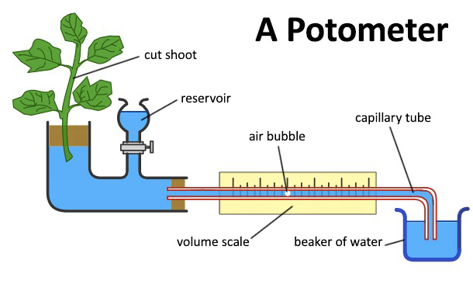
2. Potometer.
This method works on the premise that, rate of water absorption equals the rate of transpiration.
A plant shoot is sealed into a water-filled glass vessel, which has two other outlets: a graduated capillary and a water reservoir.
First, the entire apparatus is filled with water with no air spaces, by manipulating the stopcock, which controls the flow of water into the vessel from the reservoir.
An air bubble is then introduced into the capillary tube.
As transpiration proceeds, the air bubble will move along the capillary and give a measure of the rate of transpiration.

Slide 18
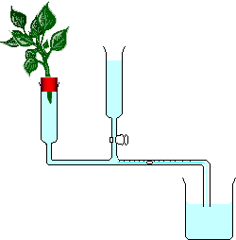
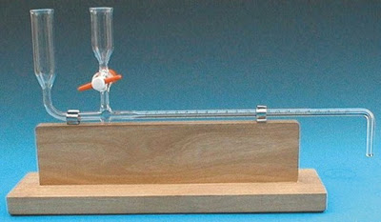
The potometer method is ideal for studying the effect of environmental factors (temperature, light, air movement) on transpiration.
However, its reliability is limited because it actually measures water absorption rather than transpiration: under certain circumstances the two can vary considerably.

Slide 19
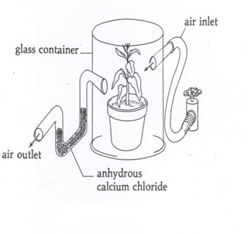
3. Collection and weighing of water vapor.
The plant is confined in a glass container; air of known moisture content is passed over it and then passed over pre-weighed water-adsorbent such as anhydrous CaCl₂, so that water vapor can be trapped and weighed.
The moisture content of air passed over the plant is measured by passing it through the same apparatus minus the plant (the control).
The difference in CaCl₂ weight before
and after air is passed through
it is a measure of air moisture.
The difference in weight between
CaCl₂ receiving air passed over the
plant and CaCl₂ receiving air passed
through the check apparatus is a measure
of transpiration.

Slide 20
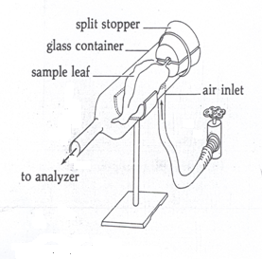
4. Cuvette.
It is a modification of the vapor method.
It allows studying the effect of environmental factors (light, temperature and humidity) on transpiration of a single leaf.
It is ideal for laboratory work but not for the field.
Air of known humidity is introduced
into the cuvette, passed over
the leaf and collected after it exits.
The increase in air humidity is
a measure of transpiration.
In the field, tent chambers equipped
with air inlets and outlets and
temperature-sensors are used.

Slide 21
5. Cobalt chloride.
This method depends on a change in color, not in weight.
Filter paper discs are impregnated with a slightly acidic 3% solution of CoCl₂ and thoroughly dried.
The dry paper is blue in color and changes to pink when exposed to humid air from a transpiring leaf.
The rate of color change is indicative of the rate of transpiration.
The CoCl₂ method can measure only the relative rates of transpiration of different plants.

Slide 22
Criticism
Transpiration rates estimated by CoCl₂ method differ from the actual rates, due to modifications of environmental conditions. The surface of the leaf covered by the paper is subjected to:
practically no air movement,
a reduction in irradiance and
a steeper vapor pressure gradient.

