Slide 1
Alkyl Halides and Nucleophilic Substitution
Introduction to Alkyl Halides
Alkyl halides are organic molecules containing a halogen atom bonded to an sp³ hybridized carbon atom.
Alkyl halides are classified as primary (1°), secondary (2°), or tertiary (3°), depending on the number of carbons bonded to the carbon with the halogen atom.
The halogen atom in halides is often denoted by the symbol “X”.

Slide 2
There are other types of organic halides. These include vinyl halides, aryl halides, allylic halides and benzylic halides.
Vinyl halides have a halogen atom (X) bonded to a C—C double bond.
Aryl halides have a halogen atom bonded to a benzene ring.
Allylic halides have X bonded to the carbon atom adjacent to a C—C double bond.
Benzylic halides have X bonded to the carbon atom adjacent to a benzene ring.

Slide 3
Figure 7.1
Examples of 1°, 2°, and
3° alkyl halides
Figure 7.2
Four types of organic
halides (RX) having
X near a π bond

Slide 4
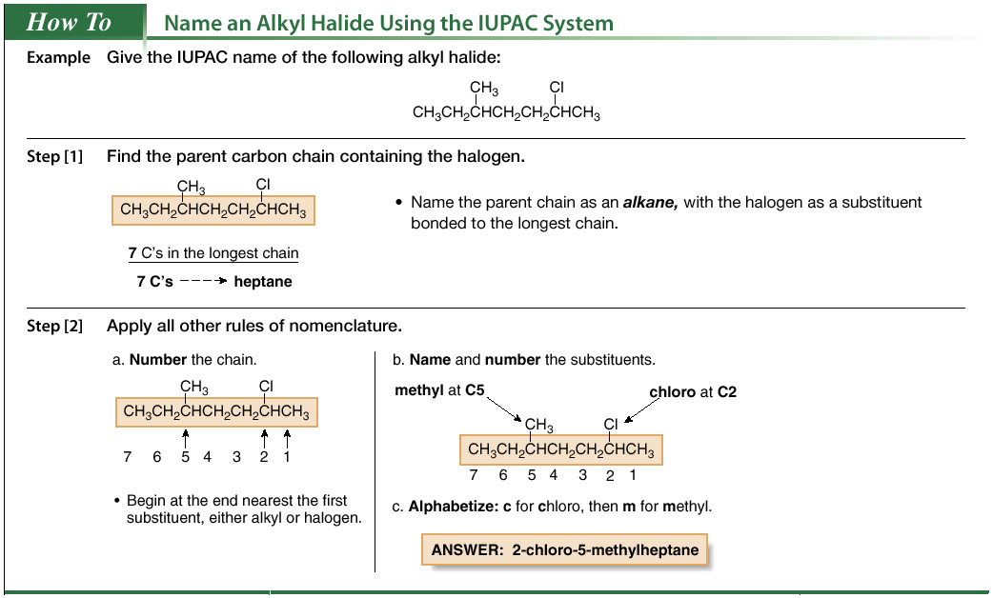
Nomenclature

Slide 5
Common names are often used for simple alkyl halides. To assign a common name:
Name all the carbon atoms of the molecule as a single alkyl group.
Name the halogen bonded to the alkyl group.
Combine the names of the alkyl group and halide, separating the words with a space.

Slide 6
Physical Properties
Alkyl halides are weak polar molecules. They exhibit dipole-dipole interactions because of their polar C—X bond, but because the rest of the molecule contains only C—C and C—H bonds, they are incapable of intermolecular hydrogen bonding.

Slide 7
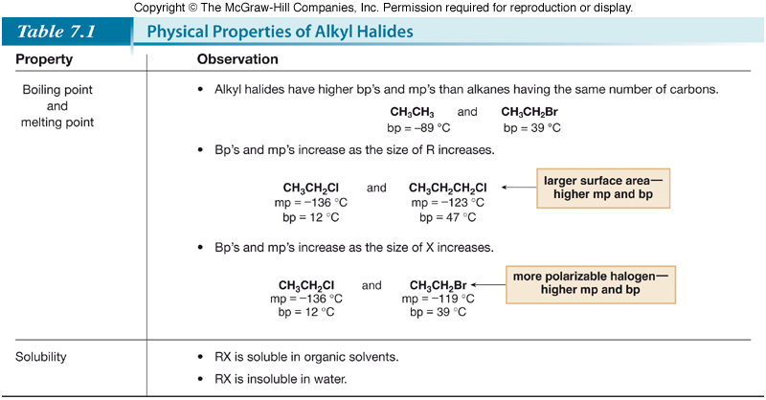

Slide 8
The Polar Carbon-Halogen Bond
The electronegative halogen atom in alkyl halides creates a polar C—X bond, making the carbon atom electron deficient. Electrostatic potential maps of four simple alkyl halides illustrate this point.
Figure 7.5
Electrostatic potential maps of
four halomethanes (CH₃X)

Slide 10
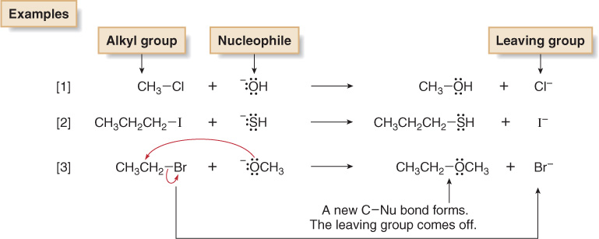
General Features of Nucleophilic Substitution
Three components are necessary in any substitution reaction.

Slide 11
Negatively charged nucleophiles like HO¯ and HS¯ are used as salts with Li⁺, Na⁺, or K⁺ counterions to balance the charge. Since the identity of the counterion is usually inconsequential, it is often omitted from the chemical equation.
When a neutral nucleophile is used, the substitution product bears a positive charge.

Slide 12
Furthermore, when the substitution product bears a positive charge and also contains a proton bonded to O or N, the initially formed substitution product readily loses a proton in a BrØnsted-Lowry acid-base reaction, forming a neutral product.
To draw any nucleophilic substitution product:
Find the sp³ hybridized carbon with the leaving group.
Identify the nucleophile, the species with a lone pair or π bond.
Substitute the nucleophile for the leaving group and assign charges (if necessary) to any atom that is involved in bond breaking or bond formation.

Slide 13
The Leaving Group
In a nucleophilic substitution reaction of R—X, the C—X bond is heterolytically cleaved, and the leaving group departs with the electron pair in that bond, forming X:¯. The more stable the leaving group X:¯, the better able it is to accept an electron pair.
For example, H₂O is a better leaving group than HO¯ because H₂O is a weaker base.

Slide 14
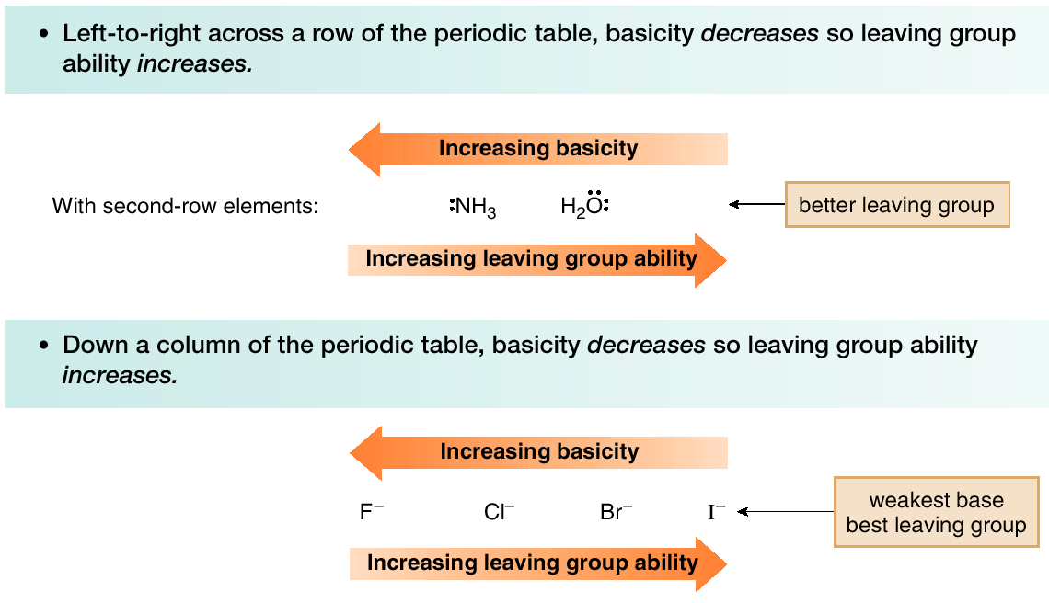
There are periodic trends in leaving group ability:

Slide 15
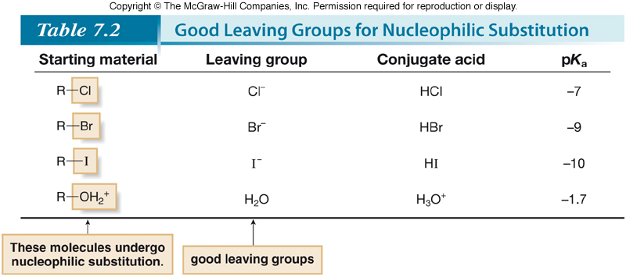

Slide 16
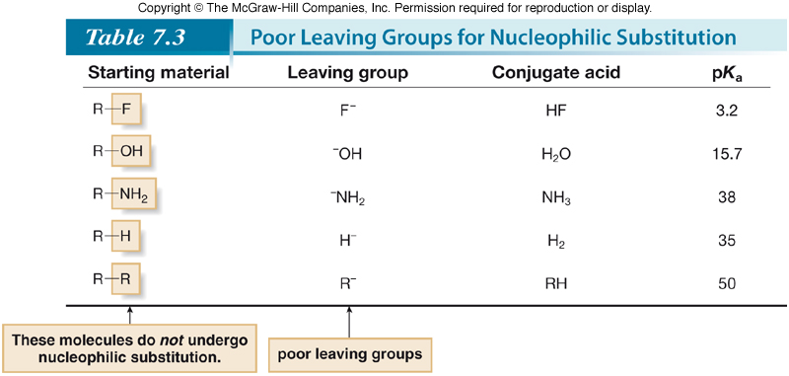

Slide 17
The Nucleophile
Nucleophiles and bases are structurally similar: both have a lone pair or a π bond. They differ in what they attack.

Slide 18
Although nucleophilicity and basicity are interrelated, they are fundamentally different.
Basicity is a measure of how readily an atom donates its electron pair to a proton. It is characterized by an equilibrium constant, K_{a} in an acid-base reaction, making it a thermodynamic property.
Nucleophilicity is a measure of how readily an atom donates its electron pair to other atoms. It is characterized by a rate constant, k, making it a kinetic property.

Slide 19
Nucleophilicity parallels basicity in three instances:
For two nucleophiles with the same nucleophilic atom, the stronger base is the stronger nucleophile.
The relative nucleophilicity of HO¯ and CH₃COO¯, two oxygen nucleophiles, is determined by comparing the pK_{a} values of their conjugate acids (H₂O = 15.7, and CH₃COOH = 4.8). HO¯ is a stronger base and stronger nucleophile than CH₃COO¯.
2. A negatively charged nucleophile is always a stronger nucleophile than its conjugate acid.
HO¯ is a stronger base and stronger nucleophile than H₂O.
3. Right-to-left-across a row of the periodic table, nucleophilicity increases as basicity increases:

Slide 20
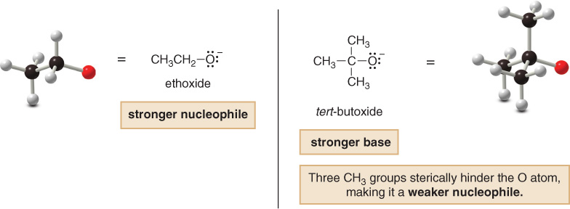
Nucleophilicity does not parallel basicity when steric hindrance becomes important.
Steric hindrance is a decrease in reactivity resulting from the presence of bulky groups at the site of a reaction.
Steric hindrance decreases nucleophilicity but not basicity.
Sterically hindered bases that are poor nucleophiles are called nonnucleophilic bases.

Slide 21
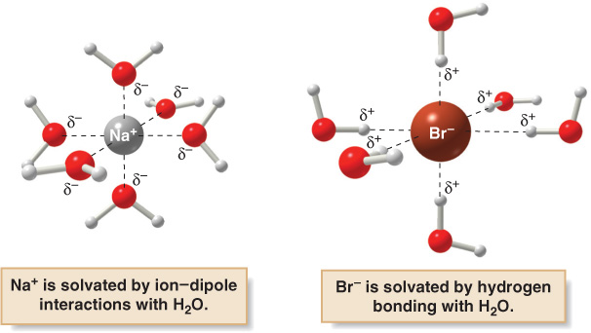
If the salt NaBr is used as a source of the nucleophile Br¯ in H₂O, the Na⁺ cations are solvated by ion-dipole interactions with H₂O molecules, and the Br¯ anions are solvated by strong hydrogen bonding interactions.

Slide 22
In polar protic solvents, nucleophilicity increases down a column of the periodic table as the size of the anion increases. This is the opposite of basicity.
Figure 7.6
Example of polar
protic solvents

Slide 23
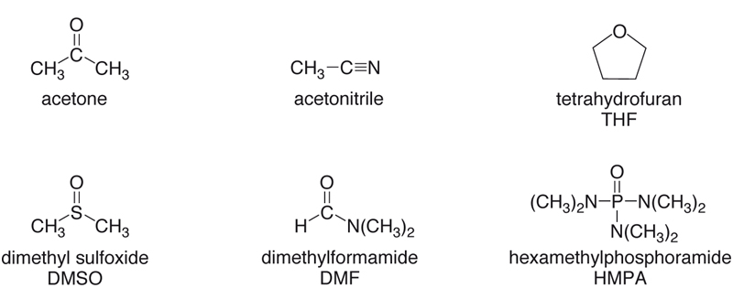
Polar aprotic solvents also exhibit dipole—dipole interactions, but they have no O—H or N—H bonds. Thus, they are incapable of hydrogen bonding.
Figure 7.7
Examples of polar
aprotic solvents

Slide 24
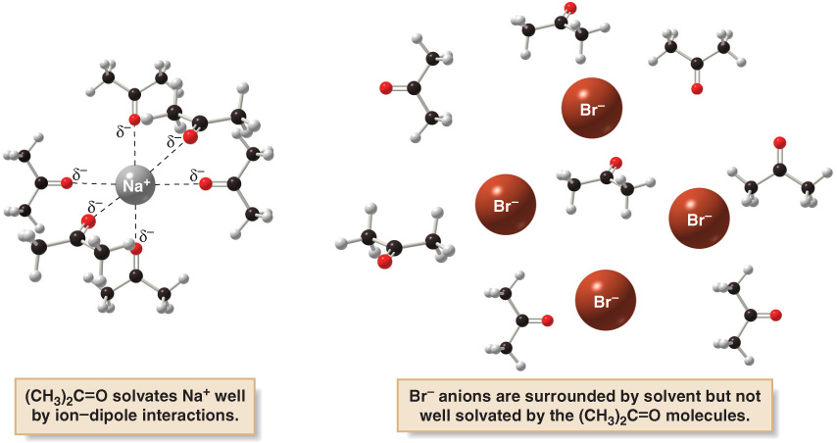
Polar aprotic solvents solvate cations by ion—dipole interactions.
Anions are not well solvated because the solvent cannot hydrogen bond to them. These anions are said to be “naked”.

Slide 25
In polar aprotic solvents, nucleophilicity parallels basicity, and the stronger base is the stronger nucleophile.
Because basicity decreases as size increases down a column, nucleophilicity decreases as well.

Slide 26
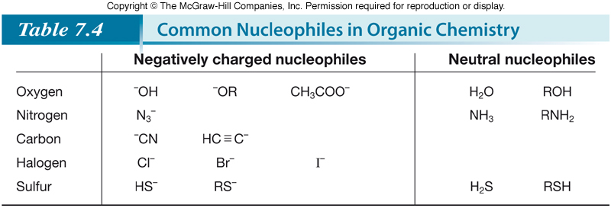

Slide 27
Mechanisms of Nucleophilic Substitution
In a nucleophilic substitution:
But what is the order of bond making and bond breaking? In theory, there are three possibilities.
[1] Bond making and bond breaking occur at the same time.
In this scenario, the mechanism is comprised of one step. In such a bimolecular reaction, the rate depends upon the concentration of both reactants, that is, the rate equation is second order.

Slide 28
[2] Bond breaking occurs before bond making.
In this scenario, the mechanism has two steps and a carbocation is formed as an intermediate. Because the first step is rate-determining, the rate depends on the concentration of RX only; that is, the rate equation is first order.

Slide 29
[3] Bond making occurs before bond breaking.
This mechanism has an inherent problem. The intermediate generated in the first step has 10 electrons around carbon, violating the octet rule. Because two other mechanistic possibilities do not violate a fundamental rule, this last possibility can be disregarded.

Slide 30
Consider reaction [1] below:
Kinetic data show that the rate of reaction [1] depends on the concentration of both reactants, which suggests a bimolecular reaction with a one-step mechanism. This is an example of an S_{N}2 (substitution nucleophilic bimolecular) mechanism.

Slide 31
Consider reaction [2] below:
Kinetic data show that the rate of reaction [2] depends on the concentration of only the alkyl halide. This suggests a two-step mechanism in which the rate-determining step involves the alkyl halide only. This is an example of an S_{N}1 (substitution nucleophilic unimolecular) mechanism.

Slide 32
The mechanism of an S_{N}2 reaction would be drawn as follows. Note the curved arrow notation that is used to show the flow of electrons.

Slide 33
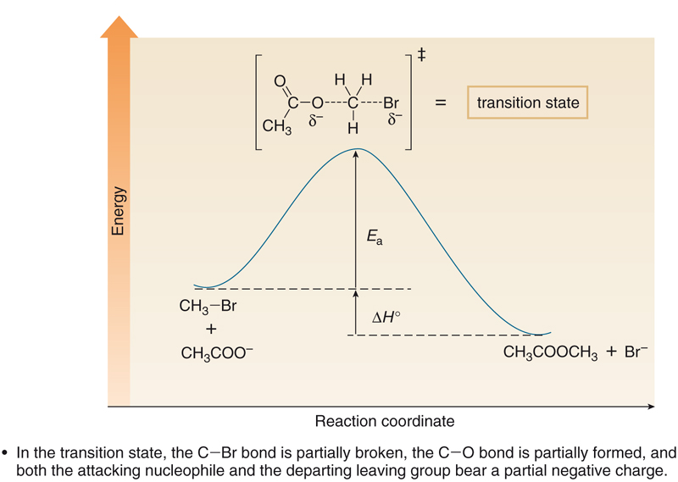
Figure.8
An energy diagram for the S_{N}2 reaction:

Slide 34
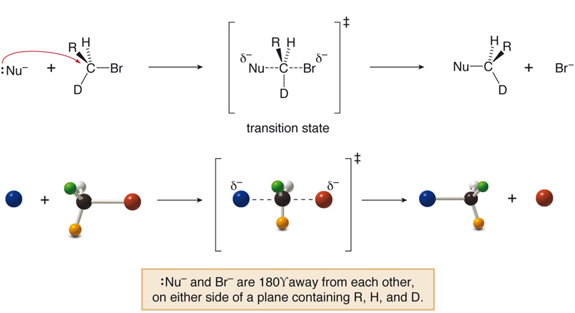
Stereochemistry
All S_{N}2 reactions proceed with backside attack of the nucleophile, resulting in inversion of configuration at a stereogenic center.
Figure 9
Stereochemistry of
the S_{N}2 reaction

Slide 35
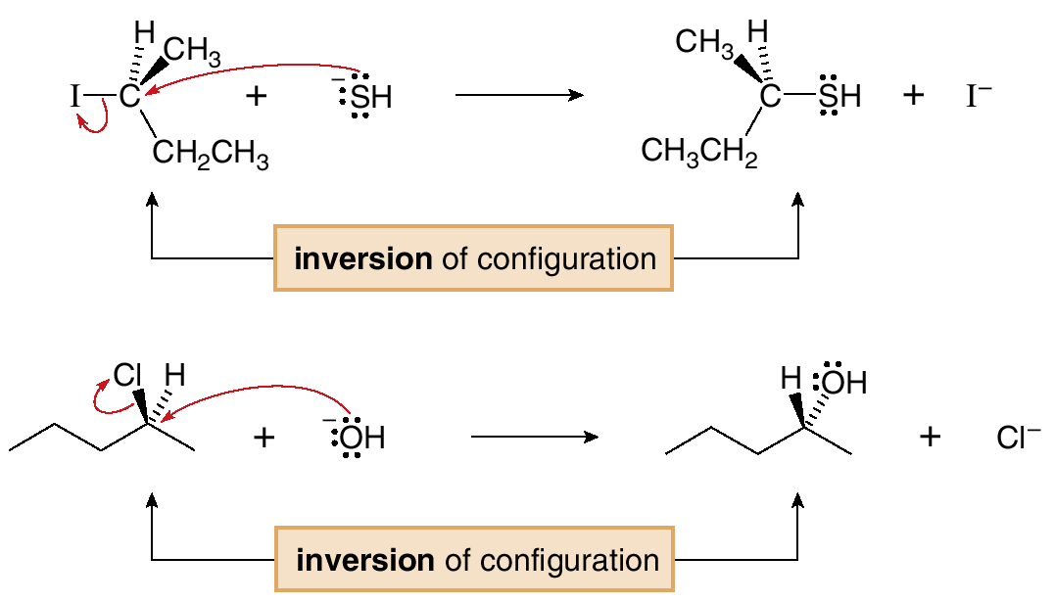
Figure 10
Two examples of inversion
of configuration in
the S_{N}2 reaction

Slide 36
Methyl and 1° alkyl halides undergo S_{N}2 reactions with ease.
2° Alkyl halides react more slowly.
3° Alkyl halides do not undergo S_{N}2 reactions. This order of reactivity can be explained by steric effects. Steric hindrance caused by bulky R groups makes nucleophilic attack from the backside more difficult, slowing the reaction rate.

Slide 37
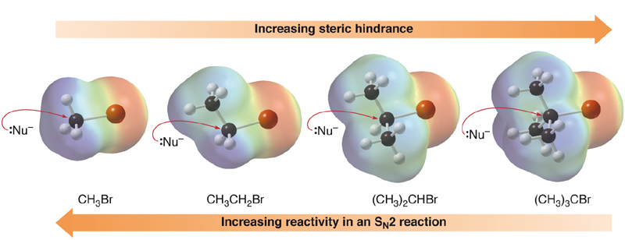
Electrostatic potential maps illustrate the effects of steric hindrance around the carbon bearing the leaving group in a series of alkyl halides.
Figure 7.11
Steric effects in the S_{N}2 reaction

Slide 38
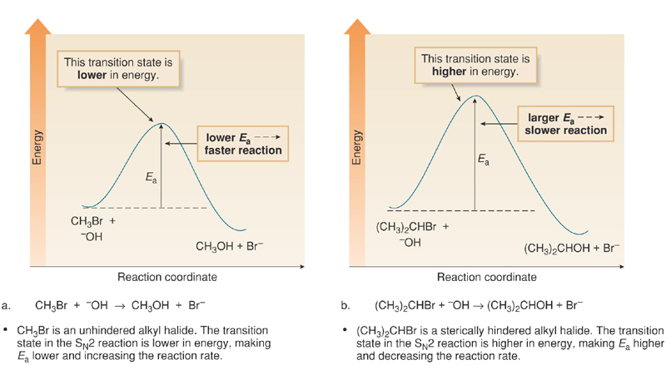
The higher the E_{a}, the slower the reaction rate. Thus, any factor that increases E_{a} decreases the reaction rate.

Slide 39
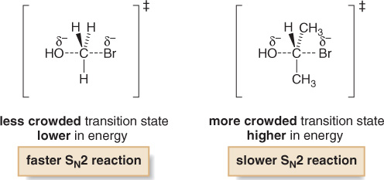
Increasing the number of R groups on the carbon with the leaving group increases crowding in the transition state, thereby decreasing the reaction rate.
The S_{N}2 reaction is fastest with unhindered halides.

Slide 41
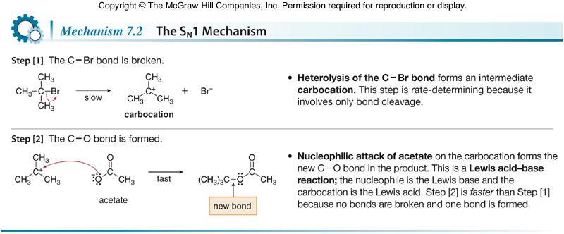
The mechanism of an S_{N}1 reaction would be drawn as follows: Note the curved arrow formalism that is used to show the flow of electrons.
Key features of the S_{N}1 mechanism are that it has two steps, and carbocations are formed as reactive intermediates.

Slide 42
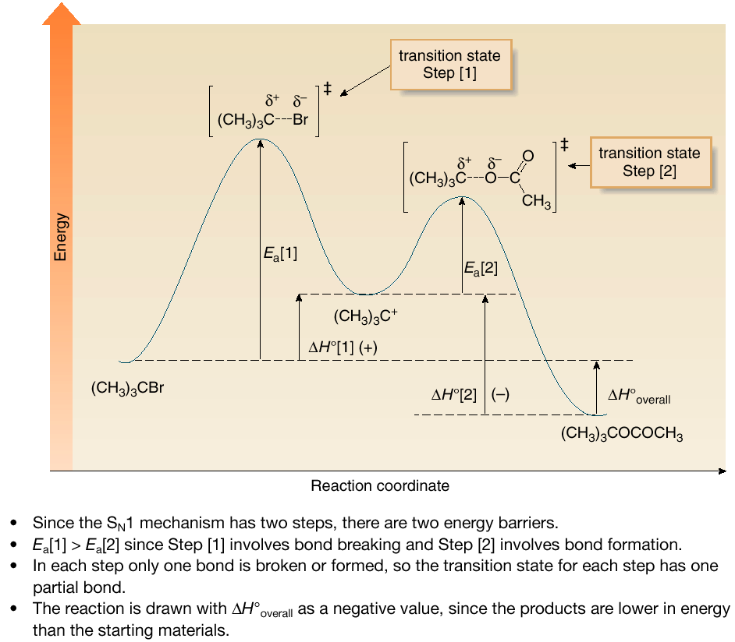
Figure 7.15
An energy diagram
for the S_{N}1 reaction:

Slide 43
Stereochemistry
To understand the stereochemistry of the S_{N}1 reaction, we must examine the geometry of the carbocation intermediate.

Slide 44
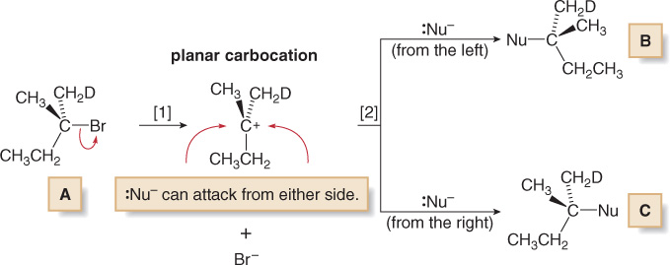
Loss of the leaving group in Step [1] generates a planar carbocation that is achiral. In Step [2], attack of the nucleophile can occur on either side to afford two products which are a pair of enantiomers.
Because there is no preference for nucleophilic attack from either direction, an equal amount of the two enantiomers is formed—a racemic mixture. We say that racemization has occurred.

Slide 45
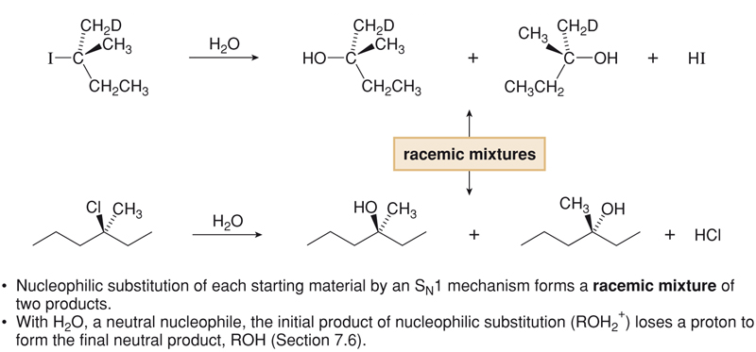
Figure 7.16
Two examples of racemization
in the S_{N}1 reaction

Slide 46
The rate of an S_{N}1 reaction is affected by the type of alkyl halide involved.
This trend is exactly opposite to that observed in S_{N}2 reactions.

Slide 48
Carbocation Stability
The effect of the type of alkyl halide on S_{N}1 reaction rates can be explained by considering carbocation stability.
Carbocations are classified as primary (1°), secondary (2°), or tertiary (3°), based on the number of R groups bonded to the charged carbon atom. As the number of R groups increases, carbocation stability increases.

Slide 49
The order of carbocation stability can be rationalized through inductive effects and hyperconjugation.
Inductive effects are electronic effects that occur through σ bonds. Specifically, the inductive effect is the pull of electron density through σ bonds caused by electronegativity differences between atoms.
Alkyl groups are electron donating groups that stabilize a positive charge. Since an alkyl group has several σ bonds, each containing electron density, it is more polarizable than a hydrogen atom, and better able to donate electron density.
In general, the greater the number of alkyl groups attached to a carbon with a positive charge, the more stable will be the cation.

Slide 50
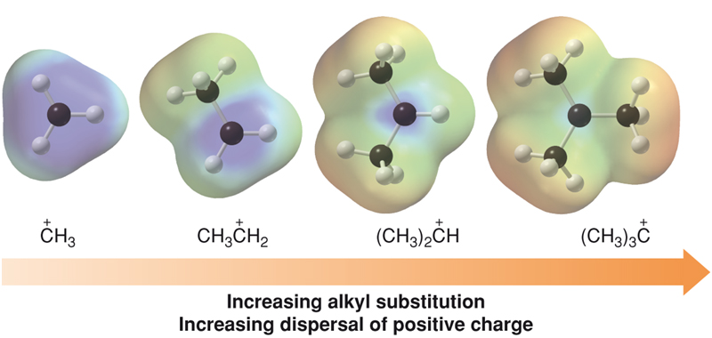
Figure 7.17
Electrostatic potential maps for
differerent carbocations

Slide 51
The order of carbocation stability is also a consequence of hyperconjugation.
Hyperconjugation is the spreading out of charge by the overlap of an empty p orbital with an adjacent σ bond. This overlap (hyperconjugation) delocalizes the positive charge on the carbocation, spreading it over a larger volume, and this stabilizes the carbocation.
Example: CH₃⁺ cannot be stabilized by hyperconjugation, but (CH₃)₂CH⁺ can.

Slide 52
The Hammond Postulate

Slide 53
The Hammond postulate relates reaction rate to stability. It provides a quantitative estimate of the energy of a transition state.
The Hammond postulate states that the transition state of a reaction resembles the structure of the species (reactant or product) to which it is closer in energy.

Slide 55
In an endothermic reaction, the transition state resembles the products more than the reactants, so anything that stabilizes the product stabilizes the transition state also. Thus, lowering the energy of the transition state decreases E_{a}, which increases the reaction rate.
If there are two possible products in an endothermic reaction, but one is more stable than the other, the transition state that leads to the formation of the more stable product is lower in energy, so this reaction should occur faster.

Slide 56
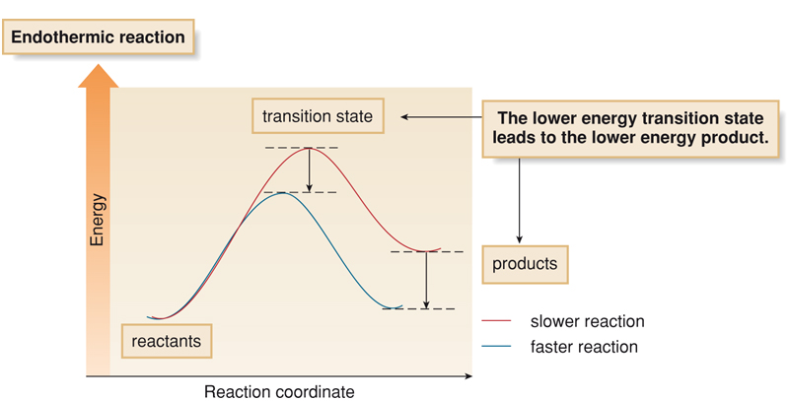
Figure 7.18
An endothermic reaction—How
the energy of the transition
state and products are related

Slide 57
In the case of an exothermic reaction, the transition state resembles the reactants more than the products. Thus, lowering the energy of the products has little or no effect on the energy of the transition state.
Since E_{a} is unaffected, the reaction rate is unaffected.
The conclusion is that in an exothermic reaction, the more stable product may or may not form faster, since E_{a} is similar for both products.

Slide 58
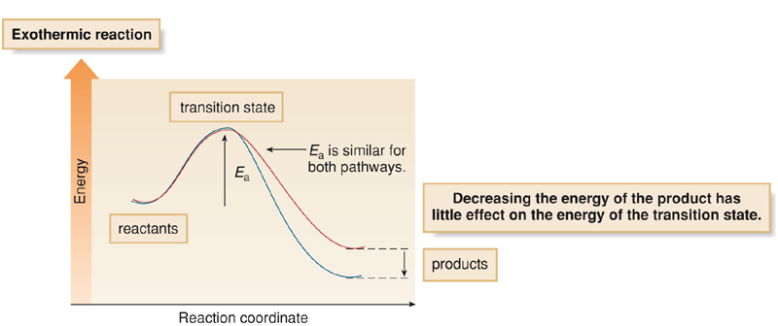
Figure 7.19
An exothermic
reaction—How
the energy of the
transition state and
products are related

Slide 59
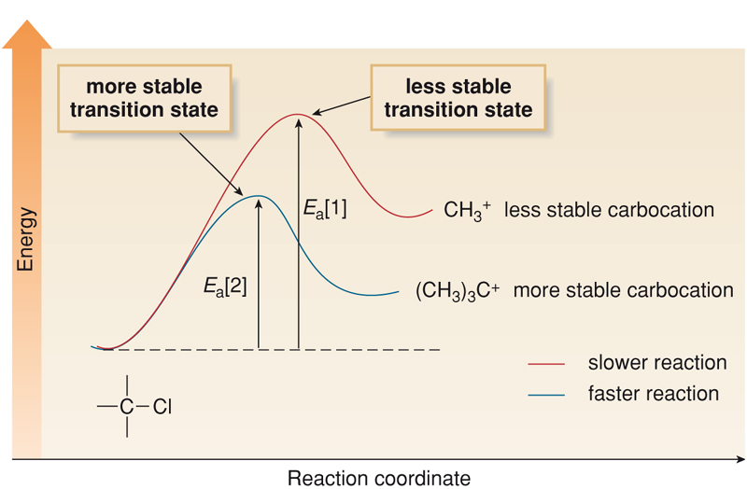
The Hammond postulate estimates the relative energy of transition states, and thus it can be used to predict the relative rates of two reactions.
According to the Hammond postulate, the stability of the carbocation determines the rate of its formation.
Figure 7.20
Energy diagram for carbocation
formation in two different
S_{N}1 reactions

Slide 60
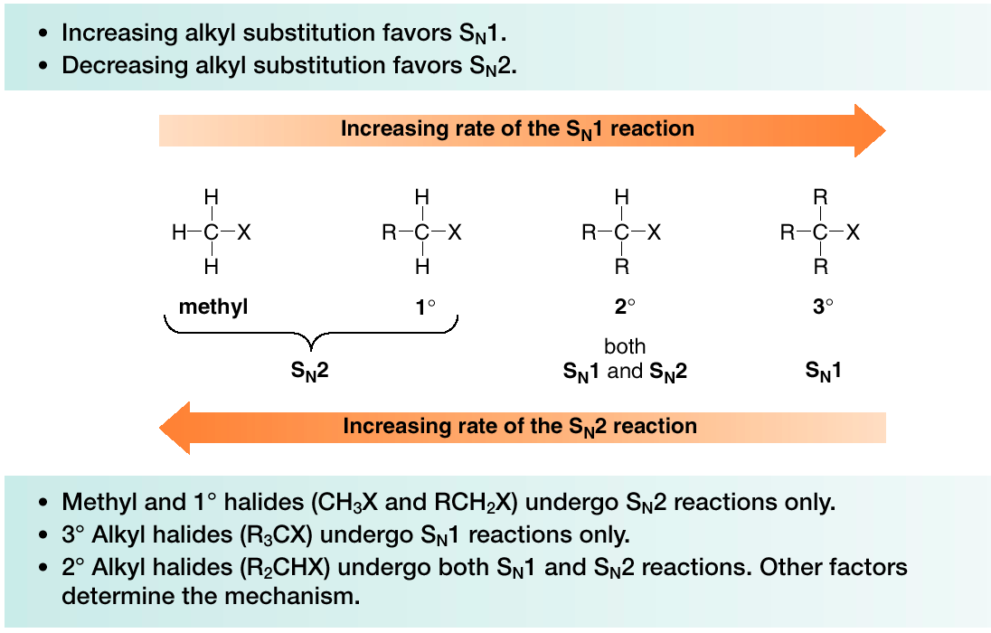
Predicting the Likely Mechanism of a Substitution Reaction.
Four factors are relevant in predicting whether a given reaction is likely to proceed by an S_{N}1 or an S_{N}2 reaction—The most important is the identity of the alkyl halide.

Slide 61
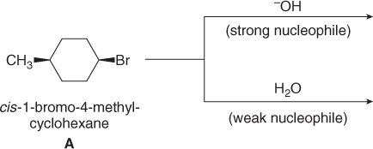
The nature of the nucleophile is another factor.
Strong nucleophiles (which usually bear a negative charge) present in high concentrations favor S_{N}2 reactions.
Weak nucleophiles, such as H₂O and ROH favor S_{N}1 reactions by decreasing the rate of any competing S_{N}2 reaction.
Let us compare the substitution products formed when the 2° alkyl halide A is treated with either the strong nucleophile HO¯ or the weak nucleophile H₂O. Because a 2° alkyl halide can react by either mechanism, the strength of the nucleophile determines which mechanism takes place.

Slide 62
The strong nucleophile favors an S_{N}2 mechanism.
The weak nucleophile favors an S_{N}1 mechanism.

Slide 63
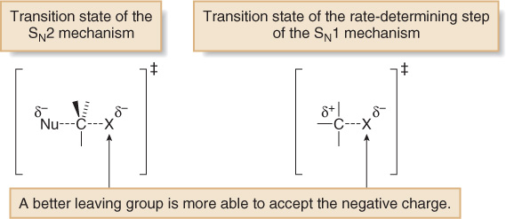
A better leaving group increases the rate of both S_{N}1 and S_{N}2 reactions.

Slide 64
The nature of the solvent is a fourth factor.
Polar protic solvents like H₂O and ROH favor S_{N}1 reactions because the ionic intermediates (both cations and anions) are stabilized by solvation.
Polar aprotic solvents favor S_{N}2 reactions because nucleophiles are not well solvated, and therefore, are more nucleophilic.

Slide 65
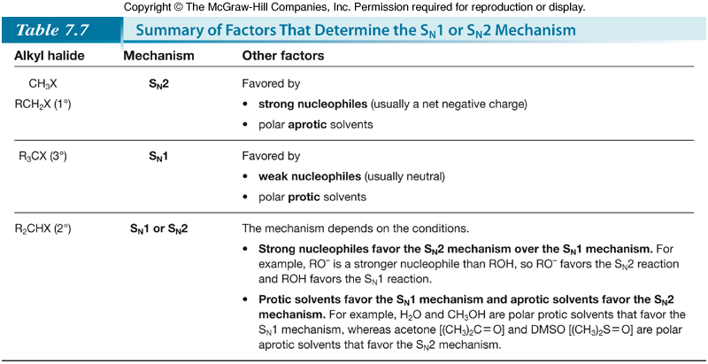

Slide 66
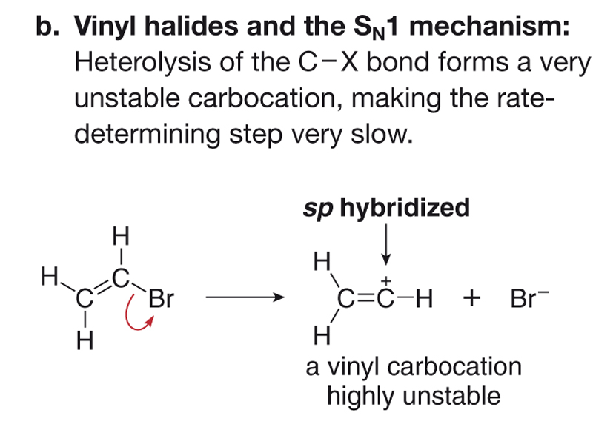
Vinyl Halides and Aryl Halides.
Vinyl and aryl halides do not undergo S_{N}1 or S_{N}2 reactions, because heterolysis of the C—X bond would form a highly unstable vinyl or aryl cation.
Figure 7.22
Vinyl halides and nucleophilic
substitution mechanisms

Slide 67
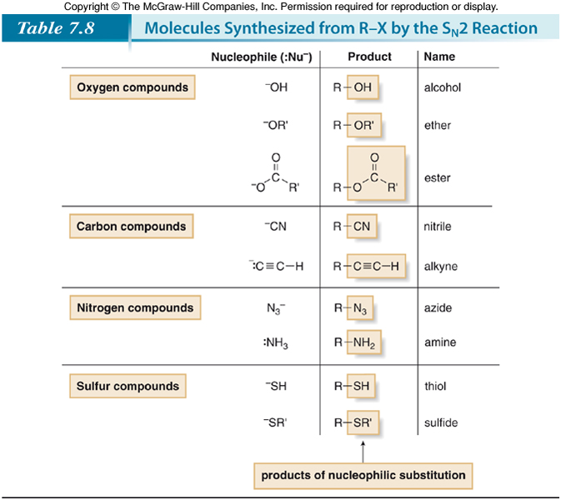
Alkyl Halides and Nucleophilic Substitution

Slide 68
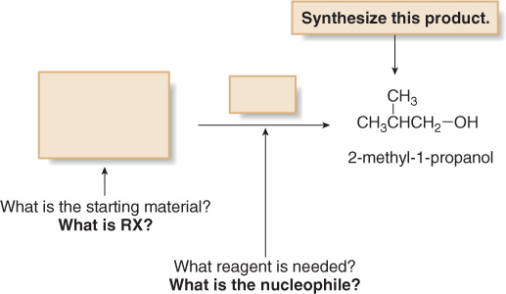
Nucleophilic Substitution and Organic Synthesis.
To carry out the synthesis of a particular compound, we must think backwards, and ask ourselves the question: What starting material and reagents are needed to make it?
If we are using nucleophilic substitution, we must determine what alkyl halide and what nucleophile can be used to form a specific product.

Slide 69
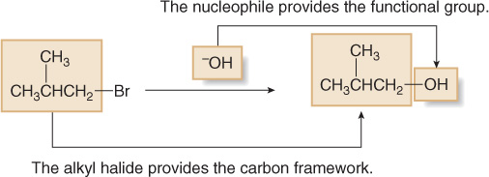
To determine the two components needed for synthesis, remember that the carbon atoms come from the organic starting material, in this case, a 1° alkyl halide. The functional group comes from the nucleophile, HO¯ in this case. With these two components, we can “fill in the boxes” to complete the synthesis.

