Slide 1
Gametogenesis
Lecture 3
Prof Dr. Hekmat El-Gammal
2018

Slide 2
Lecture Objectives
On completion of this lecture, students will be able to:
Define the origin of primordial germ cells.
Understand common path of gametogenesis.
List the stages of spermatogenesis.
Describe the events during spermiogenesis.
Describe the structure of spermatozoon.

Slide 3
Definition of Gametogenesis
Gametogenesis is the production of gametes in animals of all kinds involves the transformation of what appear to be ordinary epithelial cells into highly differentiated sex cells, each prepared to mate with a cell of opposite type to form a new individual.
Gamete maturation is called spermatogenesis in males and oogenesis in females.
The sequence of gametogenesis is the same, but the timing of events during meiosis differs in the two sexes.
The essential event in this conversion, in both males and females, is a reduction in the amount of chromatin present, so that the finished gamete contains only half as many chromosomes as all other cells of the body.

Slide 4
The Origin of Primordial Germ Cells
Initially, gametes are derived from the primordial germ cells (PGCs), which enter the embryonic gonads (known as genital ridge) during embryonic development.
PGCs may arise at some distance from the presumptive gonads, to which they migrate and become established.
The formation of the germ line is dependent upon the presence of the germ plasm, in PGCs, which is a cytoplasmic component that causes these cells to become distinct from the somatic cells.
Germ plasm can be identified morphologically by the presence of conspicuous membrane-unbound organelles with an electron-dense granulofibrillar appearance called germ granules.

Slide 5
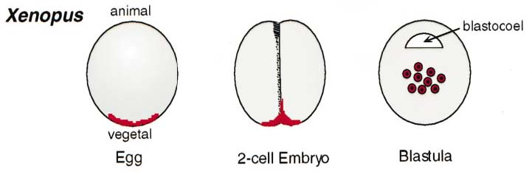
Localization of PGCs in Some Vertebrates
Xenopus PGCs are localized to the vegetal pole of the mature egg.
It is partitioned equally between the first four blastomeres and ingresses along the cleavage planes.
At the blastula stage, germinal plasm is found in about 20 cells that are positioned near the floor of the blastocoel (Fig. 12).

Slide 6
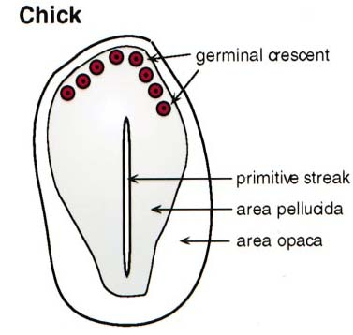
Chick PGCs are first detected at the blastodisc stage.
They are mostly found in a region called the germinal crescent that is positioned anteriorly to the embryo proper (Fig. 13).

Slide 7
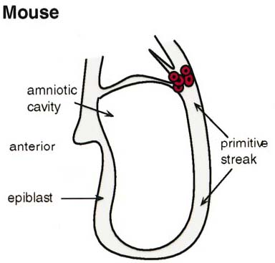
Mouse PGCs can be visualized at around day 7.5 post fertilization.
They are found in the area of the epiblast that is proximal to the primitive streak (Fig. 14).

Slide 8
Mammalian PGCs Migration
Mammalian PGCs lie in close proximity to the hindgut and are embedded in the endodermal gut wall as it forms.
PGCs then actively migrate through the gut epithelial layer (Fig. 15).
They develop large pseudopodia that scan in various directions until finding large intercellular spaces in the epithelial wall.
Having left the gut wall, the mammalian PGCs also travel up into the dorsal mesentery, which connects the developing gut to the dorsal body wall.

Slide 9
PGCs then split into two groups that migrate laterally to arrive to the somatic gonadal primordia (or genital ridges), which develop on either side of the dorsal aorta.
The steps of PGC migration in Xenopus closely resemble those described for mammalian PGCs.
  When the PGCs become established in the gonad, they become stem cells that divide by mitosis to produce the supply of gametes that the organism requires for reproduction.
  When they enter the gonads, the germ cells may associate with specific somatic cells that support, nurture and protect them.
  In the female, these somatic cells are called follicle cells.
  In the male they are called Sertoli cells.

Slide 11
Common Path of Gametogenesis
The entire path can be broken up into several distinct stages, which are: multiplication, growth and maturation, each corresponding to a particular type of cell.
Primordial germ cells (PGCs) multiply by mitosis and once they have reached the gonadal ridge they are called gametogonia.
Gametogonia divide with mitotic division and give rise to primary gametocyte, which divide with meiotic division to give secondary gametocyte, gametid and finally gamete.

Slide 12
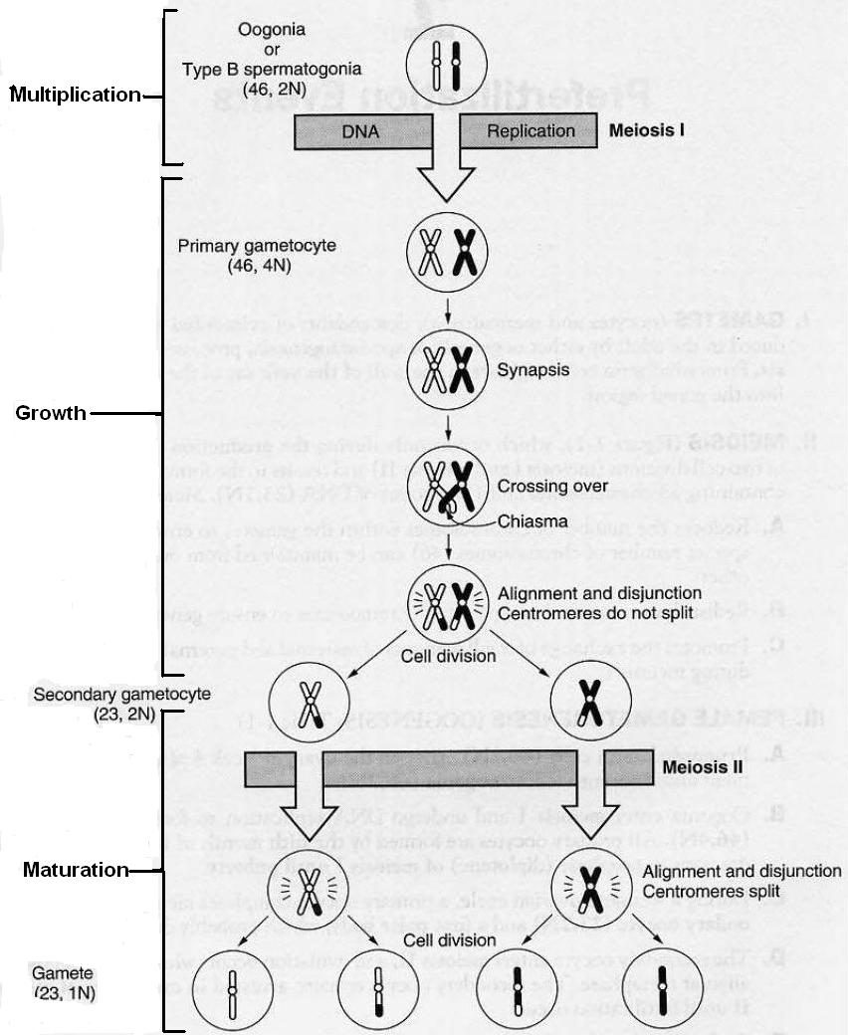

Slide 13
From gametogonia, male and female gametes develop differently. However, by convention, the following pattern is common for both:
Stages | Cell type | Ploidy/chromosomes | Chromatids | Process
Multiplication | gametogonium | diploid/46 | 2N | gametocytogenesis (mitosis)
Growth | primary gametocyte | diploid/46 | 4N | gametidogenesis (meiosis I)
 | secondary gametocyte | haploid/23 | 2N | gametidogenesis (meiosis II)
Maturation | gametid | haploid/23 | 1N | maturation
 | gamete | haploid/23 | 1N

Slide 14
Spermatogenesis
Spermatogenesis is a process by which spermatozoa are formed from spermatogonial stem cells during adult's reproductive phase.
Spermatogenesis takes place within several structures of the male reproductive system.
The initial stages occur within the testes and progress to the epididymis where the developing gametes mature and are stored until ejaculation.

Slide 15
Organization of the Vertebrate Testes
The testes are the primary organs of reproduction in males, just as ovaries are primary organs of reproduction in females.
Testes are considered primary because they produce male gametes (spermatozoa) and male sex hormones (androgens).
Testes differ from ovaries in that all potential gametes are not present at birth.
Germ cells, located in the seminiferous tubules, undergo continual cell divisions, forming new spermatozoa throughout the normal reproductive life of the male.

Slide 16
In all species testes are covered with the tunica vaginalis, a serous tissue, which is an extension of the peritoneum.
This serous coat is obtained as the testes descend into the scrotum and is attached along the line of the epididymis.
The outer layer of the testes, the tunica albuginea testis, is a thin white memberane of elastic connective tissue.
Numberous blood vessels are visible just under its surface.
Beneath the tunica albuginea testis is the parenchyma, the functional layer of the testes.

Slide 17
The parenchyma has a yellowish color and is divided into segments (in mammals), or cysts (in fishes, amphibian) by incomplete septa of connective tissue.
Thin septula testis) divide the parenchyma of the testis in about 370 conical lobules in human.
The lobules consist of the seminiferous tubules and intertubular tissue, containing groups of endocrine Leydig cells and additional cellular elements
Located within these segments of parenchyma tissue are the seminiferous tubules.

Slide 18
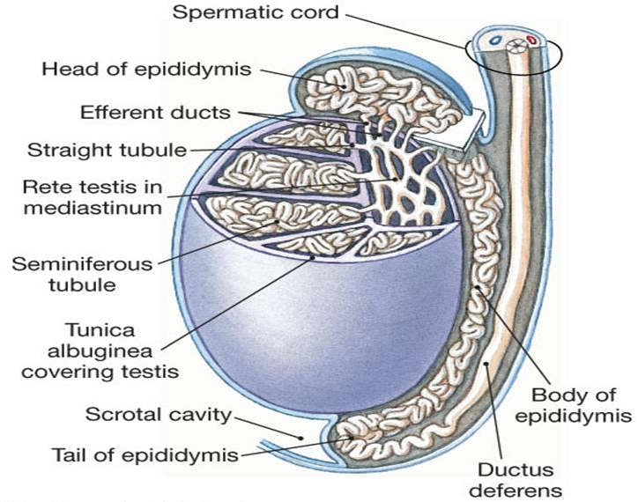

Slide 19
Structure of Seminiferous Tubules
Seminiferous tubules are small, convoluted tubules approxilately 200µ in diameter.
It has been estimated that the seminiferous tubules from a pair of bull testes, stretched out and laid end, approach 5 km in length.
Seminiferous tubules join a network of tubules, the rete testis, which connects to 12 to 15 small ducts, the vasa efferentia, which converge into the head of the epididymis.
Seminiferous tubules are surrounded by several layers of collagen and elastic fibers, myoid cells, fibroblast, flattened cells and Lyedig cells.
A stratified germinal epithelium lines each tubule and rests on a prominent basement membrane (Fig.18).

Slide 21
The process spermatogenesis occurs within the germinal epithelium of the seminiferous tubules during puberty.
Spermatogenesis is controlled by follicle-stimulating hormone (FSH), a gonadotropin produced by the pars distalis of the pituitary gland.
In adult mammals, the seminiferous tubules are lined by a complex stratified epithelium composed of two major categories of cells, supporting cells (Sertoli cells) and spermatogenic cells.
The spermatogenic cells include severed morphologically defined cell types:
spermatogonia, primary spermatocytes, secondary spermatocytes, spermatids and spermatozoa.

Slide 22
Sertoli cells are closely linked by tight and gap junctions from puberty onwards.
This structure is known as the 'blood-testis barrier', which represents a tight diffusion barrier dividing the testis into two functional compartments (basal and adluminal) within each seminiferous tubules.
Sertoli cells, the only cell type extending into two compartments have the important role of coordinating the secretion of signaling factors into tubular compartments.
Several types of spermatogonia are distinguished by their position in the basal compartment (Fig.19).

Slide 23
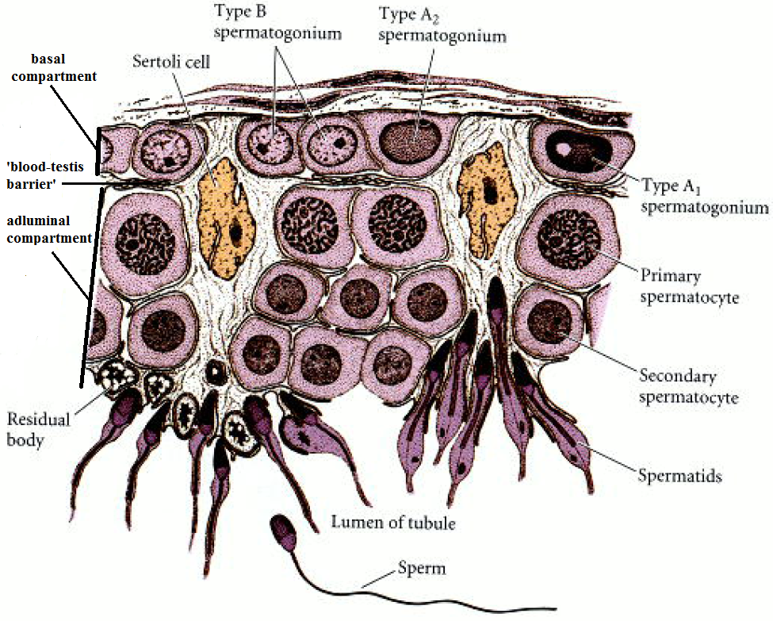

Slide 24
Meiosis of spermatocytes starts with the leptotene stage of prophase already in the basal compartment of the germinal epithelium.
After passing the Sertoli cell barrier, spermatocytes reach the adluminal compartment and continue with the further prophase stages, namely the zygotene stage, the pachytene and the diplotene stage.

Slide 25
Sertoli Cells (sustentacular cells).
These are large, tall, irregularly shaped cells extending from the basement membrane to the lumen of the tubule.
They are scattered among the more numerous germinal cells.
The nucleus usually lies at the base of the cell, near the basement membrane.
It is a large, pale, ovoid or irregularly shaped structure containing a prominently stained nucleolus.
Unlike the germinal cells, Sertoli cells apparently do not divide in the adult testis.

Slide 26
Role of Sertoli Cells
At all stages of differentiation, the spermatogenic cells are in close contact with Sertoli cells which are thought to provide structural and metabolic support to the developing sperm cells.
Sertoli cells serve a number of functions during spermatogenesis, they support the developing gametes in the following ways:
Maintain the environment necessary for development and maturation via the blood-testis barrier. This barrier prevents large macromolecules from being exchanged between the blood and upper epithelium of the seminiferous tubules.

Slide 27
Secrete substances initiating meiosis.
Secrete supporting testicular fluid.
Secrete androgen-binding protein, which concentrates testosterone in close proximity to the developing gametes.
Secrete hormones effecting pituitary gland control of spermatogenesis, particularly the polypeptide hormone, inhibin.
Phagocytose residual cytoplasm left over from spermiogenesis.
They release anti-Mulerian factor, which prevents formation of the Mulerian duct / oviduct.
The Sertoli cells may regulate the release of mature sperm into the lumen of the seminiferous tubule.

Slide 28
Sertoli cells divide during the prepuberal period until the blood testis barrier is established.
Sertoli cells coordinate germ cell proliferation and development, and determine adult testis size and sperm production.
The evidence for production of sperm cells is compelling since under normal and pathological conditions, the number of Sertoli cells is correlated precisely with the number of sperm produced.
Sertoli cell secretion is influenced by the type of germ cells, which are present in the seminiferous epithelium.

Slide 29
Leydig (interstitial) Cells
Leydig (interstitial) cells are found in the parenchyma of the testes between the seminiferous tubules.
LH timulates Leydig cells to produce testosterone and small quantities of the androgens and are also capable of producing estradiol.
Recent investigations elucidated that the Leydig cells possess neuroendocrine properties in addition to their endocrine functions.
There is evidence that Leydig cells express serotonin, catecholamine synthesizing enzymes, different antigens characteristic for nerve cells as well as neurohormones and their receptors, neuropeptides, cell adhesion molecules, components of the NO/cGMP-system, components of the renin/angiotensin system, neurofilament proteins, synaptic and storage vesicle proteins, and numerous growth factors and their receptors.

Slide 30
Furthermore, Leydig cells possess antigens characteristic for glial cells such as astrocytes, oliogodendrocytes and Schwann cells.
All these features characterize the Leydig cells as non-dividing, post-mitotic neuroendocrine cells with pluripotent properties.
Some of the neural antigens are involved in autocrine and/or paracrine regulation mechanisms of the testes such as testosterone production and release, maintaining of the hypothalamo-hypophyseal-gonadal axis.

Slide 31
The local communication between the somatic cells of the organ (Leydig cells, peritubular cells, Sertoli cells), the regulation of blood flow in the testicular blood vessels and the permeability of hormones and nutritive substances, as well as the contractility of seminiferous tubules and of the testicular capsule (tunica albuginea).
Other substances discovered are seemingly rudiments that have been active during testis morphogenesis.
The Leydig cells now are considered a part of the general neuroendocrine cell system.

Slide 32
Stages of Spermatogenesis
The entire process can be broken up into several distinct stages, which are: multiplication, growth and maturation, each corresponding to a particular type of cell:
Stages | Cell type | Ploidy/chromosomes | Chromatids | Process
Multiplication | Spermatogonium (types A and B) | diploid/46 | 2N | Spermatocytogenesis (mitosis)
Growth Maturation | Primary Spermatocyte | diploid/46 | 4N | Spermatidogenesis (meiosis I)
 | Secondary Spermatocyte | haploid/23 | 2N | Spermatidogenesis (meiosis II)
 | Spermatid | haploid/23 | 1N | Spermiogenesis
 | Spermatozoon | haploid/23 | 1N | Spermiation

Slide 33
Multiplication or Spermatocytogenesis
Spermatogonia
After reaching the genital ridge, the PGCs divide to form type A1 spermatogonia.
The A1 spermatogonia are found adjacent to the outer basement membrane of the sex cords.
They are stem cells, and at maturity, they are thought to divide so as to make another type of spermatogonium, a paler type of cell called A2 spermatogonium.
Thus, each type A1 spermatogonium is a stem cell capable of regenerating itself as well as producing a new cell type.

Slide 34
A2 spermatogonia divide to produce the A3 spermatogonia, which then beget the type A4 spermatogonia.
It is possible that each of the type A spermatogonia are stem cells, capable of self-renewal.
The A4 spermatogonium has three options:
it can form another A4 spermatogonium (self-renewal);
it can undergo cell death (apoptosis); or
it can differentiate into the first committed stem cell type, the intermediate spermatogonium (Fig. 20).

Slide 36
Intermediate spermatogonia are committed to
becoming spermatozoa, and they divide mitotically once to form the type B spermatogonia.
These cells are the precursors of the spermatocytes and are the last cells of the line that undergo mitosis.
They divide once to generate the primary spermatocytes- the cells that enter meiosis.

Slide 37
Growth
A diploid spermatogonium divides mitotically to produce a diploid intermediate cell called a primary spermatocyte. Which lie above the spermatogonia and are closer to the lumen. They are large cells and their nuclei occupy most of the cytoplasm.
Each primary spermatocyte duplicates its DNA and subsequently undergoes meiosis I to produce two haploid secondary spermatocytes.
This division implicates sources of genetic variation, such as random inclusion of either parental chromosomes, or chromosomal crossover, to increase the genetic variability of the gamete.
Secondary spermatocytes lie above the primary spermatocytes.

Slide 38
They are about the size of spermatogonia and therefore are much smaller than the primary spermatocytes.
Note: Each cell division from a spermatogonium to a spermatid is incomplete; the cells remain connected to one another by bridges of cytoplasm to allow synchronous development.
It should also be noted that not all spermatogonia divide to produce spermatocytes, otherwise the supply would run out.
Instead, certain types of spermatogonia divide to produce copies of themselves, thereby ensuring a constant supply of gametogonia to fuel spermatogenesis.

Slide 39
Maturation or Spermatidogenesis
Spermatidogenesis is the creation of spermatids from secondary spermatocytes.
Secondary spermatocytes produced earlier rapidly enter meiosis II and divide to produce haploid spermatids.
The spermatids usually lie near the lumen of the seminiferous tubule.
The spermatids do not divide but undergo metamorphic transformations, spermiogenesis, where they transform into mature spermatozoa.

Slide 40
Spermiogenesis
Spermiogenesis is the creation of spermatozoa from the spermatids.
Events During Spermiogenesis
The major events during spermiogenesis are:
chromatin condensation or nuclear changes.
morphological or cytoplasmic changes.

Slide 41
Chromatin Condensation
Helps to streamline the cell by reducing volume,
It also may serve a protective function,
Reducing the susceptibility of the DNA to mutation or physical damage.
Condensation is facilitated by formation of specific DNA-protein complexes.
Proteins that may be involved include protamines (small, highly basic, arginine-rich proteins), histone-like proteins or other sperm-specific proteins.

Slide 42
Replacement may be gradual, with somatic histones being replaced by sperm-specific proteins, or it may involve discrete steps in which transitional proteins interact with the DNA after the histones are removed and before the protamines are added
In salmonid fishes, somatic histones become hyperacetylated or undergo similar modifications that reduce the binding between the histones and DNA

Slide 43
In mammals, somatic histones are removed by. protease digestion
Remodeling of the chromatin in mammals is a two-step process.
In the first step, the histones are replaced by small, highly basic transition proteins. This eliminates nucleosomes and stops transcription.
The replacement of the transition proteins with protamines stabilizes and further compacts the chromatin via the formation of disulfide cross-bridges.
The replacement of histones by sperm-specific proteins results in a termination of transcription. This has important consequences for gene expression during spermiogenesis.
In mammals and birds, some transcription has been detected after meiosis.
It is a generalized phenomenon that spermatids lack transcription.

Slide 44
Morphological Changes resulted in the transformation from spherical shaped spermatid into elongated sperm cell.
These morphological changes begin with the arrangement of Golgi apparatus at the anterior pole of spermatid cell and development of Golgi vacuole which contain Golgi granule.
At the opposite pole the mitochondria are arranged around the axial filament (Fig. 21) which originate at the periphery of the cell and migrated to this position with the newly divided centrioles.
After that the cytoplasm is streamed backward left a thin sheath around the nucleus and the developing flagellum.

Slide 45
Golgi vacuole and granule are modified to acrosome, which has an outer membrane close to the plasma membrane and inner membrane close with nuclear membrane.
Maturation then takes place, which removes the remaining unnecessary cytoplasm and organelles.
The excess cytoplasm, known as residual bodies, is phagocytosed by surrounding Sertoli cells in the testes.

Slide 46
The resulting spermatozoa are now mature but lack motility, rendering them sterile.
The mature spermatozoa are released from the protective Sertoli cells into the lumen of the seminiferous tubule in a process called spermiation.
The non-motile spermatozoa are transported to the epididymis in testicular fluid secreted by the Sertoli cells with the aid of peristaltic contraction.
Whilst in the epididymis they acquire motility and become capable of fertilisation.

Slide 47
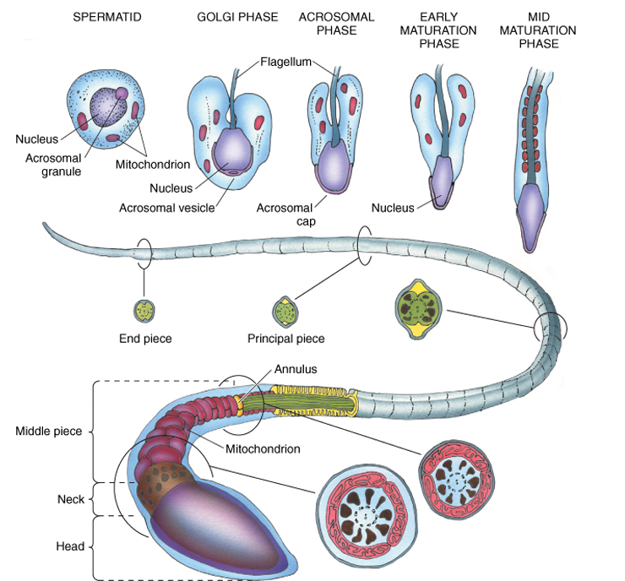

Slide 48
Sperm or Spermatozoon Structure
Sperm come in a variety of shapes and sizes.
The most elaborate sperm are found in species with internal fertilization.
The primary components of typical sperm are the head (nucleus, acrosome), neck and tail or flagellum. We shall now examine mammalian sperm structure in detail.
Nucleus contain the haploid number of chromosome which transmitted to the offspring

Slide 49
The acrosome contains hydrolytic enzymes, which are released from the sperm during the acrosome reaction.
This occurs in the immediate vicinity of the egg and causes the sperm plasma membrane and the outer acrosomal membrane to vesiculate and be shed, thus releasing the enzymes.
The posterior portion of the acrosome is the equatorial segment, which remains intact during the acrosome reaction and is the site of initial contact between the sperm and egg at fertilization.

Slide 50
The neck is the connecting piece between the head and tail; it contains two centrioles.
The two centrioles of the spermatid’s centrosome position themselves at the posterior pole of the sperm nucleus.
One of the two centrioles acts as a microtubule-organizing center (MTOC), providing the microtubular core of the sperm tail (flagellum), while the other centriole persists as the centriole of the spermatozoon, destined to play an important role after fertilization.

Slide 51
The middle piece contains dense longitudinal fibers which surround the axoneme and also contribute to motor functions.
A helix of mitrochondria, lying end to end, forms a sheath just outside the longitudinal fibers and supplies the sperm with energy-rich ATP molecules.
At the lower end of the middle piece there is a ring of dense material, the annulus, which is fused to the plasma membrane.
It forms a boundary between the middle and principal pieces Figure 21.

Slide 52
The tail contains the motor apparatus of the sperm.
It is divided into principal piece, and a terminal end piece.
The principal piece is a circumferential sheath of dense fibrils surrounding the axoneme.
In addition, the longitudinal fibrils from the middle piece also extend into the principal piece.

Slide 53
The end piece is composed only of the axoneme, and near the end of the tail the doublets of microtubules separate into 18 singles.
The entire sperm is surrounded by a plasma membrane, and all but the end piece has a thin layer of peripheral cytoplasm.
Flagellum consists of two central microtubules surrounded by 9 microtubule doublets.
This structure is called the axoneme.

Slide 54
The Mammalian Sperm Heads
Sperm of most mammalian species have a spatulate head (Fig. 22), with the nucleus and acrosome flattened in the plane of the anterior-posterior axis of the sperm and the acrosome and nucleus are symmetrical structures.
However, in the guinea pig and some other animals, the distal part of the principal piece bends out of the flattened plane of the sperm head.
In contrast, the sperm of some rodents have a falciform shaped head, with the acrosome overlying the convex margin of the nucleus.
Although sperm are uniform in size and shape within most species, a third or more of human sperm are abnormal in size and shape.

