Slide 1
The Vegetation -Lecture (3)

Slide 2
Vegetation
Mass of plants covering an area
Modify habitats from drier to wet or
From wet to drier

Slide 3
Types of Vegetation
1- Natural modified by nature e.g. Forest, desert, mountains
2-Semi-Natural modified by nature and partially by man e.g. Cutting forests, Fire,
3- Artificial made by human interference e.g. Agriculture, Afforestation, horticulture

Slide 4
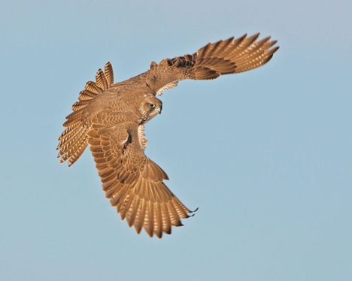
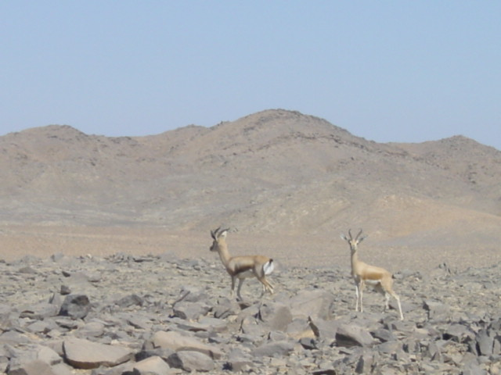
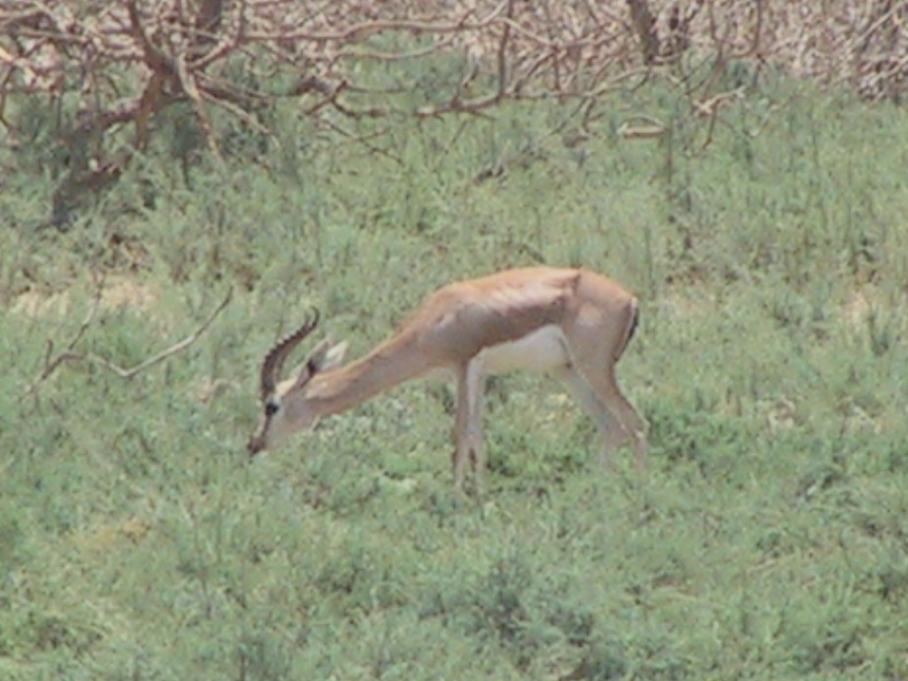
Desert Ecosystems
Desert
Wadis

Slide 5
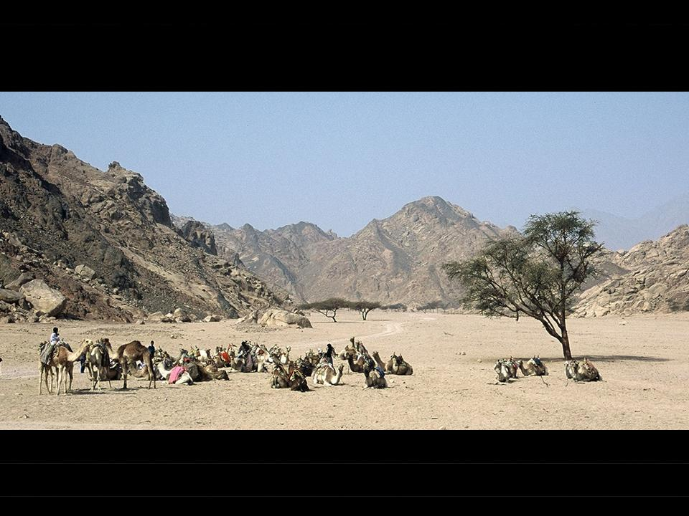

Slide 6
Evolution of Vegetation
Refers to development of vegetation from bare ground to climax stage

Slide 7
Decreasing species
Habitats
New comers species
Disappearing species
Increasing species

Slide 8
5-Reaction
6-Stabilization
4-Competition
Stages of Vegetation Evolution
3-Colonization
1-Migration
2-Ecesis

