Slide 1
The Vegetation -Lecture (4)

Slide 2
Vegetation
and
Flora
Are there any differences?

Slide 3
Vegetation: is all plants covering the soil surface in a specific area regardless their taxonomic position.
Flora: more emphasis is given more focus to the taxonomic position, rare species while vegetation gives more focus to the relationships between the species and its environment.

Slide 4
Vegetation is an aggregation of different plant species in two main layers:
1st layer (above soil surface)
trees
shrubs
undershrubs
bushes,
herbs

Slide 5
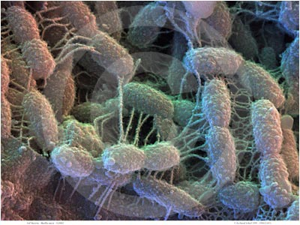
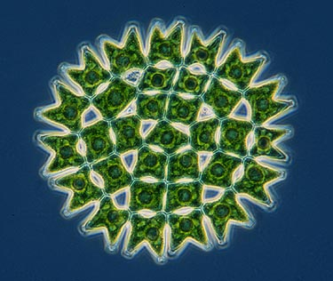
2nd layer (under soil surface)
Soil micro-flora including:
Bacteria
Algae

Slide 6
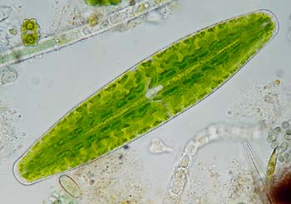
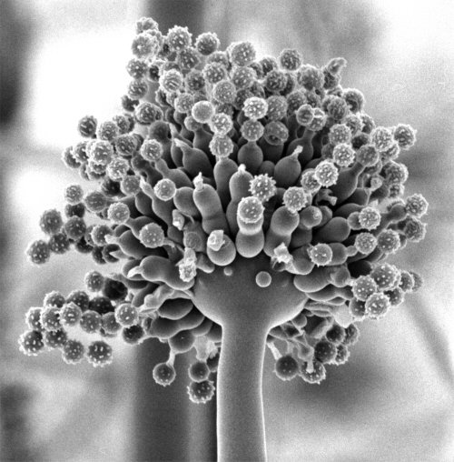
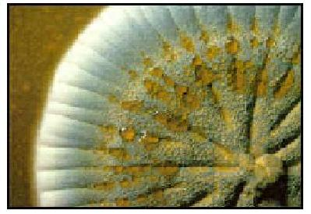
Algae
Aspragillus sp.
Fungi
Penicillium sp.

Slide 7
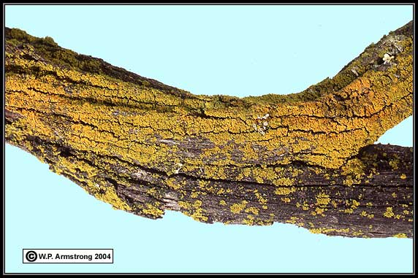
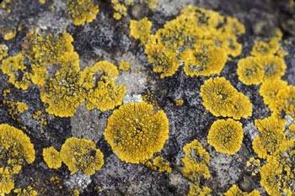
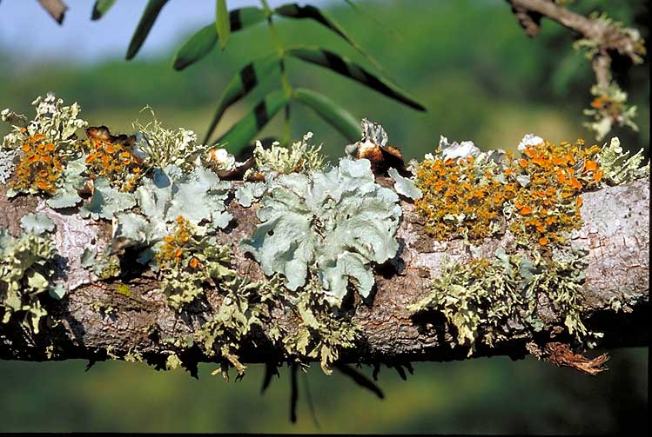
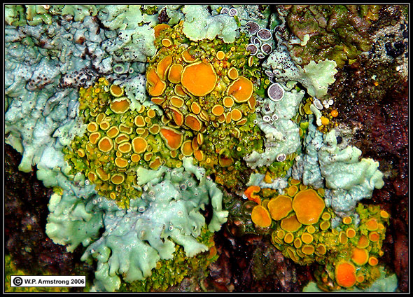

Slide 8
Vegetation types
Vegetation types are controlled by environmental factors, e.g. climate (rainfall, humidity, temperature) and soil characteristics, (physical, chemical characteristics and topography.

Slide 9
Vegetation types Examples

Slide 10
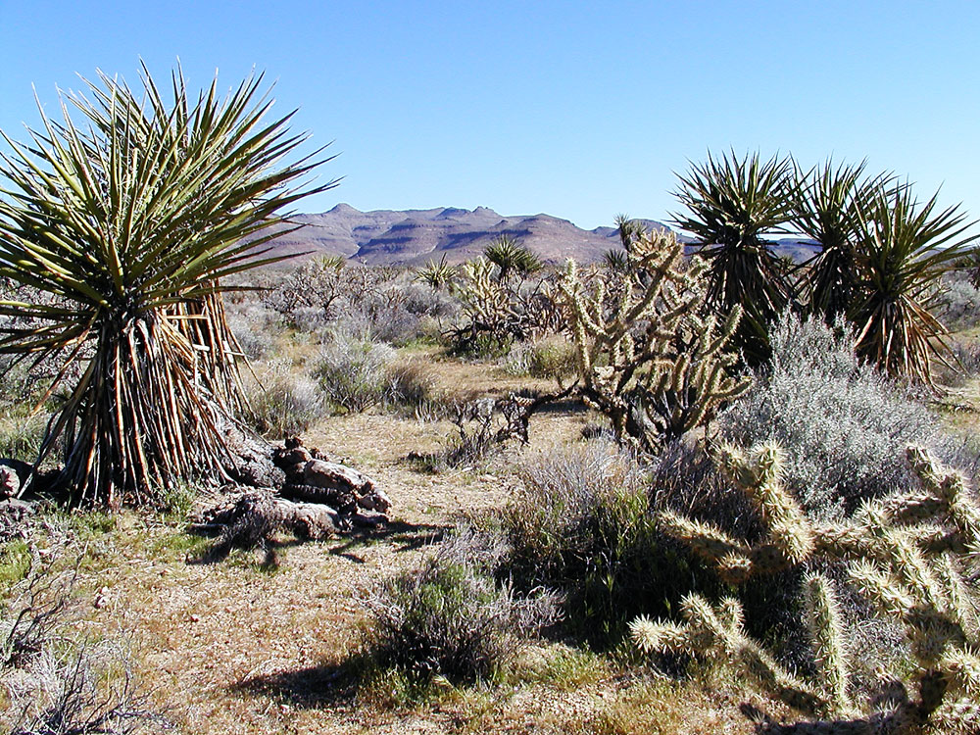
Vegetation types are named after its habitats
1. Desert Vegetation type is growing in the desert habitat

Slide 11
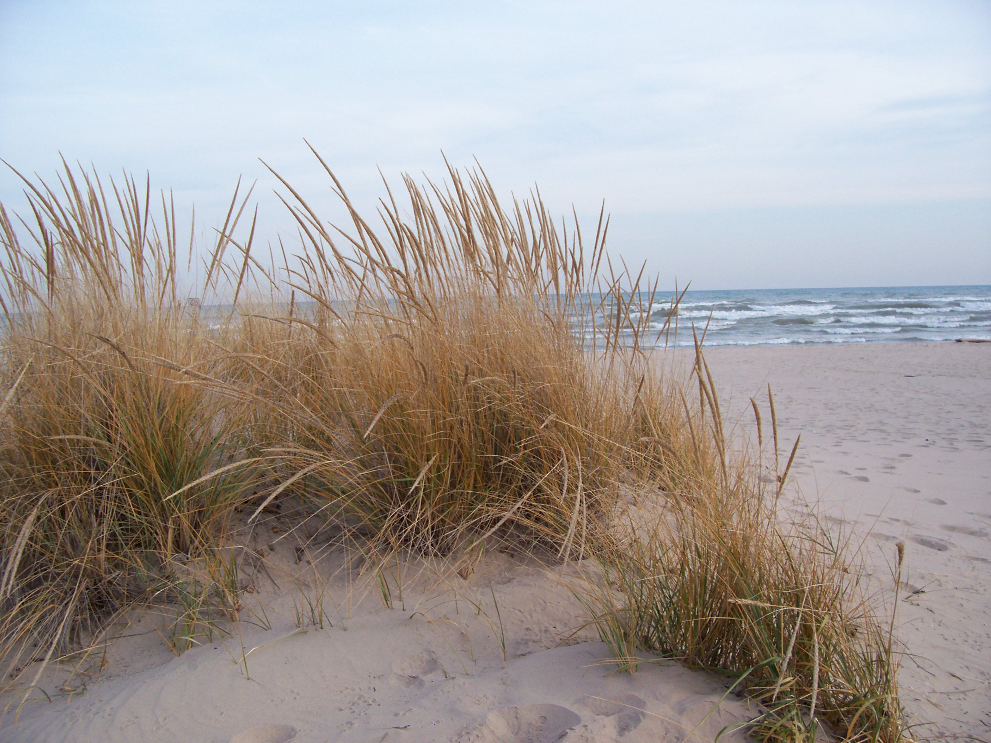
2. Sand dune vegetation growing on dune habitat (coastal or inland)

Slide 12
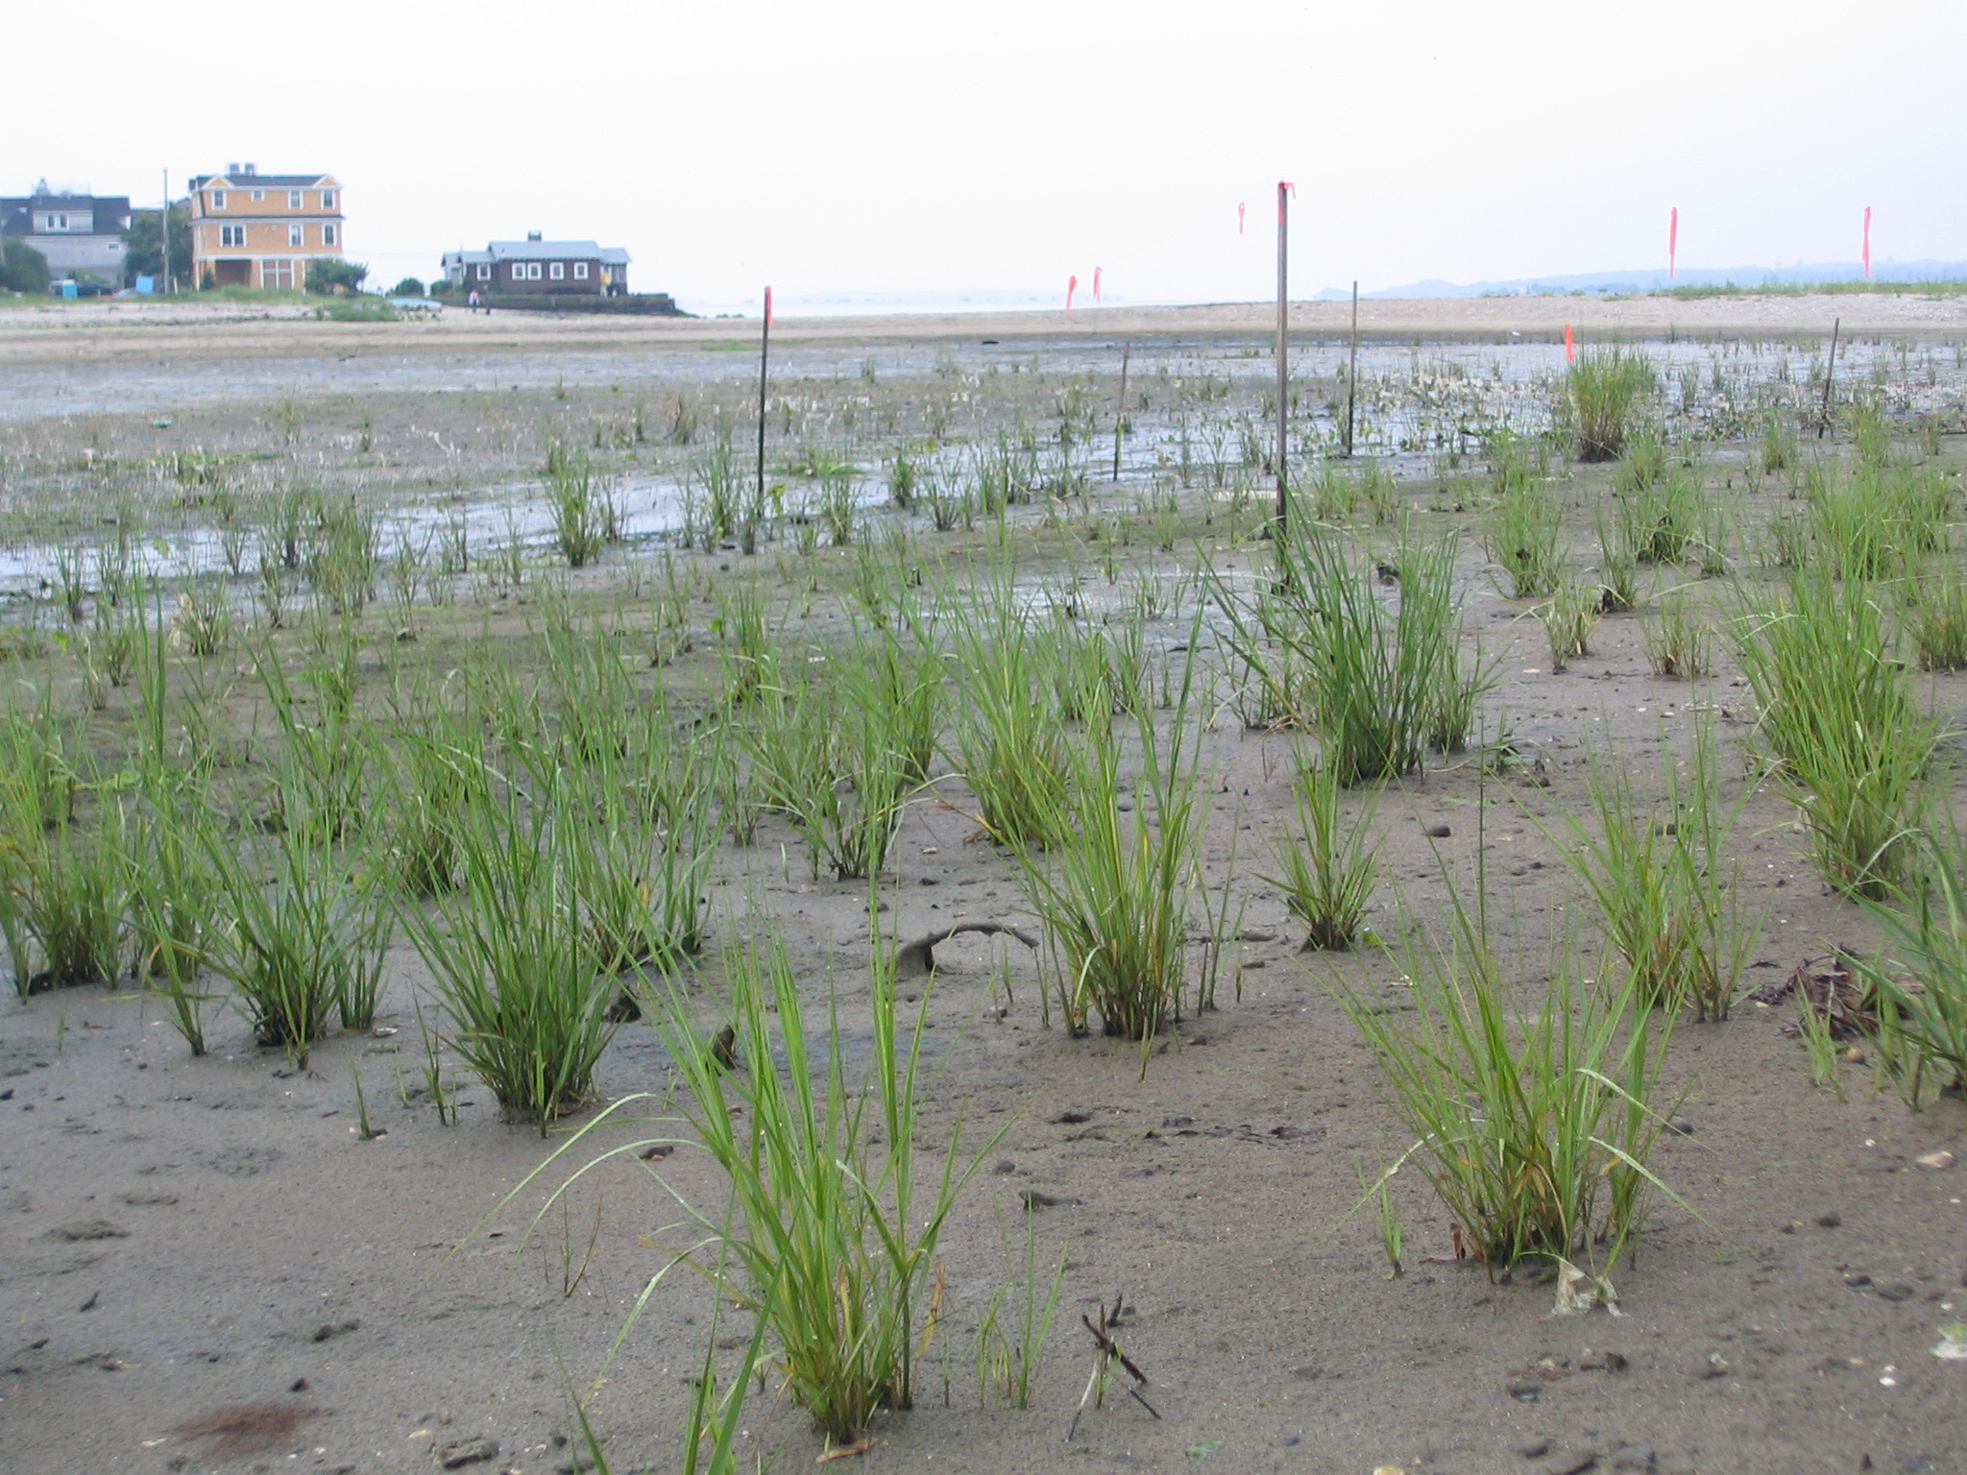
3. Wetland vegetation growing in aquatic habitat (coastal or inland)

