Slide 1
Plant tIssue culture
Prof.Dr. Nemat Mohamed Hassan, Department of Botany and Microbiology, Faculty of Science, University of Damietta
Lecture 31.03.2020

Slide 2
IV. Application of Plant Cell and Tissue
Culture for the Production
of Phytochemicals in Medicinal Plants

Slide 3
Approximately 80 % of the world inhabitants depend on the medicinal plants in the form of traditional formulations for their primary health care.
Many commercially used drugs have come from the information of indigenous knowledge of plants and their folk uses.
Plant tissue culture technique has proved potential alternative for the production of desirable bioactive components from plants.
To produce the enough amounts of plant material that is needed and for the conservation of threatened species.
Different plant tissue culture systems have been extensively studied to improve and enhance the production of plant chemicals in various medicinal plants.

Slide 4
Increase in population and increasing demand of plant products are causing depletion of medicinal plants and many are threatened in natural habitat.
Plant tissue culture technique has proved potential alternative for the production of desirable bioactive components from plants.
It should to produce the enough amounts of plant material that is needed and for the conservation of threatened species. Different plant tissue culture systems have been extensively
studied to improve and enhance the production of plant chemicals in various medicinal plants.

Slide 5
Threat to Medicinal Plants
Increase in population and increasing demand of plant products are causing depletion of plants species from their natural habitat making many valuable plants threatened and endangered.
Most of these endangered species are the plants of medicinal and aromatic values, which are either conﬁned in small areas and/or are collected from their natural habitat.
The plant material is harvested in the wild by gatherers, who usually collect whole plant.
The plant material sold as traditional medicine consists of root, bulb, rhizomes or bark.

Slide 6
Biotechnological tools especially in vitro culture technique has been investigated in various medicinal plants for their conservation and also as an alternative means of phytochemical production.
Development of protocol for mass propagation of valuable medicinal plants has contributed not only in their conservation but also for their commercial cultivation.

Slide 7
Plant Cell and Tissue Culture for Medicinal Plants
Plant cell and tissue culture offers an alternative source for rapid plant propagation and controlled production of disease-preventive phytochemicals or food ingredients in medicinal plants.
Many plant species can be regenerated in vitro through several approaches such as from a single cell that can be reproduced, a tissue or organ part, or a cut out piece of differentiated tissue (or organ) known as an
explant.

Slide 8
These technologies can be established under sterile conditions from any vegetative parts or organs of plant such as meristems, nodes, leaves, stems, roots, axillary or adventitious shoot buds, endosperm, embryo etc. for unlimited plant multiplication and production of metabolites.
Micropropagation in Medicinal Plants
Micropropagation protocols have been developed for many important species of medicinal plants.
Many important medicinal herbs have been successfully propagated in vitro since long before either by organogenesis or by somatic embryogenesis

Slide 9
In Vitro Synthesis of Metabolites
Plant tissue cultures, are found to have potential as a supplement to traditional means of plant propagation in the industrial production of bioactive plant
metabolites .
Plant cells being totipotent; that is, cells in culture can produce the same metabolites as the whole plant.
Many efforts have been made for commercial production of the medical plant metabolites from plant-cell culture.
This is more convenient as useful compounds from the cells of any plants can be produced under controlled conditions independent of environmental conditions.
These metabolites are more easily extractable from the culture cells than from the intact plants.

Slide 10
Conventional biotechnological methods for inﬂuencing secondary metabolite
Production include changing nutrient composition, environmental conditions, and growth regulator composition. More recently, use of specialized techniques such as metabolic engineering, cell immobilization, elicitation, and in situ product removal have been investigated and applied to increase yields of secondary metabolites.
In vitro production of secondary metabolite in plant cell cultures has been reported from various medicinal plants. Various food ingredients and phytochemicals, including ﬂavors, nutraceuticals, colorants, essential oils, sweeteners,
antioxidants have been produced in cell culture some of which have been commercialized

Slide 11
Advances in plant cell cultures could provide new means for the cost-effective, commercial production of even rare or exotic plants, their cells, and the chemicals that they will produce.
A continuation and intensiﬁcation efforts in this ﬁeld will
lead to controllable and successful biotechnological production of speciﬁc, valuable, and as yet unknown plant chemicals.
Types of Culture
Different strategies, using an in vitro culture system, have been extensively studied to improve the production of plant chemicals. Several types of cell culture are used to produce the desired metabolites or food ingredients, such as organized tissue, callus, cell suspension, immobilized cells, transform cells and organs.

Slide 12
Organized Tissue Cultures
Various organs such as shoot, root, and other plant organ cultures have been developed for the production of desired compounds that require cell differentiation.
Though the production of secondary metabolites in organized tissue cultures differ from those of the intact plants, stable growth and consistent secondary metabolite production equivalent or in higher concentration have been observed in shoot and root cultures of many species.

Slide 13
Callus and Cell Suspension Culture
Callus is an undifferentiated mass of cell developed in culture from any kind of explants.
Cell suspension cultures are rapidly dividing homogenous suspensions of cells grown in liquid nutrient media.
In a cell suspension, a callus is suspended in liquid media. The cell suspension is then placed on a shaker to allow the cell aggregates to disperse to form smaller clumps and single cells that are equally distributed and continuously grow throughout the liquid media .
Thus plant suspension cultures provide a valuable platform for the production of high-value secondary metabolites and other substances of commercial interest .

Slide 14
Scale up of Secondary Metabolites by Using Different Systems
Advances in tissue culture, combined with improvement in genetic engineering, speciﬁcally transformation technology has opened new avenues for high volume production of pharmaceuticals, nutraceuticals, and other beneﬁcial substances .
For the large-scale cultivation of plant cells for the production of valuable bioactive compounds speciﬁc bioreactors systems are applied.
Plant cells cultured in liquid suspension must be accommodated in large-scale bioreactor for the constant and
continuous production of metabolites.
Various types of bioreactors have been designed and being used for the commercial production of metabolite .
Many culture systems to scale up of secondary metabolites are used.

Slide 15
Elicitation
Elicitors are compounds that stimulate the synthesis of phytoalexins and various secondary metabolites in plants. Cell cultures are exposed to biotic elicitors such Aspergillus niger, crude chitin and abiotic elicitors such as mannitol, ethyl
jasmonate to induce metabolite production.
Elicitors such as fungal wall materials, plant and microbial polysaccharides, and some chemicals increase secondary
metabolite production in various plant cell and tissue culture systems.
The most frequently used elicitors are fungal carbohydrates, yeast extract, MJ and chitosan.
MJ, a proven signal compound, is the most effective elicitor of taxol production in Taxus chinensis and goinsenoside production in P. ginseng

Slide 16
Metabolic Engineering
Metabolic engineering has been applied to improve production of secondary metabolites in different culture systems.
Metabolic engineering is the targeted and purposeful alteration of metabolic pathways in an organism to achieve better
cellular pathways for chemical transformation and regulatory functions of the cells by using recombinant DNA technology. Metabolic engineering directs cellular metabolism to produce desired metabolites by inserting genes that encode speciﬁc biosynthetic enzymes into the plant genome.
Efforts have been made for the production of speciﬁc metabolites such as scopolamine, nicotine, and
berberine by altering the metabolic pathways.

Slide 17
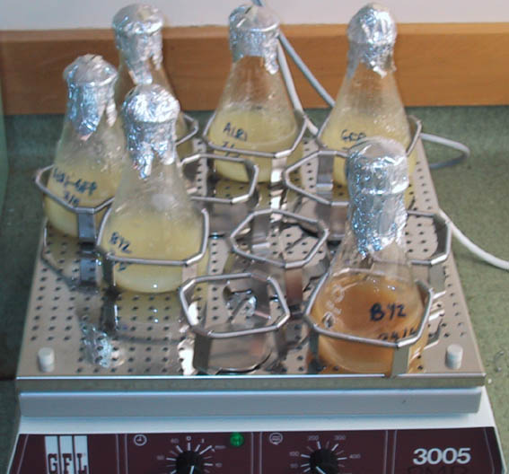
Cell suspension culture
Suspensions are much easier to bulk up than callus since there is no manual transfer or solid support
Cell suspension culture techniques are very important for plant biotransformation and plant genetic engineering.

Slide 18
Callus formation

Slide 20
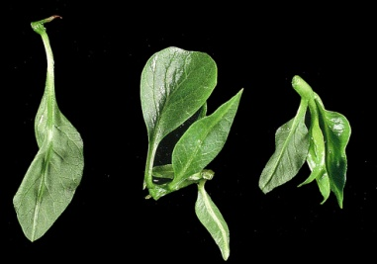
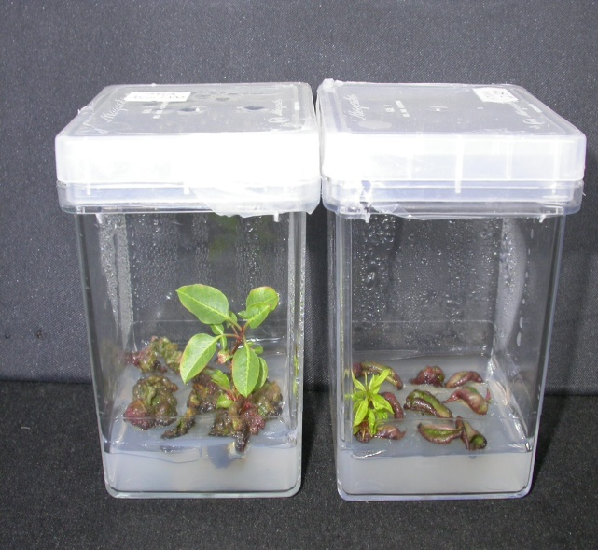
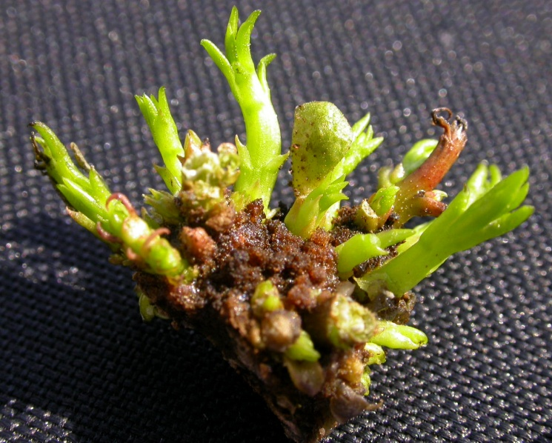
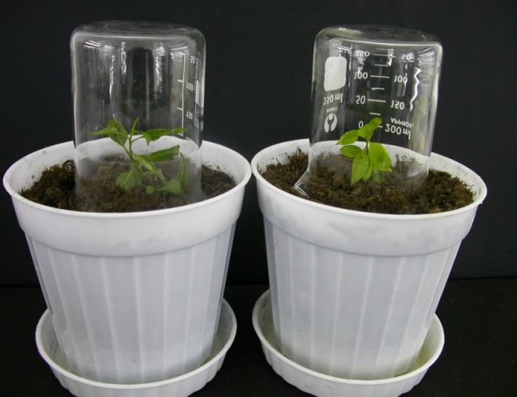
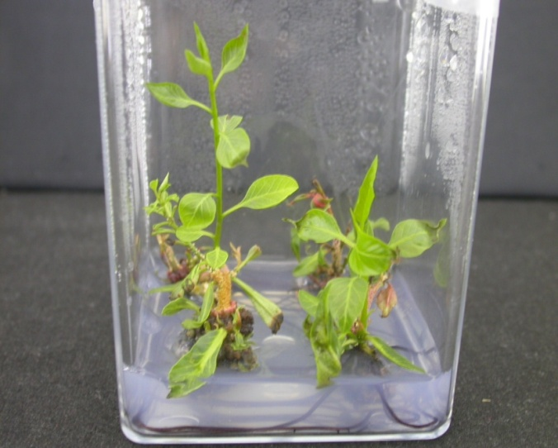
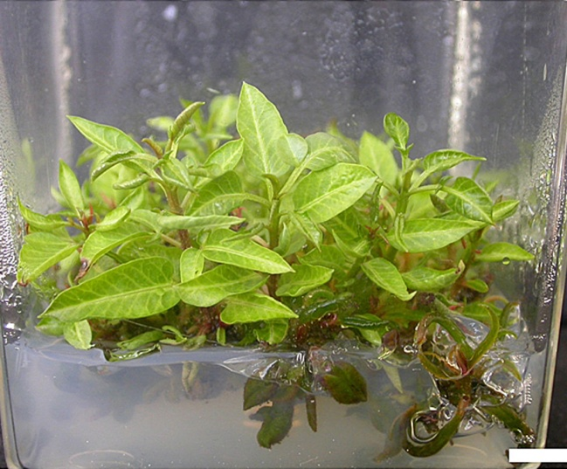
Steps of Micropropagation
Adventitious Buds
2
2
2
Elongation and
3
1
2
from Single Leaflet
3
Regeneration of
Plantlets
6
5
4
4

Slide 21
THANK YOU！

Slide 22
THANK YOU！

