Slide 1
Plant physiology
Dr. Enas Budran

Slide 2
Enzymes
What are enzymes?
Characteristics of Enzymes
Acceleration
Turnover number
Reversibility
Specificity
Sensitivity
Structure
Absolute specificity
Group specificity
Bond specificity
Three dimension specificity

Slide 3
Absolute specificity
Urease
urea not methyl urea
NH₂
H₂O
C = O
CO₂ + 2NH₃
urease
NH₂
Urea
NH₂
H₂O
C = O
urease
NH CH₃
Methyl urea

Slide 4
Succinic DH
Succinic acid not Malonic acid
CH₂ - COOH
CH₂ - COOH
+ FAD
Succinic DH
CH – COOH + FAD. H₂
CH - COOH
+ FAD
CH₂ - COOH
COOH
Succinic DH

Slide 5
Bond specificity
Esterase
Esterase
R–O-CO–R” + HOH
ROH + HO–OC–R”
Peptidase
H₂O
2 COOH–CH–NH₂
R
COOH–CH–NH–CO–CH–NH₂
R R
peptidase

Slide 6
Three dimension specificity
Lactic DH
L-lactic acid not D-lactic
CH₃
CHOH
COOH
CH₃
C=O
COOH
CH₃
HOCH
COOH
Lactic DH
Lactic DH
CH₂ - COOH CH₂ - COOH
COOH-CH
CH-COOH
Succinic DH
Fumaric
acid not Maleic
CH -COOH
CH-COOH

Slide 7
Distribution and nomenclature
of Enzymes
In every organelle
Free
Bound
Constitutive
Inducible
Endo
suffix "ase"

Slide 8
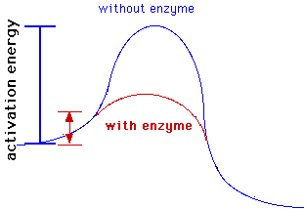
Nature of Enzyme
Function
lowering the energy barrier (activation energy)
increases the favourable orientation of reactants

Slide 9
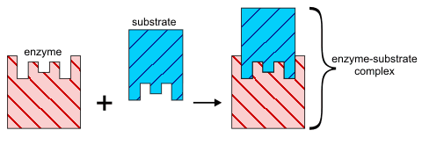
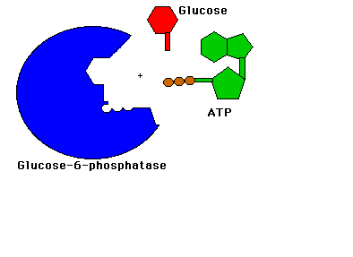
Lock and Key Model For Enzyme Activity
E + S <---> ES <---> ES* <---> EP <---> E + P
E + S <==> ES <==> E + P

Slide 10
Nature of the Purified
Enzymes
Holoenzyme
Cofactors
Non-protein part
Prosthetic groups
Coenzymes
Protein part (Apoenzyme)

Slide 11
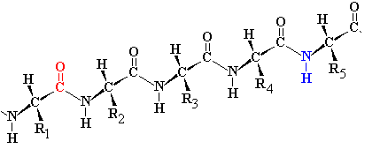
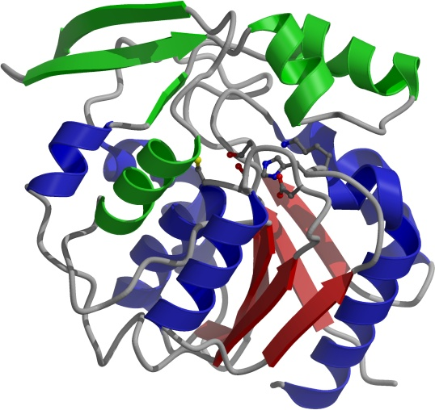
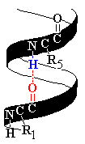
The structure of Proteins
Primary structure (Amino acid chain)
Secondary structure
Tertiary (3D) structure
Disulfide bond

Slide 12
Cofactors
Cations
(activators)
organic groups
Fe
Cu
Mn
Mo
Cu
Ni
coenzymes
prosthetic groups
Group carrier
AMP
ADP
ATP
TPP
CoA-SH
Pyridoxal phosphate
Hydrogen carrier
NAD
NADP
Lipoic acid
FMN
FAD

Slide 13
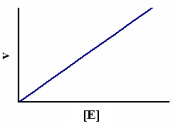
Factors Affecting Enzyme Activity
E + S <==> ES <==> E + P
1- Enzyme Concentration

Slide 14
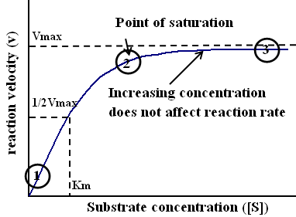
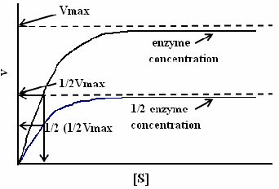
2- Substrate Concentration

Slide 15
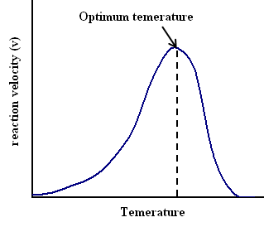
3- Temperature

Slide 16
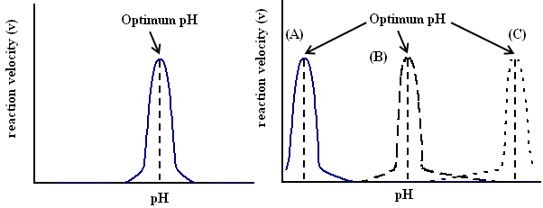
4- pH

Slide 17
5- Accumulation of end products
feedback effect
change the optimum pH
production of some unsuitable substances
6- Activators and inhibitors
Competitive inhibitors
Un-competitive inhibitors
Non-competitive inhibitors

Slide 18
Classification of Enzymes
depends on the reaction nature that catalyzes
6 groups
Hydrolases
Oxidoreductases
Lyases
Isomerases
Transferases
Ligases (Synthetases)

Slide 19
1- Hydrolases
Maltase
Maltose 2 glucose units
H₂O
Invertase
Sucrose glucose fructose
H₂O
amylase
Starch
maltose
Cellulase
Cellobiase
Cellulose Cellobiose Glucose
H₂O
H₂O
Esterase
Ester Alcohol Acid

Slide 20
Asparaginase
Asparagine Aspartic acid + ammonia
H₂O
Glutaminase
Glutamine Glutamic acid + ammonia
H₂O
Urea Carbon dioxide+ ammonia
Urease
H₂O
peptidase
Dipeptide
2 Amino Acids
H₂O

Slide 21
2. Oxidoreductases
a- Oxidation state, electron
(Reductases)
b- Oxygen addition
(Oxidases, Peroxidases,Oxygenases)
c- Hydrogen transfer
(Dehydrogenases)

Slide 22
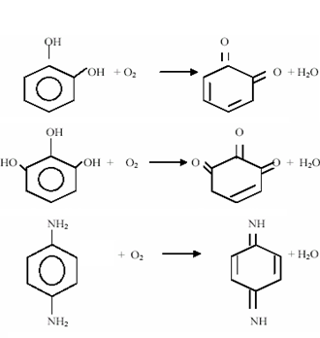
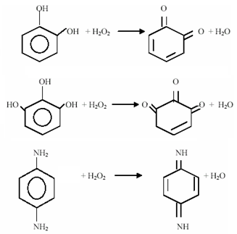
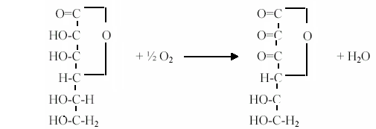
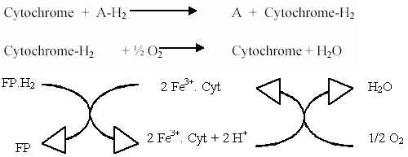
Oxidases
Peroxidases

Slide 23
Dehydrogenases

Slide 24
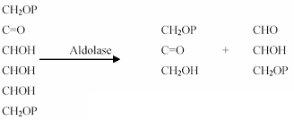
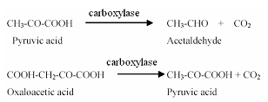
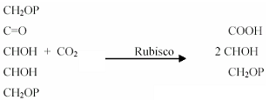
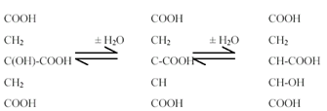
3. Lyases
A + B
A + B
Aldolase,
Carboxylase,
AA carboxylase
Ammonia lyase , Aspartase
Carbonic anhydrase,
Hydratase, aconitase, fumarase
C
C + D

Slide 25
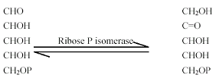
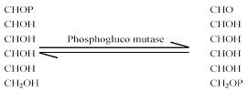
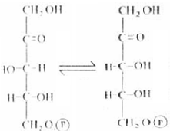
4. Isomerases
Rearrange
a- Isomerization
(Isomerases)
b- Epimerization
(Epimerases)
c- mutation
(Mutases)

Slide 26
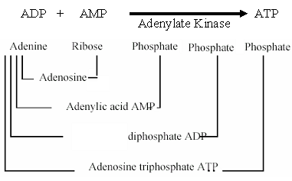
5. Transferases
transfer a group
Transaminases,
Adenylate Kinase,
Sucrose transglucosylase,
Starch transglucosylase
Methyl transferase
Acetyl transferase

Slide 27
6. Ligases (Synthetases)
Activate synthesis on the expense of ATP consumption.
Glutamine synthetase, GS
Asparagine synthetase, AS
Acetyl Coenzyme A synthetase (Acetothiokinase)

Slide 28
Metabolism
Anabolism
Photosynthesis
Occurs in all green organisms
Catabolism
Respiration
Occurs in all living organisms

Slide 29
Photosynthsis
Factors affecting the rate of photosynthsis:
External factors:
1- O2 5-CO2
2- Light
3- Temperature
4-Mineral elements 6- Water
Enternal factors:
1- Air pollution 4- Chlorophyll
2- Leaf 5- Protoplasm
3- Accumulation of end products

Slide 30
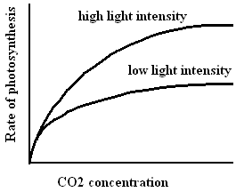
Limiting Factor theory
When a process depends upon a number of no jointed factors, the rate of the process will be limited by the slowest factor (the least presented factor).

Slide 31
Mechanism of photosynthesis
6CO₂ + 12H₂O + Light Energy C₆H₁₂O₆ + 6O₂ + 6H₂O
HCHO theory
CO2 reduction theory
e
X X⁻
CO2 is reduced by:
1- H carrier (reducing power)
2- Electron donors

Slide 32
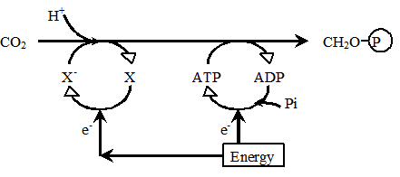
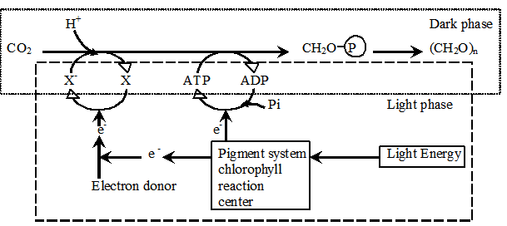

Slide 33
CO₂ reduction into carbohydrates requires
reducing powers and energy supply
The importance of light is mainly the generation of these reducing powers and energy supply
Light seemed unnecessary during CO₂ reduction into carbohydrates as these reducing powers and energy supply are present

Slide 34
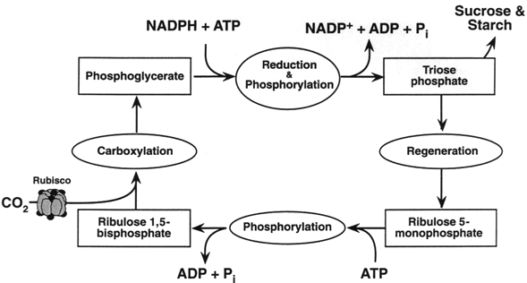
Calvin cycle

Slide 35
Respiration
Aerobic or Oxygen Respiration
Sugar oxidation:
C₆H₁₂O₆ + 6 O₂ 6 CO₂ + 6 H₂O + 674 K Cal
Triolein oxidation:
C₅₇H₁₀₄O₆ + 80 O₂ 57 CO₂ + 52 H₂O + 950 K Cal
Anaerobic or Non-Oxygen Respiration
C₆H₁₂O₆ 2 CO₂ + 2 C₂H₅OH + 26 K Cal
Lactic acid Bacteria
C₆H₁₂O₆ 2 CH₃.CHOH.COOH + E
Lactic acid
Butyric acid Bacteria
C₆H₁₂O₆ CH₃.CH₂.CH₂.COOH + E
Butyric acid

Slide 36
CO₂ volume evolved
quotient Respiratory (RQ) =
O₂ volume absorbed
C₆H₁₂O₆ + 6 O₂ 6 CO₂ + 6 H₂O + E RQ = 6/6 = 1
C₅₇H₁₀₄O₆ + 80 O₂ 57 CO₂ + 52 H₂O + E RQ = 57/80 < 1
RQ = 4/1 > 1
RQ = 0/3 = 0
RQ = 1/0 = ∞

Slide 37
Factors affecting respiration:
1- O₂
2- CO₂
3- Temperature
4- Respiratory matter
5- Water content
6- Light
7- Chemicals and Injuries
Rate of respiration
Factor

Slide 38
Mechanism of Respiration
C₆H₁₂O₆ + 6 O₂ 6 CO₂ + 6 H₂O + E
It is a multi-enzymic complicated process
It is aimed to release energy
directly indirectly
ATP
energy-rich compounds
(NADH, FADH2, succinate)
in mitochondria
in presence of oxygen
(oxidative phosphrylation)
differs from
photo phosphrylation

Slide 39
Oxidation of carbohydrates
Phase I:
Glycolysis
Occurs in all living organisms
It is an anaerobic phase
Glucose
2 puruvic acid +
2 NADH +
2 ATP
Phase II:
Treatment of pyruvate
It differs in
aerobic from anaerobic
puruvic acid
Acids + ATP
H₂O + CO₂ + ATP
Alcohol + CO₂ + ATP

Slide 40
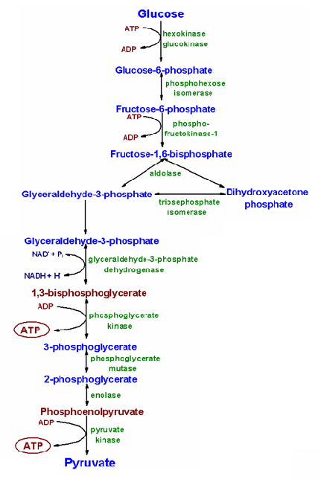
Oxidation of Carbohydrates
Phase I:
Glycolysis

Slide 41
Glycolysis
in the cytoplasm
in the absence of O₂
2 ATP are use to phosphorylate glucose
which is then broken down into 2 C3 molecules (pyruvate).
2 NADH and
4 ATP are generated
i.e. glucose
2 pyruvate + 2 ATP + 2 NADH
Pyruvate may then either undergo aerobic respiration in the mitochondria or anaerobic respiration in cytoplasm.

Slide 42
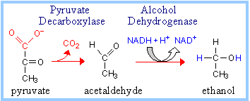
Phase II in anaerobic respiration
A. Alcoholic fermentation

Slide 43
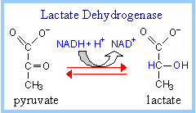
Phase II in anaerobic respiration
B. Lactate formation
Pyruvate lactate

Slide 44
Phase II in aerobic respiration:
a) Formation of acetyl Co A
b) The Citric Acid (Krebs, TCA) Cycle
c) Electron transport chain
(terminal oxidation, oxidative phosphorylation).

Slide 46
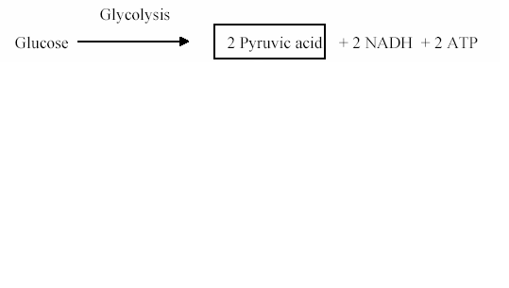
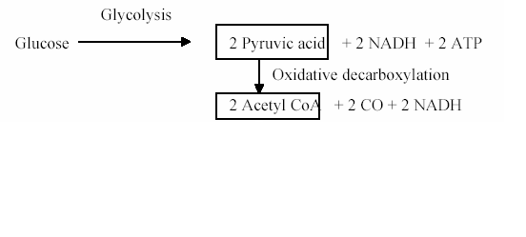
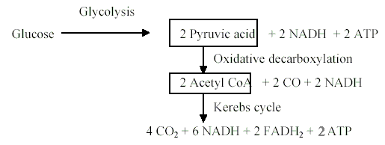
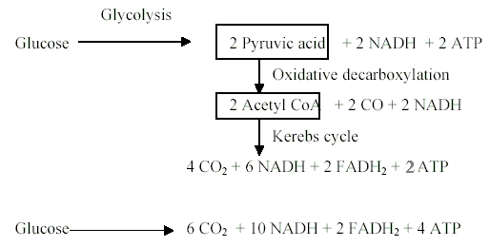
The net result of aerobic respiration
Oxidative phosphorylation
NADH + O₂ NAD + H₂O + 3 ATP
Oxidative phosphorylation
FADH₂ + O₂ FAD + H₂O + 2 ATP
The net result of aerobic respiration
Glucose + O₂ 6 CO₂ + H₂O + 38 ATP

